Slide 1

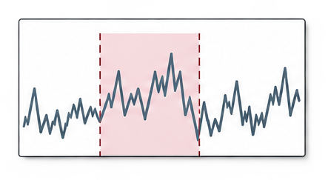
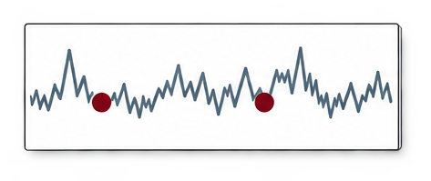











τ
Information
release
Observed series
Known calendar
Late report
Decision cutoff
Data management
Temporal processing
Context and memory
Temporal validation
Available
Late
Time | Value | Unit
t1 | x1 | u
t2 | — | u
t3 | x3 | u
… | … | …
Event A
Event B
Past case
v ≤ τ
Transform
Admit
Exclude
Preserve temporal state
Operate on windows
Align and retrieve
Check availability
Requests
Observations
LLM

