Slide 1


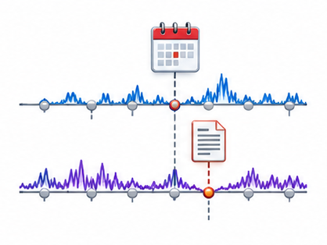
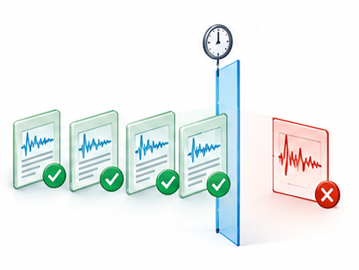
Temporal workspace
Observations • event records • data versions
τ
Available by decision time
Late release
Data management
Temporal processing
LLM
Preserve timestamps, units and missingness
Select windows and apply numerical operations
Request
operations
Context and memory
Temporal validation
Receive
observations
Align events with the observation window
Admit only information available by τ
Temporal state remains explicit across every operation

