Slide 1

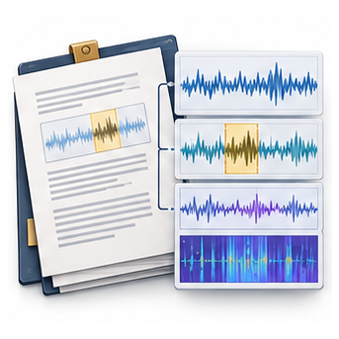

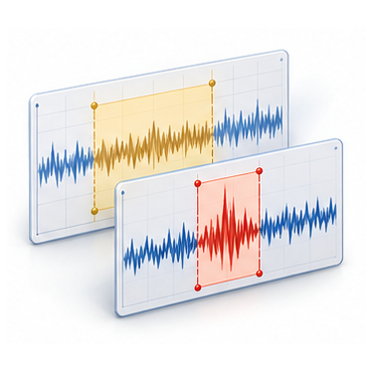

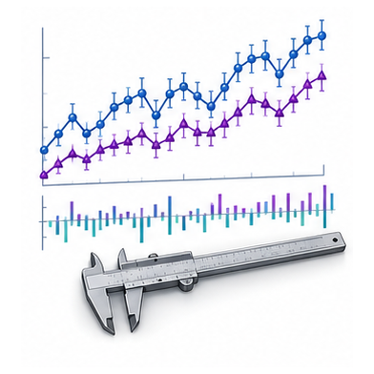
Acquire evidence
Construct evidence
Detect intervals
Refine intervals
Retrieve knowledge
and diagnostics
Numerical and
contextual cues
Classify candidate
intervals
Revise candidates
with new evidence
Update the evidence state
Knowledge memory + numerical diagnostics
Detector training
Support evidence acquisition and construction
Parse validity · interval agreement
false-positive penalty

