Slide 1
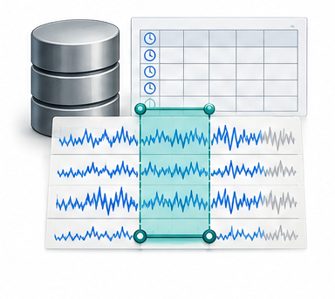
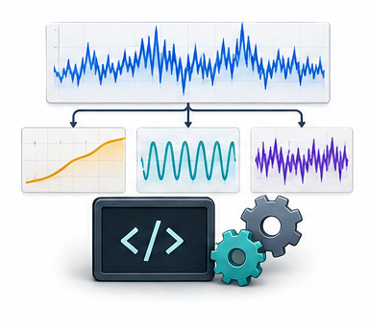
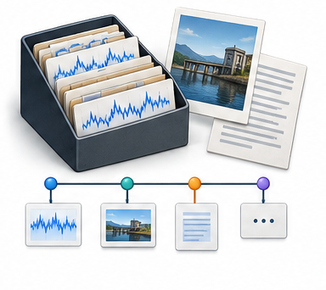

Time-series runtime
Numerical state
Temporal tools
Multimodal memory
Series, windows and metadata
Operate on addressable series
Retrieve analytical context
Recorded executions
Reuse accepted capabilities
Capability evolution
Extract a procedure
Test the candidate
Register the tool
Cluster execution traces
Held-out similar tasks
Invocation description

