Slide 1
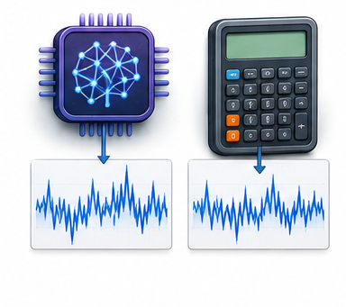


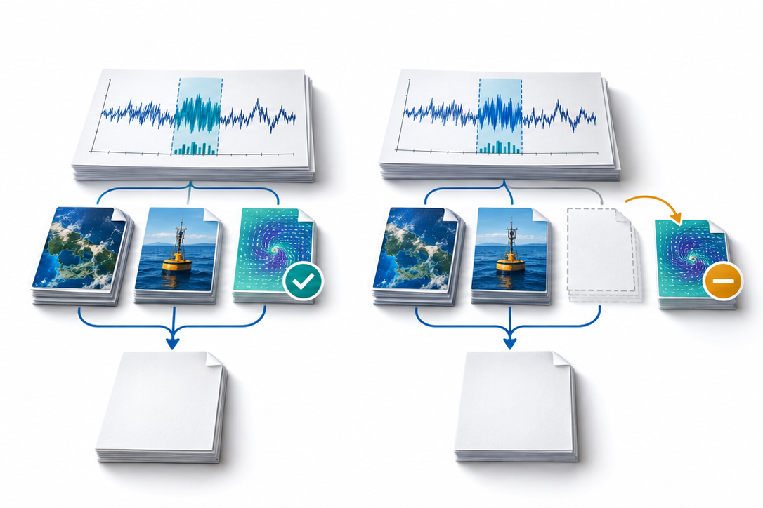
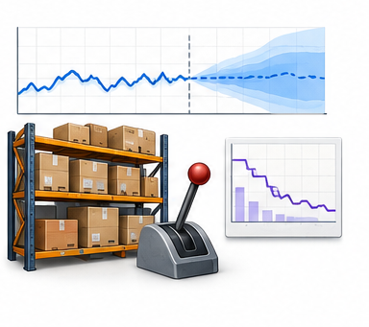
Controlled comparisons for reusable Time-Series Agents
Perception and execution
Memory under change
Procedure transfer
Model judgment vs. tool use
Old vs. revised evidence
Seen vs. held-out setting
Accuracy, grounding and cost
Revalidate, revise or retire
Transfer across tasks and regimes
Evidence sensitivity
Prediction to decision
Supporting evidence vs. removal
Forecast quality vs. action utility
Does the conclusion change?
Costs, constraints and repeated actions
Match the backbone and resource budget while varying the factor under study

