Slide 1

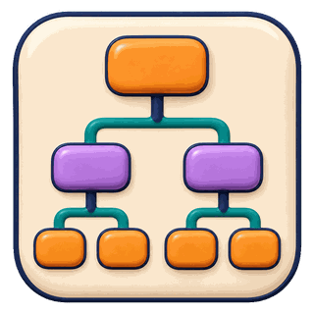









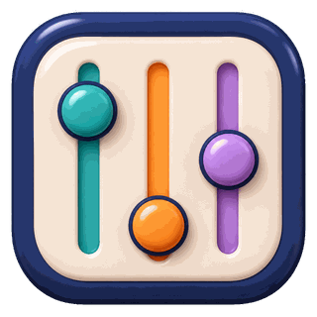
Interaction Episode
Planning and Orchestration
Decomposition
and Planning
Execution
Control
Checkpoints and
Governance
Multi-Agent
Coordination
Observe
Call
Respond
Return
Interface and Interaction
LLM: Caller
Tools and Execution
Reasoning Loop · Action Interface
Environment and Users
Function Calls · Code and Job Execution
Verification Tools
Memory and Context
Working Context · Episodic Records
Knowledge Retrieval · Shared State
Record
Optimization and Evolution
Update
Recorded
Trajectories
Tested
Updates
Prompt
Optimization
Experience
Distillation
Tool and Skill
Evolution
Harness
Configuration
Search

