Slide 1
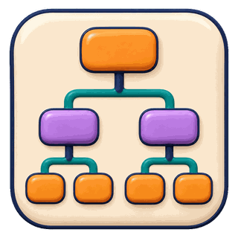











Evaluation Episode
Contract
Resources
Execution
Artifact
Result
Output
Spec
Time
Cutoff
Budget
Data
Code
Documents
Tool
Call
Output
File
Now
Failure
Prediction
Evidence Links
Execution Record
Artifact Validity
Task Performance
Call
tool(input)
Regression
Status
Result or Error
Error · CRPS
Artifact
Output Reference
File
Schema
Execution
Classification
A
B
Complete,
Readable
Required
Structure
Runs, Loads
or Parses
Accuracy · F1 · Brier
Resource Use
Generation
Rubric · Fidelity · Claims
Latency
Cost
Tool Use

