Slide 1





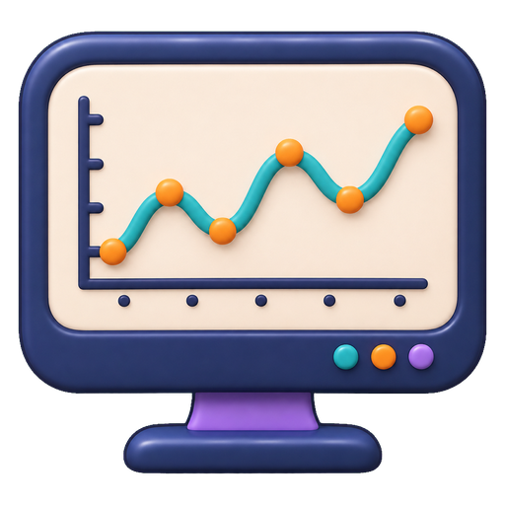







Time Series Agent: Components and Information Flow
scope of reuse: general → temporal → task-specific
LLM Side
General Harness
General Time Series Harness
Task-Specific Harness
Validation & Evaluation
§3
§4
§5
§6
§7
Time series & context
interprets temporal evidence and selects actions
executes actions, keeps state, coordinates roles
supplies temporal data, tools and time constraints
organizes outputs around task objectives
checks process, temporal validity, task and decision utility
Forecast · diagnosis · decision
observations · events · task request
• Representation alignment
• Temporal instruction & reasoning
• Workflow policy learning
• Interface & Interaction
• Memory & Context
• Tools & Execution
• Planning & Orchestration
• Optimization & Evolution
• Temporal Data Management
• Temporal Processing
• Temporal Context & Memory
• Temporal Validation
• Forecasting & Prediction
• Data Augmentation & Synthesis
• Anomaly Detection & Diagnosis
• Decision Support
• Execution checks
• Information-cutoff checks
• Task metrics
• Downstream utility
accepted output
ChatTS
Time-LLM
TimeClaw-Harness
AION
TimeSage-EV
OpenForecaster
FLAIRR-TS
MetaCaster
TimeSeriesGym
Dr-CiK
TimeRLM
TS-Agent
TradingAgents
TSQAgent
TS-Reasoner
Argos
FinCon
TraceBench
TSFLab
↺ feedback from validation: revise the plan, or terminate
act, observe, check, revise
Solid: execution flow · dashed: returned observation · purple loop: validation feedback

