Slide 1


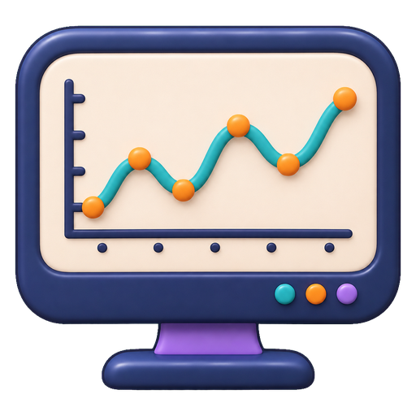


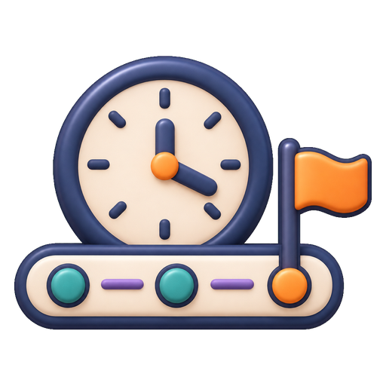




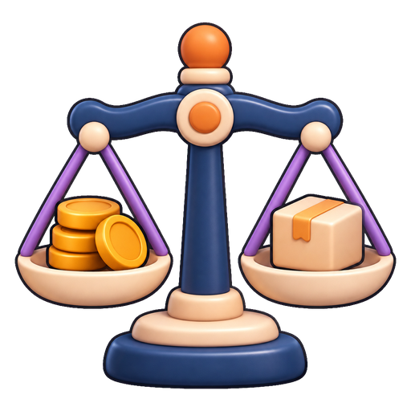


Time Series Agent: Components and Information Flow
> layers ordered from general to specific; validation feeds back to the LLM
Time series & context
LLM Side
Representation alignment
Temporal instruction & reasoning
ChatTS
Time-LLM
§3 · LLM
Workflow policy learning
TimeRLM
observations · events · task request
interprets temporal evidence and selects actions
action
observation
General Harness
Interface & Interaction
Memory & Context
Tools & Execution
TimeClaw-Harness
agent loop:
act · observe · check
general
AION
§4 · GH
Planning & Orchestration
Optimization & Evolution
TS-Agent
executes actions, keeps state, coordinates roles
TradingAgents
temporal operations
TimeSage-EV
General Time Series Harness
Temporal Data Management
Temporal Processing
feedback: revise / terminate
temporal
OpenForecaster
§5 · GTS
Temporal Context & Memory
Temporal Validation
TSQAgent
supplies temporal data, tools and time constraints
TS-Reasoner
shared temporal capabilities
Task-Specific Harness
Forecasting & Prediction
Data Augmentation & Synthesis
FLAIRR-TS
task-specific
MetaCaster
§6 · TSK
Anomaly Detection & Diagnosis
Decision Support
Argos
organizes outputs around task objectives
FinCon
candidate output
Validation & Evaluation
TimeSeriesGym
Forecast · diagnosis · decision
scope of reuse
narrows downward
Execution checks
Information-cutoff checks
Task metrics
Dr-CiK
accept
§7 · EVAL
Downstream utility
TraceBench
checks process, temporal validity, task and decision utility
TSFLab
accepted output

