Slide 1

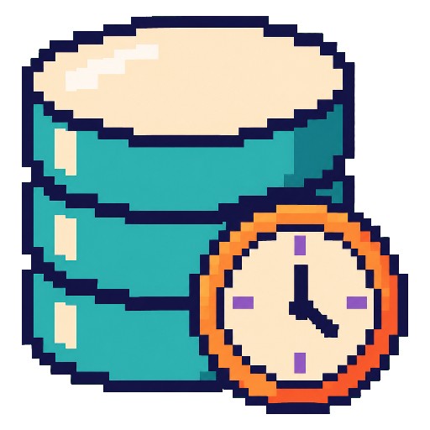



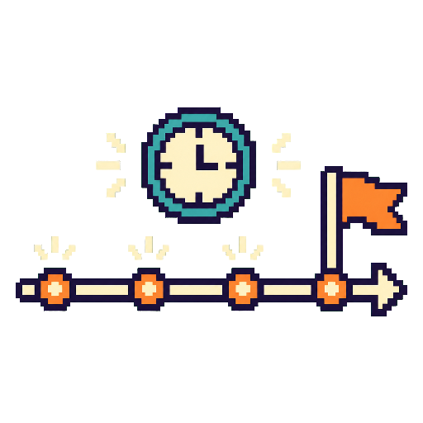








MODELS & EVALUATION
The Time Series Agent loop:
how the parts work together
HARNESS: GENERAL → SPECIFIC
✦
✦
§3 LLM SIDE
§4 GENERAL HARNESS
Representation alignment · Temporal instruction & reasoning · Workflow policy learning
✦
Interface & Interaction · Memory & Context · Tools & Execution · Planning & Orchestration · Optimization & Evolution
✦
T
ChatTS
Time-LLM
TimeRLM
MEMORY
PLANNING
TimeClaw-Harness
AION
TS-Agent
TradingAgents
§7 VALIDATION & EVALUATION
§5 GENERAL TIME SERIES HARNESS
Execution checks · Information-cutoff checks · Task metrics · Downstream utility
✦
Temporal Data Management · Temporal Processing · Temporal Context & Memory · Temporal Validation
T
✦
TOOLS
TIME
TimeSeriesGym
Dr-CiK
TraceBench
TSFLab
TimeSage-EV
OpenForecaster
TSQAgent
TS-Reasoner
LLM × HARNESS × TIME × EVALUATION
WHAT EVALUATION MUST SEPARATE
§6 TASK-SPECIFIC HARNESS
1 process validity
Forecasting & Prediction · Data Augmentation & Synthesis · Anomaly Detection & Diagnosis · Decision Support
2 temporal validity
FLAIRR-TS
MetaCaster
Argos
FinCon
LLM
§3
GH
§4
GTS
§5
TSK
§6
EVAL
§7
3 task performance
EACH WORK MAY CONTRIBUTE TO SEVERAL LAYERS
4 decision utility
↺ feedback: revise · or terminate
Layer = scope implied by a module’s inputs, state and assumptions.
Modules are tested from the most specific layer to the most general (Table 2).
Benchmarks expose the information, actions and output requirements the deployed workflow will meet (§7).
IN
Time series & context — observations · events · task request
OUT
Forecast · diagnosis · decision — accepted output

