Slide 1






Recursive self-improvement
A mechanism-level view
Task-system inheritance
Retain capability for future tasks
Task system S_t
execute
Experience
Updated system S_{t+1}
Model, code,
memory, tools
Traces, outcomes,
failures
Accepted and
retained state
inspect
state
accept system
update
feedback
Improvement process I_t
propose
Candidate changes
test
Validate & select
Diagnose, propose,
search
System or
improvement process
Gains, regressions,
cost
Meta-improvement: in bevit I_{t+1}
Accepted changes govern how the next improvements are produced
Declared external anchors: task goals, protected evaluation, and resource budgets
Figure 1. A mechanism-level view of recursive self-improvement. Experience informs candidate changes.
Validation determines what is retained: the upper loop carries task-system state into later tasks; the dashed lower loop carries changes to the process that produce later improvements.
External anchors specify the conditions outside the update scope. The diagram describes possible dependencies, rather than a guarantee of gains.

Slide 2
Sections
Core topics
§ 1 Introduction
Two engineering goals
Central questions
§ 2 Scope and Review
Methodology
Inclusion and evidence
Related-review tree
§ 3 Foundations and
Problem Formulation
AutoML and meta-learning
Design / repair objectives
Task, retention, improver gains
§ 4 Taxonomy of RSI
Engineering goal Update target
Feedback Persistence
Editable scope Fixed anchors
RSI
Survey
Reader’s guide
§ 5 Automated Design of
AI Infrastructure
Learning pipelines Agent workflows
Algorithm search Research loops
Useful design Better designer
§ 6 Repair and
Optimization of
Existing Systems
Weights Memory and skills
Prompts and code Feedback
Improver revision Regression checks
§ 7 Benchmarks and
Evaluation
Goal-matched tests Sealed audit
Budget controls Paired improvers
Retention / transfer Accept / roll back
§ 8 Challenges and
Future Directions
External feedback Coverage
Update stability Integrity
Cost / transfer Scientific validity
§ 9 Conclusion
Demonstrated gains
Open limits and next tests

Slide 3
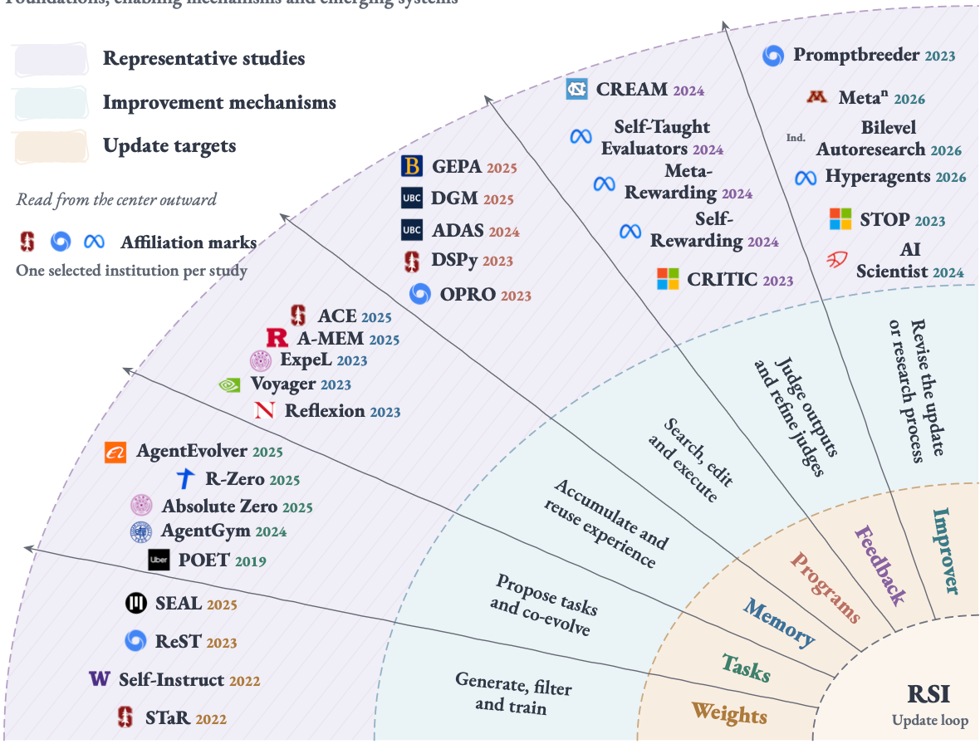
The landscape of recursive self-improvement
Foundations, enabling mechanisms and emerging systems
Figure 3. Landscape of mechanisms relevant to recursive self-improvement. The map connects update targets
in the inner band, improvement mechanisms in the middle band, and representative studies in the outer band.
The six sectors cover weights, tasks, memory, programs, feedback, and the improvement process. A work may
involve several targets; its placement highlights one connection. The map includes historical foundations, enabling
methods, and RSI-oriented systems. Logos denote selected author or work-done affiliations, rather than base
models; other collaborating institutions may be omitted. The accompanying source register records each selection.

Slide 4
Research routes toward recursive self-improvement
Selected milestones by first public year | Historical roots and the foundation-model era
Data &
training
Tasks &
curricula
Memory &
skills
Code &
workflows
Feedback &
judges
Meta-level
improvement
Synthetic data
Persistent updates
Task generation
Environment feedback
Reflective memory
Reusable knowledge
Prompts and code
Agent architectures
Learned rewards
Evaluator learning
Update strategies
Research automation
MetaClaw
Prime Agent
Meta^n
2026
Bilevel Autoresearch
Hyperagents
SEAL
AgentEvolver
SICA
Process Self-Rewarding
AlphaEvolve
2025
TTRL
R-Zero
Dynamic Cheatsheet
GEPA
AI Scientist-v2
Absolute Zero
A-MEM
DGM
RISE
AgentGym
TextGrad
Meta-Rewarding
Quiet-Star
AFlow
CREAM
2024
Self-Rewarding
SCoRe
SPIN
ADAS
Self-Taught Evaluators
AI Scientist
ReSTEM
Expel
STOP
2023
ReST
Voyager
DSPy
Promptbreeder
Reflection
OPRO
CRITIC
StAR
Constitutional AI
2022
Self-Instruct
◫ 2003 | Gödel Machine
◉ 2016 | Learned optimizers
▣ 2019 | POET
Marks: selected affiliations | Branches: research routes, not technical ancestry
Figure 4. Research routes toward recursive self-improvement. Forty-five representative method papers are grouped into six research routes, with three historical anchors shown separately.
Year bands use the first public dates in the checked source records; spacing within each band is adjusted for legibility. Branch lines denote research families.
Technical ancestry, cross-route transfer, and sustained recursive gains require separate evidence. The selection reflects the literature search through September 12, 2026.
Logos identify one selected author or work-done affiliation per study; “Ind.” denotes independent researchers. Affiliation and logo sources are documented separately.

Slide 5








Answer
Memory
Parameters
Improver
Revise within one task
Accumulate experience
Learn weights $\theta_t$
Revise the update process
y_k
y_{k+1}
I_t
revise / test
check → revise
M_t → M_{t+1}
θ_{t+1}
⊥ local only
retain
retain
later reuse
Same solver
Solver + memory
Updated model
Next update process
Future task
M_{t+1}
θ_{t+1}
I_{t+1} ΔS_{t+1}
(a) Local revision
(b) Memory retention
(c) Parameter learning
(d) Improver update
Figure 6. What survives a round of improvement? Four patterns distinguished by the state carried forward. (a) Local checking
and revision change an answer without retaining a change to the solver. (b) Memory M is retained while the model parameters a
nd the chosen update procedure are held fixed. (c) Parameters θ are updated under a fixed training procedure. (d) An accepted
change to the improver I is retained and governs a subsequent task-system update ΔS_{t+1}. The horizontal gray dashed line s
eparates current-task or current-round processing from later reuse. Black dashed enclosures group components. Colored arrows
denote retained updates, and a capped line denotes a change that is not carried forward. Networks, memory stacks, and procedu
re graphs are schematic representations. Solver and improver are functional roles that may share an implementation. These ana
lytical patterns may coexist and do not form a capability ranking; persistent or meta-level changes alone do not establish su
stained recursive gains.

