Slide 1
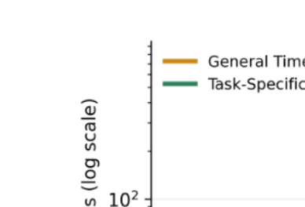
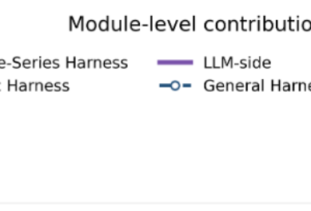

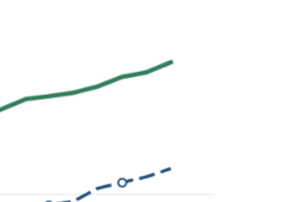
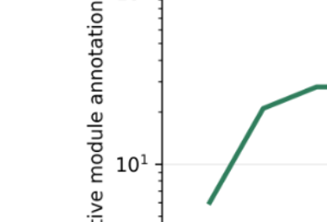

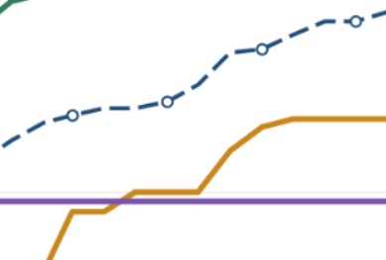
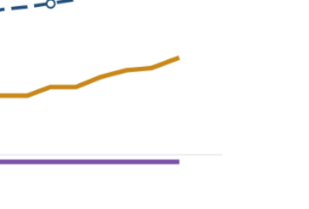
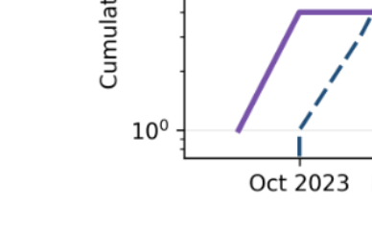
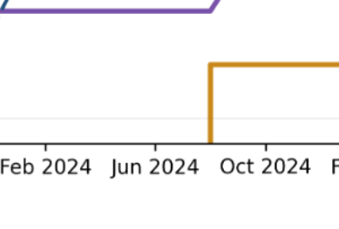
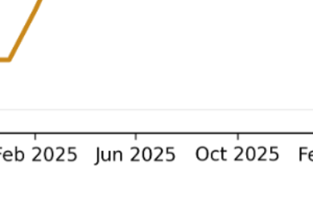
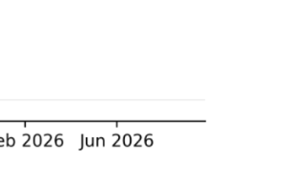
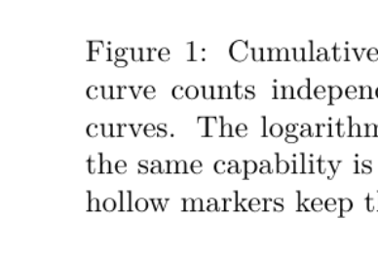
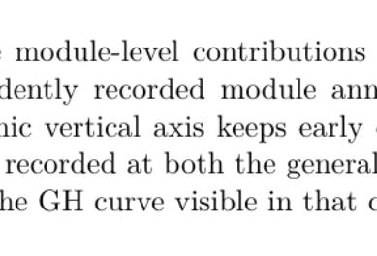
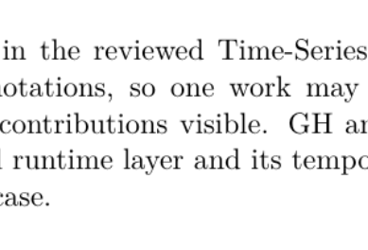
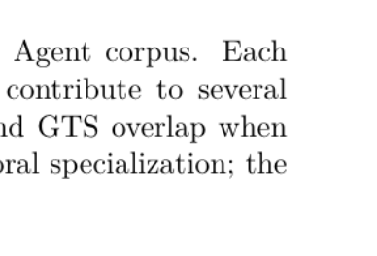
Notes:
Pixel-faithful conversion of the user-provided screenshot 03514d1b-0ebc-4946-8261-3b775509d1f7.png. The visible figure is the original image split into sixteen independently movable image components (4 x 4). No redraw or generated artwork is used.

Slide 2
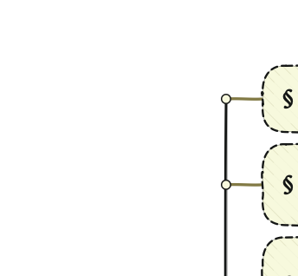
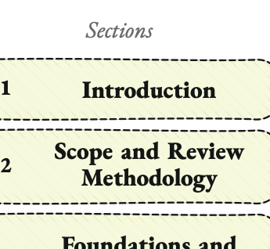
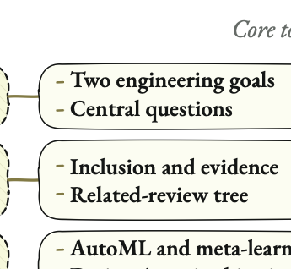
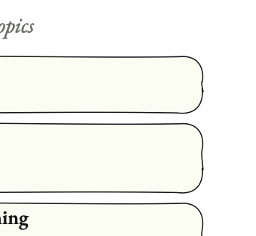
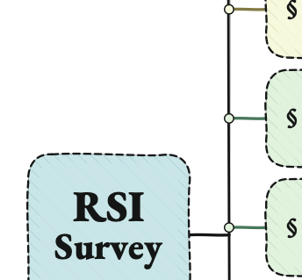
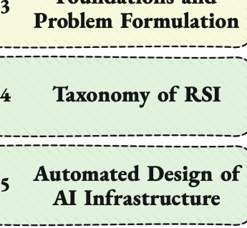
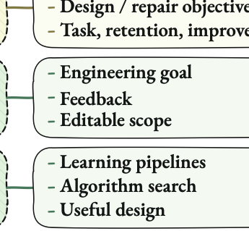
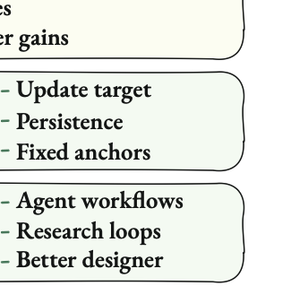
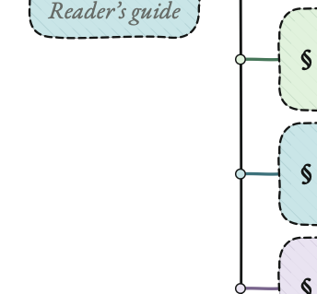
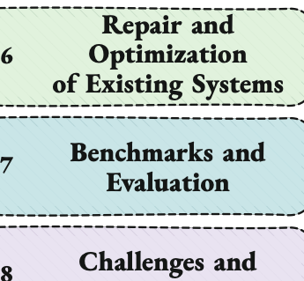
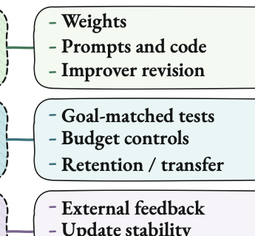
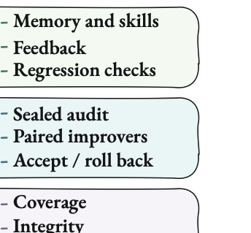
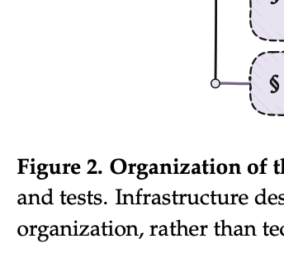
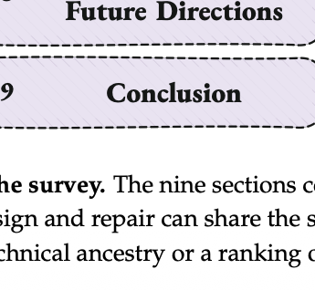
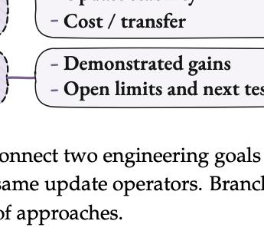
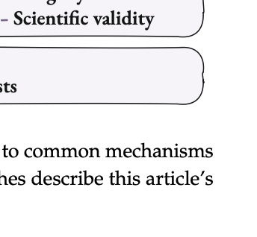
Notes:
Pixel-faithful conversion of the user-provided screenshot 250411b2-1d1f-4bba-a7bd-241fd0ec6be1.png. The visible figure is the original image split into sixteen independently movable image components (4 x 4). No redraw or generated artwork is used.

Slide 3


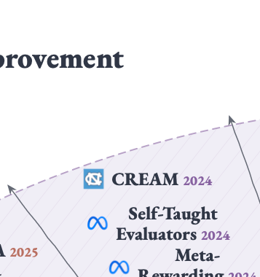
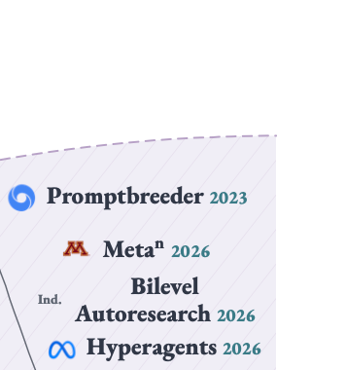

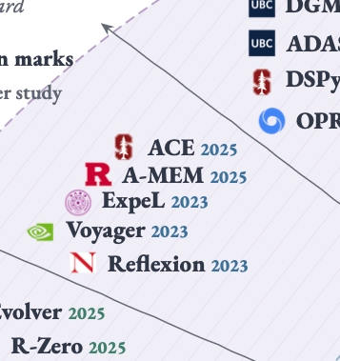
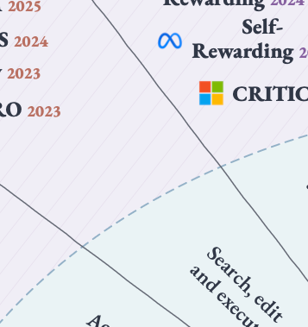
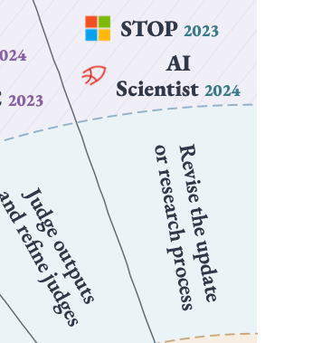
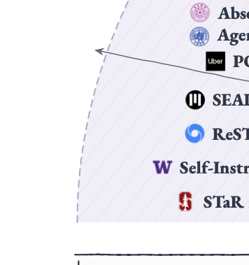
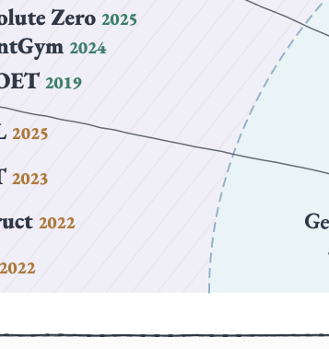
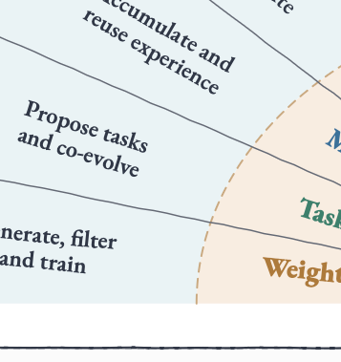
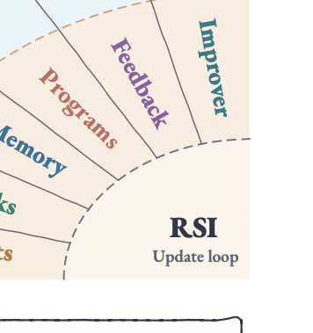
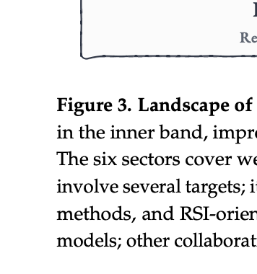

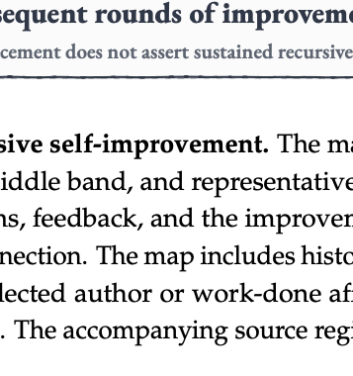
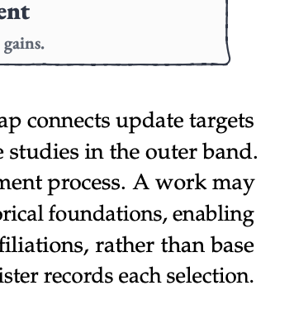
Notes:
Pixel-faithful conversion of the user-provided screenshot 2ee58a4a-5ea6-43c1-b6cd-fa97801e2762.png. The visible figure is the original image split into sixteen independently movable image components (4 x 4). No redraw or generated artwork is used.

Slide 4
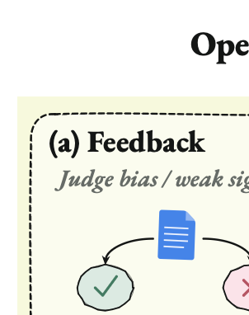

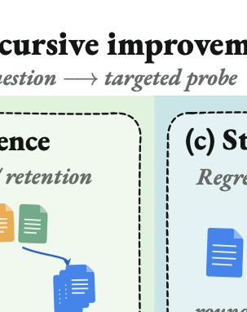

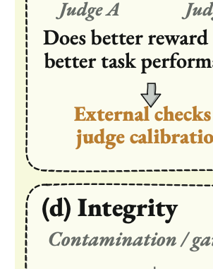
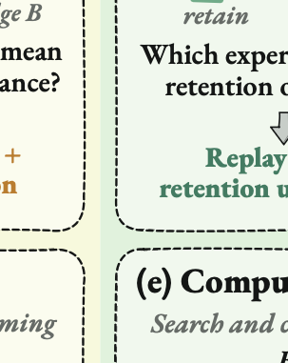
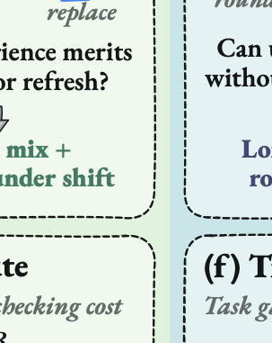
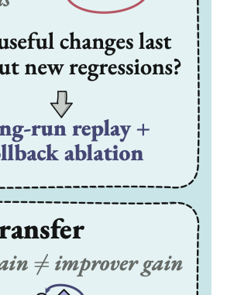
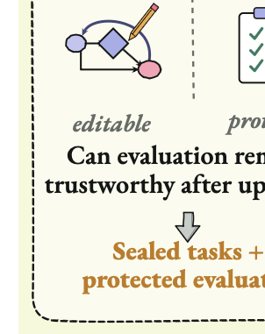
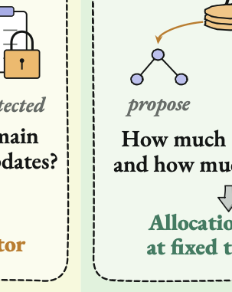






Notes:
Pixel-faithful conversion of the user-provided screenshot 473be8a2-e4eb-4cca-bfdd-97302b50480b.png. The visible figure is the original image split into sixteen independently movable image components (4 x 4). No redraw or generated artwork is used.

Slide 5
















Notes:
Pixel-faithful conversion of the user-provided screenshot 70181ba7-3a8e-4452-9f50-ffa240cc6655.png. The visible figure is the original image split into sixteen independently movable image components (4 x 4). No redraw or generated artwork is used.

Slide 6
















Notes:
Pixel-faithful conversion of the user-provided screenshot 7572f4b2-a5e3-4239-800f-b94ac30e4317.png. The visible figure is the original image split into sixteen independently movable image components (4 x 4). No redraw or generated artwork is used.

Slide 7
















Notes:
Pixel-faithful conversion of the user-provided screenshot 93b9b499-6e13-4dd0-bbe2-28235f020bfe.png. The visible figure is the original image split into sixteen independently movable image components (4 x 4). No redraw or generated artwork is used.

Slide 8
















Notes:
Pixel-faithful conversion of the user-provided screenshot a5f5d981-2117-48b5-8cb6-bcbbbbe0f3e6.png. The visible figure is the original image split into sixteen independently movable image components (4 x 4). No redraw or generated artwork is used.

Slide 9
















Notes:
Pixel-faithful conversion of the user-provided screenshot cc759328-3690-4186-9986-fe51794f5931.png. The visible figure is the original image split into sixteen independently movable image components (4 x 4). No redraw or generated artwork is used.

Slide 10
















Notes:
Pixel-faithful conversion of the user-provided screenshot ded9e63e-c562-44fb-941d-7de354ae4c7d.png. The visible figure is the original image split into sixteen independently movable image components (4 x 4). No redraw or generated artwork is used.

Slide 11
















Notes:
Pixel-faithful conversion of the user-provided screenshot c4471a69-b143-4c54-8d60-2b3909aec7b0.png. The visible figure is the original image split into sixteen independently movable image components (4 x 4). No redraw or generated artwork is used.

