Slide 1


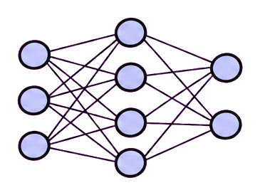
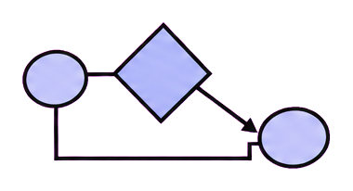

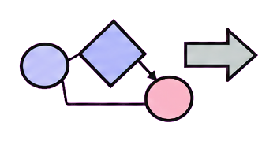
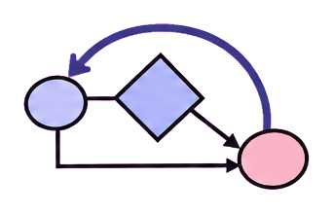

Forecasting
Augmentation
Anomaly diagnosis
Decision support
origin, horizon,
calibration
fidelity, diversity,
utility
event, window,
cause
action, cost,
uncertainty
state
action A
action B
input
prediction
risk
plan / verify
check → revise
transform
evidence
forecast
review
review
validate
forecast
training views
diagnosis
selected action
future horizon
utility
event interval
outcome feedback
(a) Forecasting
(b) Augmentation
(c) Anomaly diagnosis
(d) Decision support
Notes:
Time-Series Agent survey figure adapted from the user-supplied RSI visual template. The layout, typography, and visual hierarchy are retained while the content is rewritten for the LLM + General Harness + Time-Series Harness Module framework. Editable PowerPoint objects remain available for later grouping and revision.

