Slide 1






Time-Series Agent system
A module-level construction view
Time-Series Agent construction
Modules compose across tasks
Time-Series Agent
instantiate
Paper cards
New task agent
LLM + harness
and temporal data
claims, evidence,
module tags
Reusable harness
configuration
observe
select module
evaluate
General Harness
adapt
Time-Series Harness
benchmark
Task contract
tools, memory,
control, planning
temporal state,
operations, validation
forecasting, anomaly,
augmentation, decisions
Module-level paper card
One paper may contribute several modules
Task semantics and benchmark protocols remain explicit
Notes:
Time-Series Agent survey figure adapted from the user-supplied RSI visual template. The layout, typography, and visual hierarchy are retained while the content is rewritten for the LLM + General Harness + Time-Series Harness Module framework. Editable PowerPoint objects remain available for later grouping and revision.

Slide 2
Survey organization
Sections
§ 1 Introduction
Motivation and scope
Construction questions
§ 2 What Is a
Time-Series Agent?
Agent interaction loop
Tasks and module reuse
§ 3 LLM-Side
Contributions
Model interfaces
Temporal adaptation
Workflow policies
§ 4 General
Harness
Interfaces, tools, memory
Control, plans, learning, roles
Time-Series
Agent
Reader’s guide
§ 5 General Time-Series
Harness
Data management Temporal processing
Context and memory Temporal validation
§ 6 Task-Specific
Harness
Forecasting Augmentation
Anomaly diagnosis Decision support
§ 7 Infrastructure and
Benchmarks
ModernTSF TimeSeriesGym
Traces and episodes Evaluation
§ 8 Open Problems
and System Analyses
Transfer and memory Evidence quality
Decision feedback Design implications
§ 9 Conclusion
Construction choices
Evaluation and reuse
Notes:
Time-Series Agent survey figure adapted from the user-supplied RSI visual template. The layout, typography, and visual hierarchy are retained while the content is rewritten for the LLM + General Harness + Time-Series Harness Module framework. Editable PowerPoint objects remain available for later grouping and revision.

Slide 3
Contribution layers in Time-Series Agents
LLM capabilities combine with three Harness scopes to support temporal tasks.
LLM side
Time-Series Agent
Evaluation and evidence
LLM interaction
General Harness
Benchmark contract
tools · memory · control · planning · coordination
interpret observations
select tool actions
use returned feedback
temporal adaptation
episodes
chronology
held-out tests
reproducible traces
General Time-Series Harness
temporal state · operations
provenance · validation
Action-selection model
Task-Specific Harness
module-level
counts
forecasting
augmentation
anomaly · decisions
Model contribution
interfaces and training
Each paper can contribute
several modules
General Harness ⊃ General Time-Series Harness ⊃ Task-Specific Harness
Notes:
Time-Series Agent survey figure adapted from the user-supplied RSI visual template. The layout, typography, and visual hierarchy are retained while the content is rewritten for the LLM + General Harness + Time-Series Harness Module framework. Editable PowerPoint objects remain available for later grouping and revision.

Slide 4
Research routes in Time-Series Agent systems
Representative module contributions by first public year | LLM and Harness layers
LLM
side
General
Harness
General Time-Series
Harness
Task-Specific
Harness
Infrastructure
and benchmarks
Paper-card
database
Representation
Alignment
Tools and memory
Control and planning
Temporal state
Operations and grounding
Forecasting and prediction
Anomaly and diagnosis
Episodes, traces
TimeSeriesGym and ModernTSF
Claim, evidence
module-level counts
Augmentation
TS-Agent
Paper card
2026
Ledger
Module tags
ChatTS
TimeCAP
TimeClaw
TraceBench
Open tasks
2025
Time-LLM
Temporal grounding
Decision support
TimeART
Case studies
Forecasting
ModernTSF
AION
TimeMaster
Anomaly diagnosis
TSQBench
Calib.
2024
TS-Agent
TimeCAP
LLM4TS
TimeART
TFRBench
Verify
Surveys
AION
TimeSeriesGym
BibTeX
2023
TimeClaw
TFRBench
ModernTSF
Claims
TSQBench
TimeSeriesGym
Audit
Reflection
Reproducibility
2022
Memory Bank
◫ 2003 | Gödel Machine
◉ 2016 | Learned optimizers
▣ 2019 | POET
Marks: selected affiliations | Branches: research routes, not technical ancestry
Notes:
Time-Series Agent survey figure adapted from the user-supplied RSI visual template. The layout, typography, and visual hierarchy are retained while the content is rewritten for the LLM + General Harness + Time-Series Harness Module framework. Editable PowerPoint objects remain available for later grouping and revision.

Slide 5


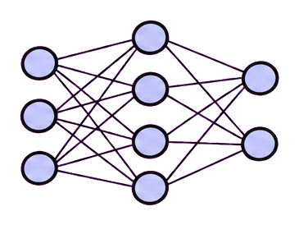
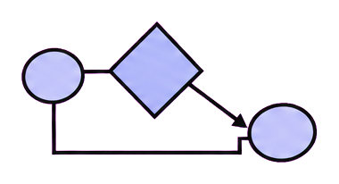
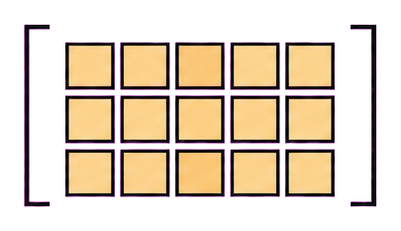
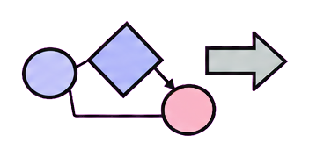
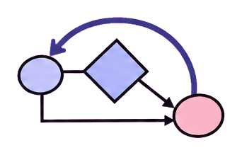

Forecasting
Augmentation
Anomaly diagnosis
Decision support
origin, horizon,
calibration
fidelity, diversity,
utility
event, window,
cause
action, cost,
uncertainty
state
action A
action B
input
prediction
risk
plan / verify
check → revise
transform
evidence
forecast
review
review
validate
forecast
training views
diagnosis
selected action
future horizon
utility
event interval
outcome feedback
(a) Forecasting
(b) Augmentation
(c) Anomaly diagnosis
(d) Decision support
Notes:
Time-Series Agent survey figure adapted from the user-supplied RSI visual template. The layout, typography, and visual hierarchy are retained while the content is rewritten for the LLM + General Harness + Time-Series Harness Module framework. Editable PowerPoint objects remain available for later grouping and revision.

