Slide 1
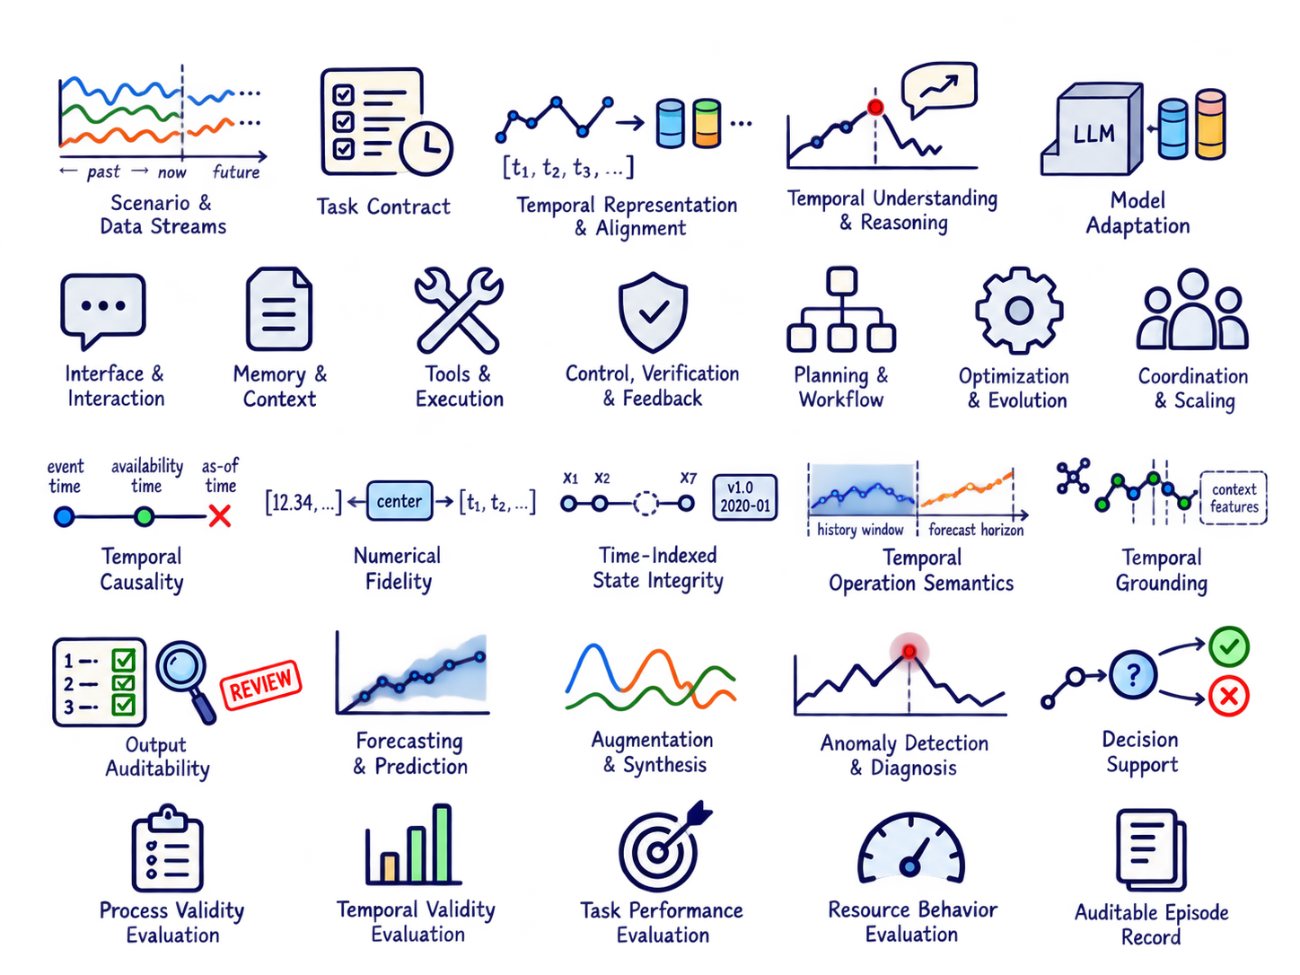

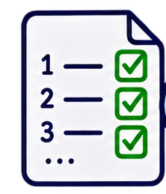

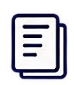
Time-Series Agents: From General to Specific
Scenario & Task Contract
Time-Series Agent
Layer-Aligned Evaluation §7
General Harness (GH)
§4
Scenario
LLM-Side Capabilities §3
Reusable agent runtime
Evaluated
by
Interface &
Interaction
Memory &
Context
Tools & Execution
Control, Verification
& Feedback
Process Validity · GH
• Data streams & context
• Information boundary
• Operational objective
Temporal Representation
& Alignment
•••
Tool-call validity · Recovery
Trace faithfulness
Memory / artifact provenance
State · Actions ·
Observations
Store · Retrieve ·
Reuse
APIs · Code · Models · Simulators
Check · Retry · Recover
Series ↔ language /
multimodal representations
Planning & Workflow
Optimization & Evolution
Coordination & Scaling
…
Decompose · Schedule · Stop
Prompts · Tools ·Memory · Policies
Roles · Shared state ·Review
Temporal Validity · GTS
[x₁, x₂, x₃, …]
As-of / leakage checks · Alignment
Temporal operations · Grounding
Units · Numerical fidelity
← past → now ← future
General Time-Series Harness (GTS)
§5
Temporal Understanding
& Reasoning
Cross-dimensional temporal requirements
Define
requirements
Temporal Causality
Numerical Fidelity
Time-Indexed State Integrity
Task Performance · TSK
Attributes · Instructions ·Reasoning
State-
Actions
Observations
Event time · Availability time
As-of admissibility
Values · Scales · Units
Alignment · Missingness ·
Provenance · Data vintage
Forecast quality ·
Synthesis utility
Detection / diagnosis ·
Decision utility
Trend
increase?
Event
time
Availability
time
As-of
cutoff
Unavailable
[1.2, 3.4, …]
Encode /
Decode
[1.2, 3.4, …]
v1.0
2020-01
Task Contract
Select &
specialize
Check values & units
x₁ x₂ … x_{T}
• Output & horizon
• Admissible information
• Constraints & metrics
• Review authority
Temporal Operation Semantics
Temporal Grounding
Output Auditability
Windowing · Frequency · Horizons
Context · Lags · Evidence
Traces · Checks · Review
Resource Behavior
Model Adaptation
Context
evidence
REVIEW
Cost · Latency
Failures · Revisions
Training · Adapters · Supervision
History window
Forecast horizon
LoRA
Adapters
Instruction
supervision
Task-Specific Harness (TSK)
§6
Task-bound outputs and validation
LLM
Forecasting & Prediction
Augmentation & Synthesis
Anomaly Detection
& Diagnosis
Decision Support
Output:
Future values /
probabilities
Output:
Generated
time series
Output:
Anomaly intervals /
causes
Output:
Actions /
recommendations
Auditable Episode Record
Learned temporal capabilities
Task · As-of boundary · Visible context
Tool calls · Artifacts · Evidence
Validator decisions · Revisions
Final output · Resource use
Validation: Horizon ·
Backtesting · Calibration
Validation: Temporal fidelity
Downstream utility
Validation: Localization
False alarms · Evidence
Validation: Utility · Risk
Cost · Review
Module-Level Evidence Ledger: Claims · Source evidence · Modules · Task contracts · Evaluation · Review status

