Slide 1


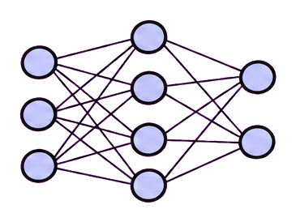
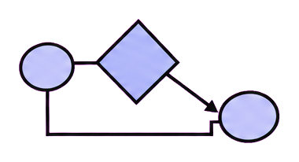
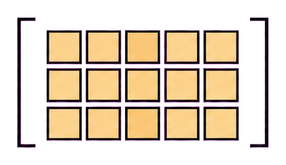
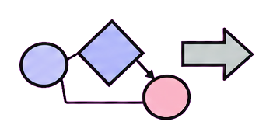
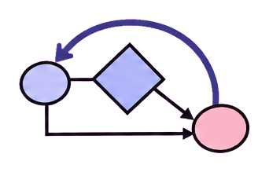

Forecasting
Augmentation
Anomaly diagnosis
Decision support
origin, horizon,
calibration
fidelity, diversity,
utility
event, window,
cause
action, cost,
uncertainty
forecast y_t
forecast y_{t+h}
task contract
plan / verify
check → revise
H_t → H_{t+1}
task output
task-bound
retain
retain
cross-task reuse
same harness
Agent + temporal state
updated forecast
next task episode
new task
temporal memory
task output
new module record
(a) Forecasting
(b) Augmentation
(c) Anomaly diagnosis
(d) Decision support
Notes:
Time-Series Agent survey figure adapted from the user-supplied RSI visual template. The layout, typography, and visual hierarchy are retained while the content is rewritten for the LLM + General Harness + Time-Series Harness Module framework. Editable PowerPoint objects remain available for later grouping and revision.

