Slide 1


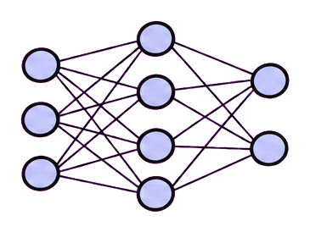
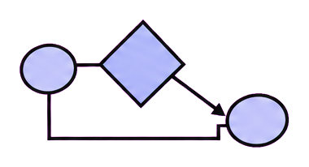
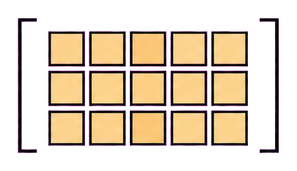
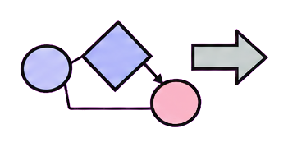
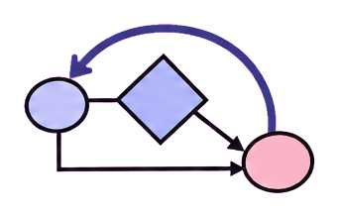

Answer
Memory
Parameters
Improver
Revise within one task
Accumulate experience
Learn weights $\theta_t$
Revise the update process
y_k
y_{k+1}
I_t
revise / test
check → revise
M_t → M_{t+1}
θ_{t+1}
⊥ local only
retain
retain
later reuse
Same solver
Solver + memory
Updated model
Next update process
Future task
M_{t+1}
θ_{t+1}
I_{t+1} ΔS_{t+1}
(a) Local revision
(b) Memory retention
(c) Parameter learning
(d) Improver update
Figure 6. What survives a round of improvement? Four patterns distinguished by the state carried forward. (a) Local checking
and revision change an answer without retaining a change to the solver. (b) Memory M is retained while the model parameters a
nd the chosen update procedure are held fixed. (c) Parameters θ are updated under a fixed training procedure. (d) An accepted
change to the improver I is retained and governs a subsequent task-system update ΔS_{t+1}. The horizontal gray dashed line s
eparates current-task or current-round processing from later reuse. Black dashed enclosures group components. Colored arrows
denote retained updates, and a capped line denotes a change that is not carried forward. Networks, memory stacks, and procedu
re graphs are schematic representations. Solver and improver are functional roles that may share an implementation. These ana
lytical patterns may coexist and do not form a capability ranking; persistent or meta-level changes alone do not establish su
stained recursive gains.

