Slide 1
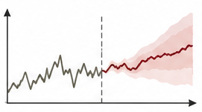
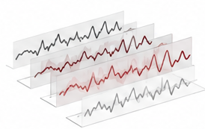
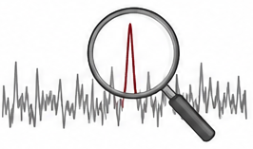
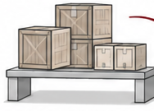


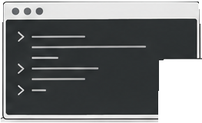
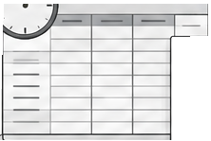
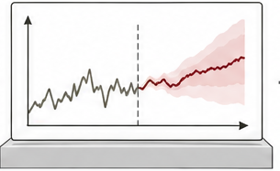
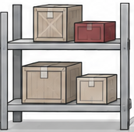
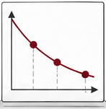
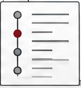



(a) Tasks × temporal functions
Forecasting
Synthesis
Diagnosis
Decision
Data | History | Samples | Streams | State
Processing | Horizon | Transforms | Intervals | Actions
Context | Events | References | Incidents | Experience
Validation | Cutoff | Fidelity | Evidence | Constraints
(b) From shared modules to a task
Execute
Prepare
Forecast
Decide
General Harness
General Time-Series Harness
Task-Specific Harness
Task-Specific Harness

