Slide 1











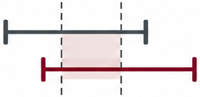

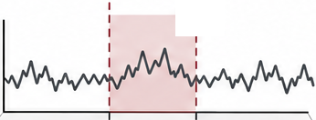




Acquire evidence
Construct state
Detect
Refine
Diagnostics
Statistics
Knowledge
Context
History
Update evidence
Detector training
Parse validity
Interval agreement
False positives

