Slide 1

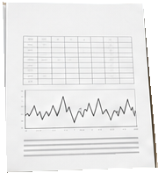
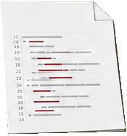

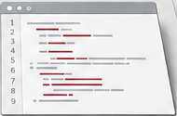
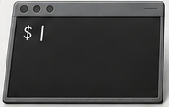
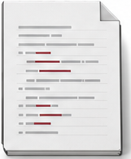




Challenge package
Execution environment
Challenge grader
Agent
Artifact validity
Data
Code
Code
Execute
Task metrics
Edit
Inspect
Submission
Paper
Documentation
Task description
Submit
Saved output

