Slide 1
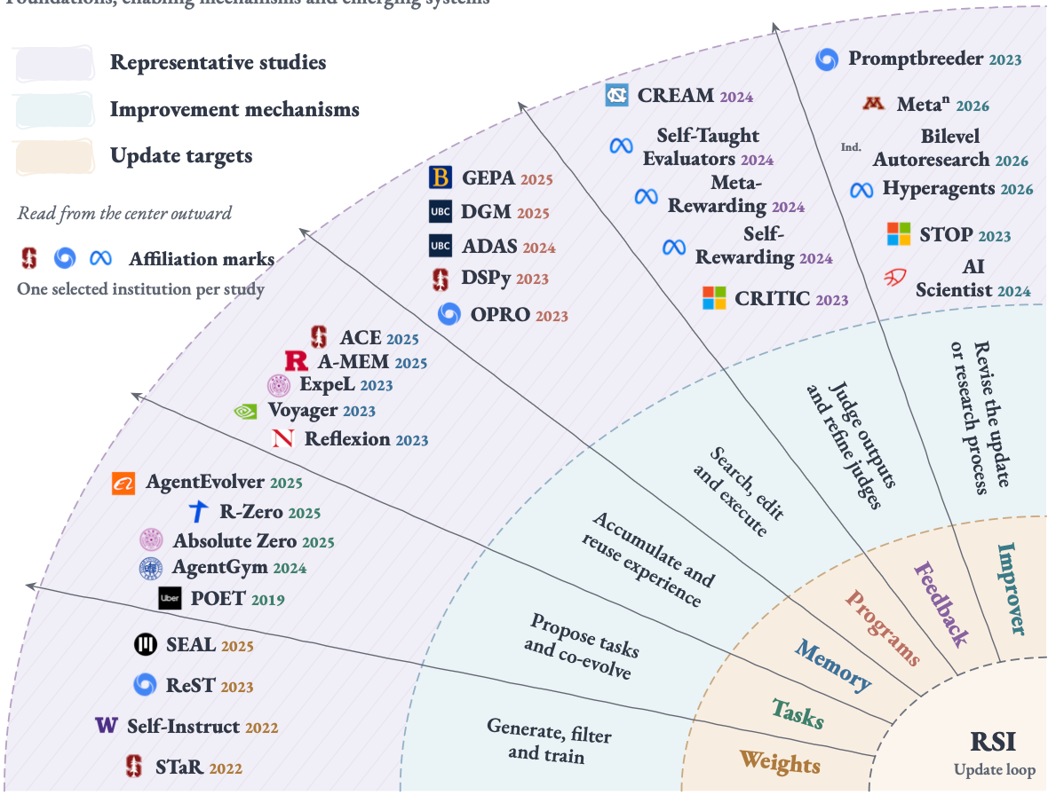
The landscape of recursive self-improvement
Foundations, enabling mechanisms and emerging systems
Figure 3. Landscape of mechanisms relevant to recursive self-improvement. The map connects update targets
in the inner band, improvement mechanisms in the middle band, and representative studies in the outer band.
The six sectors cover weights, tasks, memory, programs, feedback, and the improvement process. A work may
involve several targets; its placement highlights one connection. The map includes historical foundations, enabling
methods, and RSI-oriented systems. Logos denote selected author or work-done affiliations, rather than base
models; other collaborating institutions may be omitted. The accompanying source register records each selection.

