Slide 1
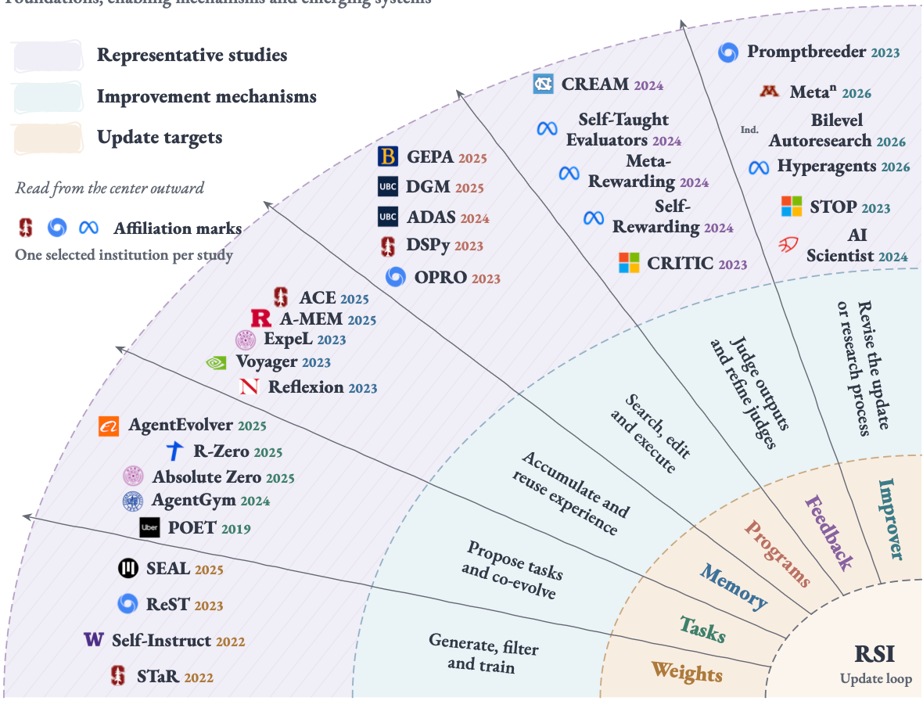
The landscape of recursive self-improvement
Foundations, enabling mechanisms and emerging systems

