Slide 1













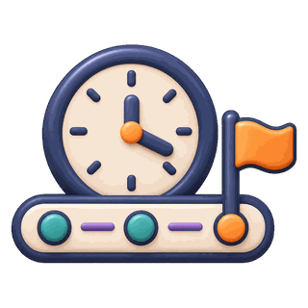





















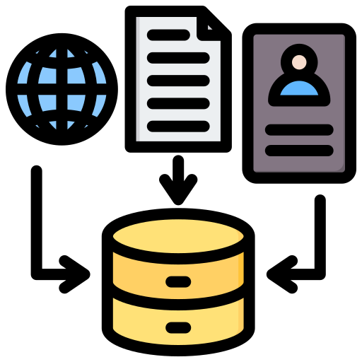





WorldReasoner
2026
OpenForecaster
2025
TimeRLM
2026
TimeSage-EV
TimeClaw
2026
TSQAgent
2026
2026
NEXUS
2026
AURA
2026
FutureSim
2026
TS-Reasoner
2024
TSQAgent
2026
STRIDE
2026
MAS4TS
2026
BatteryLake
2026
AuditForecast
2026
AIAForecaster
2025
AION
2026
S2S-FDD
2026
CoLLMLight
2025
ZARA
2025
FLAIRR-TS
2025
EvoTS-Agent
2026
TS-Scientist
2025
ReasonCast
CALM
2026
TSOrchestr
2025
FinMem
2023
HeraldLight
2025
2025
TimeClaw
TS-Gym
2025
TimeSage-MT
2026
FLAIRR-TS
2025
2026
SIRN
2026
TIEM
2026
FactorMAD
2025
MemCast
2026
MetaCaster
2026
FinCon
2024
ARTIST
2026
MoiraiAgent
2026
Dr-CiK
2026
CRAFTER
2026
MarsTSC
2026
HFMD
2025
MoiraiAgent
2026
AION
2026
MOSAIC
2026
MarsTSC
2026
FinAgent
2024
TS-Exam Agent
2026
TS-Agent
2025
Temporal Data
Management
Temporal
Processing
WeatherTGD
2026
Optimization
and Evolution
Temporal
Context and Memory
Time-RA
2025
FETA
2025
Planning
and Orchestration
GenAutoML
2026
TimeCAP
2025
Temporal
Validation
MERIT
2025
TradingAgents
2024
Tools
and Execution
ChatAD
2026
TS-Skill
2026
General Time Series
Forecasting
and Prediction
AION
2026
TraceBench
2026
TFRBench
2026
Memory
and Context
Harness
Data Augmentation
and Synthesis
SAGE-AD
2026
TS-Agent
2025
General
AnomaMind
2026
ARGOS
Argos
2025
2025
AgentFM
2025
ChatTS
2025
Interface
and Interaction
Harness
Anomaly Detection
and Diagnosis
SAGE-Sleep
2026
Task-Specific
AQuA
2026
Time-R1
2025
Time Series
Agents
PandaAI
ChatAD
2026
Harness
2026
STRIDE
Align, Reason
and Operate
Decision
Support
AgriWorld
2026
2026
LLM Side
Fin-Analyst
2026
CastFSR
2026
LLMTraveler
2025

Slide 2


















Promptbreeder
2023
2023
Promptbreeder
CREAM
2024
Metaⁿ
2026
2026
Metaⁿ
2024
CREAM
Self-Taught
Evaluators
Ind.
Bilevel
Autoresearch
Bilevel
Autoresearch
Ind.
Self-Taught
Evaluators
GEPA
2025
2024
2026
2026
2024
2025
GEPA
Meta-
Rewarding
Hyperagents
2026
2026
Hyperagents
Meta-
Rewarding
DGM
2025
2024
2024
2025
DGM
ADAS
2024
Self-
Rewarding
STOP
2023
2023
STOP
Self-
Rewarding
2024
ADAS
DSPy
2024
AI
Scientist
AI
Scientist
2024
DSPy
2023
CRITIC
2024
2024
CRITIC
2023
OPRO
2023
2023
2023
2023
OPRO
ACE
2025
2025
ACE
A-MEM
2025
2025
A-MEM
ExpeL
2023
Optimization
& Evolution
2023
ExpeL
Voyager
2023
Planning
& Workflow
2023
Voyager
Reflexion
2023
General Time Series
Harness Module
2023
Reflexion
AgentEvolver
Control
& Verification,
& Feedback
AgentEvolver
2025
2025
R-Zero
2025
2025
R-Zero
Absolute Zero
2025
Tools
& Execution
2025
Absolute Zero
AgentGym
2024
2024
AgentGym
POET
2019
2019
POET
SEAL
2025
Memory
& Context
General Harness
2025
SEAL
Time Series Harness Module
Task-specific Time Series
Harness Module
ReST
2023
2023
ReST
Self-Instruct
2022
Interface
& Interaction
Time Series
Agent Systems
2022
Self-Instruct
STaR
2022
2022
STaR

Slide 3
TS-Agent
2025
TradingAgents
2024
TimeRLM
TimeClaw
2026
2026
TimeClaw
2026
ReasonCast
S2S-FDD
STRIDE
2026
2026
2026
BatteryLake
AURA
2026
2026
TS-Scientist
CALM
2025
FLAIRR-TS
2025
2025
FinCon
2024
TimeSage-MT
2026
MetaCaster
2026
Temporal
Processing
MoiraiAgent
2026
Temporal Data
Management
Temporal Context
And Memory
CRAFTER
2026
Optimization
& Evolution
Temporal
Validation
HFMD
2025
Forecasting &
Prediction
FinAgent
2024
Planning
& Orchestration
AION
2026
MarsTSC
2026
Tools
& Execution
Data Augmentation
& Synthesis
TS-Agent
2025
General TS
Harness Module
TimeCAP
FETA
2025
2025
TradingAgents
2024
Memory
& Context
Anomaly Detection
& Diagnosis
TS-Skill
General
Harness
Task-Specific TS
Harness Module
2026
AION
2026
TFRBench
2026
Interface
& Interaction
Time Series
Agent Systems
Decision
Support
TS-Agent
2025
ARGOS
2025

Slide 4
WorldReasoner
2026
WorldReasoner
2026
WorldReasoner
2026
OpenForecaster
2025
NEXUS
2026
WorldReasoner
2026
TimeSage-EV
2026
TSQAgent
2026
AION
2026
TimeRLM
2026
TSQAgent
2026
TS-Reasoner
2024
AIAForecaster
2025
EvoTS-Agent
2026
TimeClaw
2026
FutureSim
2026
MAS4TS
2026
FLAIRR-TS
2025
HeraldLight
2025
STRIDE
2026
AuditForecast
2026
GridMind
2025
FinMem
2023
TIEM
2026
MemCast
2026
AURA
2026
CoLLMLight
2025
ZARA
2025
FactorMAD
ARTIST
2026
S2S-FDD
2026
TSOrchestr
2025
SIRN
2026
2025
Dr-CiK
BatteryLake
2026
ReasonCast
Grid-Agent
2025
2026
TS-Scientist
2026
TS-Gym
2025
MarsTSC
2026
2025
TimeClaw
2026
MoiraiAgent
2026
CALM
2025
MOSAIC
2026
FLAIRR-TS
2025
TS-Exam Agent
2026
TimeSage-MT
2026
FinCon
2024
WeatherTGD
2026
MetaCaster
Time-RA
2025
2026
Temporal Data
Management
Temporal
Processing
Temporal Context
And Memory
GenAutoML
2026
MoiraiAgent
2026
Temporal
Validation
MERIT
2025
CRAFTER
2026
Optimization
& Evolution
ChatAD
2026
HFMD
2025
Forecasting &
Prediction
AION
FinAgent
2024
Planning
& Orchestration
Tree-of-Evidence
2026
2026
TraceBench
2026
MarsTSC
2026
Data Augmentation
& Synthesis
SAGE-AD
2026
TS-Agent
2025
Tools
& Execution
General TS
Harness Module
AnomaMind
2026
FETA
2025
Argos
2025
TimeCAP
2025
AgentFM
2025
TradingAgents
2024
Memory
& Context
Anomaly Detection
& Diagnosis
SAGE-Sleep
2026
TS-Skill
2026
General
Harness
Task-Specific TS
Harness Module
AQuA
2026
AION
2026
PandaAI
2026
TFRBench
2026
Time Series
Agent Systems
Decision
Support
AgriWorld
2026
TS-Agent
2025
Interface
& Interaction
Fin-Analyst
2026
ARGOS
2025
LLMTraveler
2025

