Slide 1
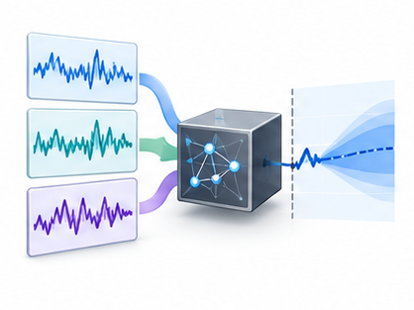
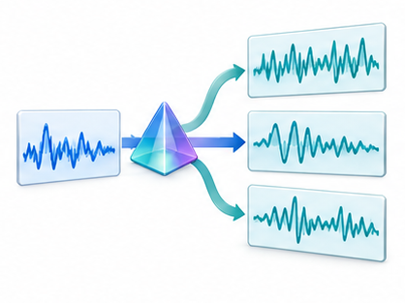
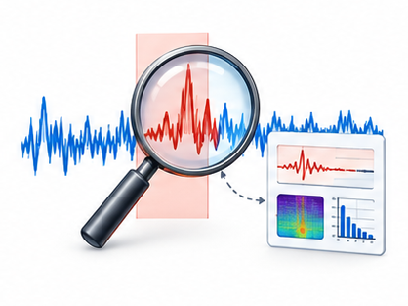
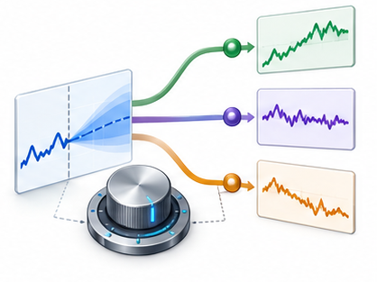
Task-specific procedures and feedback
Forecasting and prediction
Data augmentation and synthesis
History + context
Samples + task requirements
Select model → predict → revise
Generate → review → train learner
Evaluate: Forecast error / calibration
Evaluate: Fidelity / downstream learning
Anomaly detection and diagnosis
Decision support
Series + supporting evidence
State + forecast + constraints
Detect → diagnose → refine intervals
Compare actions → act → update
Evaluate: Detection / diagnosis quality
Evaluate: Action utility / risk / latency
The target artifact determines the feedback and acceptance criterion

