Slide 1



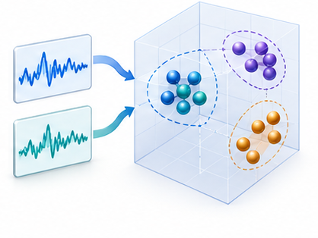
Retrieval-guided augmentation and review
Retrieve examples
Construct positive views
Review and select
Relevant series inform
transformation choices
Generate related but varied
training examples
Assess semantic quality
of candidate views
Revise generation
Accepted views
Contrastive representation learning

