Slide 1
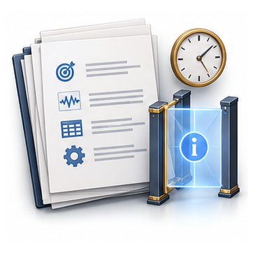

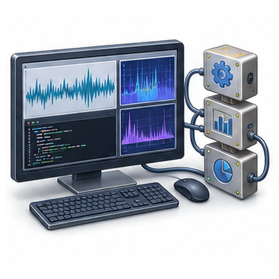
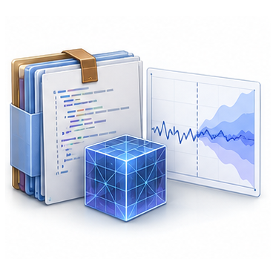
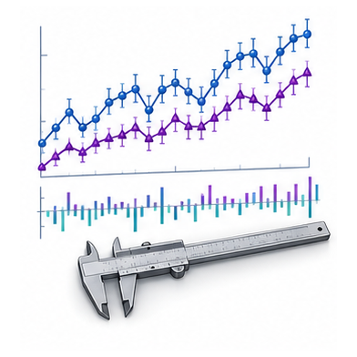
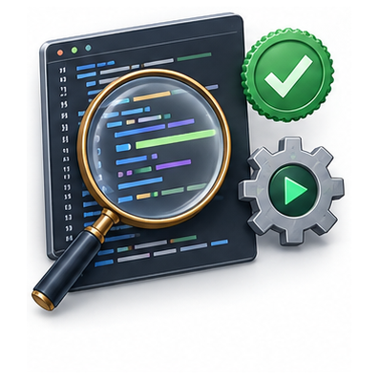
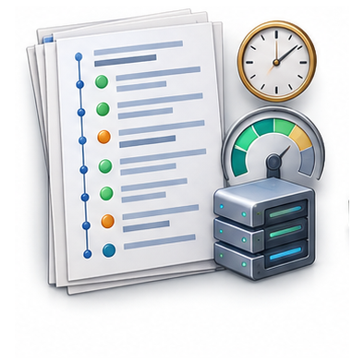
One reproducible Agent episode
Task contract
Resources
Execution
Artifact
Output and information boundary
Data, tools and versions
Calls, checks and revisions
Files, models or code
Task performance
Artifact validity
Execution record
Error, utility
or task score
Executable and
contract-compliant
Trace, failures
and resource cost
Complementary records locate different failure causes

