Slide 1

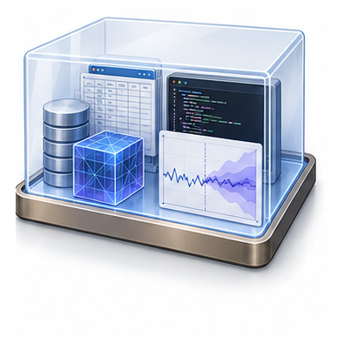
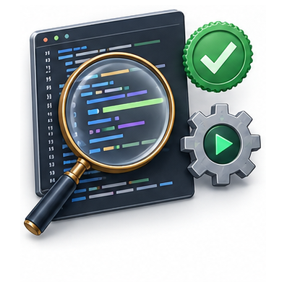
Challenge resources
Executable environment
Challenge grader
Data · code · papers
Artifact checks
Task description
Agent uses resources to produce artifacts
Task-specific metrics
Shared challenge contract across Agents

