Slide 1
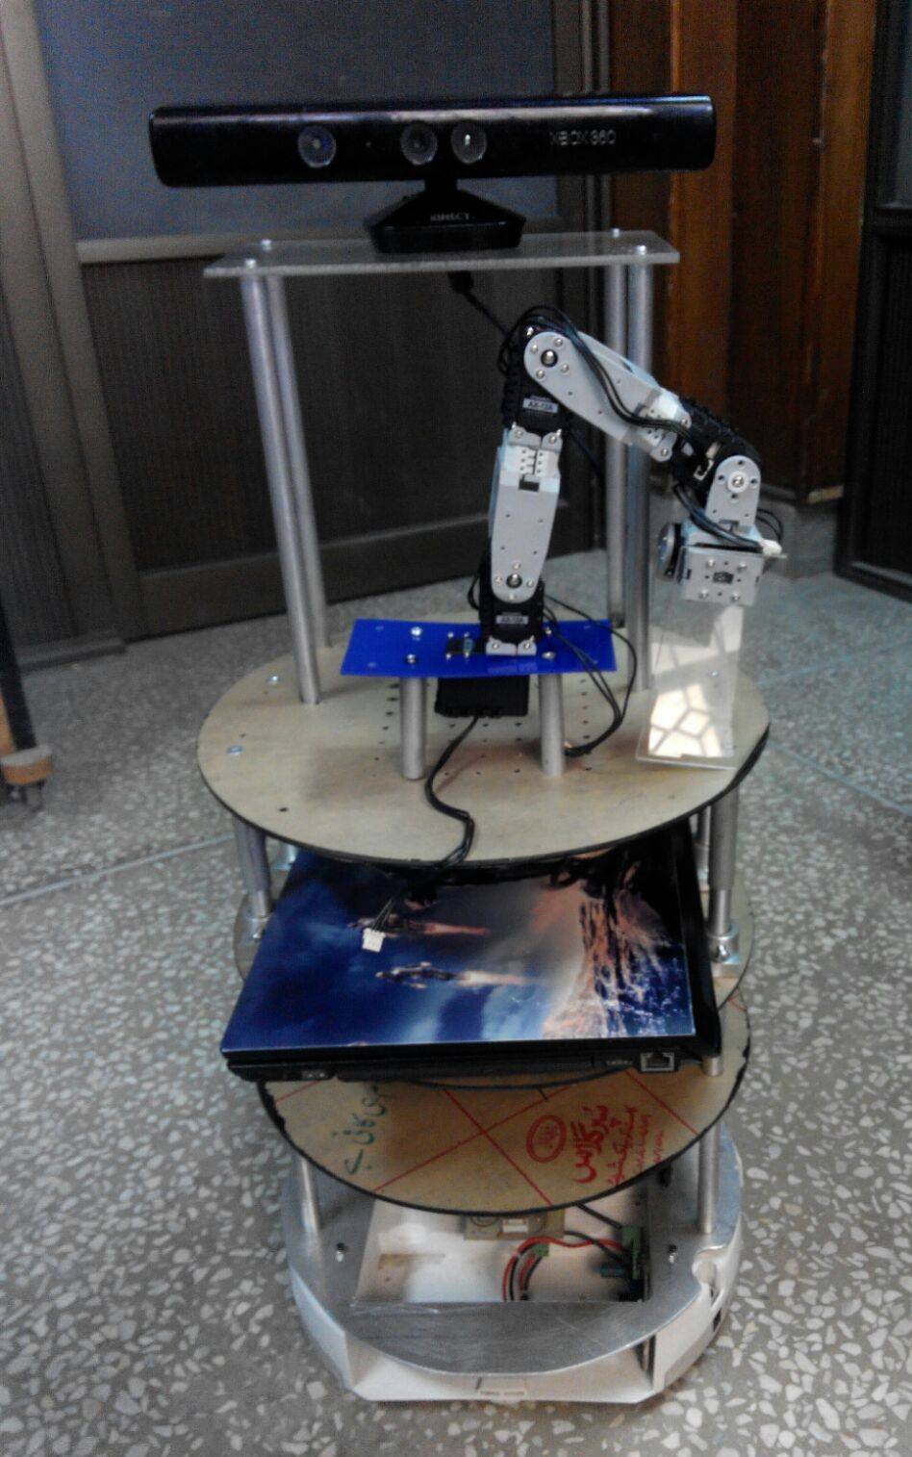
Intelligent Driving System
Amal, Minha, Anila, Maria & Rabeel

Slide 2
Previous Modules
Object recognition and manipulation
Face recognition
Partial speech recognition and synthesis
Human follower
Mapping
Qualifying Video

Slide 3

Voice based Modules
Minha Shabbir & Anila Ishfaq

Slide 4
Voice based Modules
Speech-to-text conversion
Speech recognition
Speech synthesis
Voice localization

Slide 5
What has already been done
The tasks they implemented were speech recognition and speech synthesis (partially)
And the API they used was that of GoogleNow known as artyom

Slide 6
Continued
How it works:
Artyom is the API that converts the speech to text. The Firebase is the cloud database that is used. The commands are stored there and then a comparison with the firebase database is made and then concludes what the user commanded

Slide 7
Our Plans
We plan to move forwards with the work already done. And add extra modules of voice localization and complete speech synthesis.
In order for that to be done, we have three options to move with:
Sphinx by ROS
Hark on ROS
Artyom

Slide 8
Our Plans
34 preferred artyom over Sphinx because the pocketSphinx version is not very accurate. However we are using Hark over artyom because
It is made to work on ROS
it is very reliable for voice separation
It is made to work for sound source localization so works with microphones in every configuration

Slide 9
Our Plans
The initial idea for voice localization is using 3 mics 120 degrees apart and then running the voice source follower code to reach the origin of sound.
We have another idea of matching the sound recognized with the face of the person producing it and then using the facial recognition to reach them. However, this is just a raw idea for now

Slide 10
Our Plans
For now, we are just going to use the voice synthesis by Hark, However we do plan to write a code for Natural Language Classifying in order to make the robot smart. But since this module has been kept for later stages
(18th-20th week); not much homework has been done on it

Slide 11

Simultaneous Localization And Mapping (SLAM)
Amal Fatemah & Maria Jalil

Slide 12
What has already been done
Creating a map of the environment
Rgbd-slam Algorithm → 3D map
Store the 2D vision of the environment using Kinect
RVIZ simulation
Not implemented on hardware yet

Slide 13
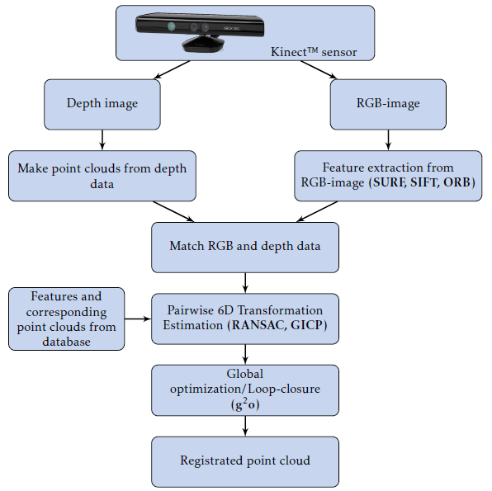

Slide 14
Our Plan
Hardware implementation
Localization and Navigation:
Strands navigation
Adaptive monte Carlo localization (AMCL)
Improve the mapping algorithm
Gyro meter
Odometer

Slide 15
Human follower
Amal Fatemah & Maria Jalil

Slide 16
What has already been done
Follower on a straight & curved path implemented
33 → skeletal tracking
34 → centroid line tracking

Slide 17
Our Plan
Improving the Centroid line tracking
Cater for a person coming between the robot and the person being followed
Strands people perception package
Implement a robot guider (robocup@home task)
The robot memorizes the path and guides the person back
Integration of SLAM and Human Follower

Slide 18
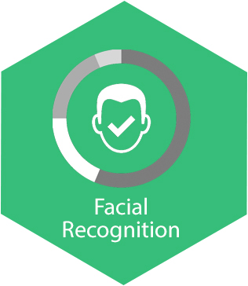
Face Tracking
Rabeel Azhar

Slide 19
Overview of Task
Acquire training images of a person (Detection Step)
Finding Eigen vectors of each of the new images
Face Recognition
Application of PCA(Principal Component Analysis)

Slide 20
What has already been done
Face detection → Open CV
Feature Based Approach applied
Eigen Faced Approach applied
Principal Component Analysis technique used

Slide 21
Continued
After launching the program file, Fserver is run
Fserver is a node which has different libraries to perform face recognition
Goal messages are executed and sent to Fserver by Fclient
Feedback is received and results are displayed on terminal by Fclient

Slide 22
Plan
Implementing face recognition in a crowd
Based on previous years Robocup theme

