Slide 1
Summer Training Seminar
Last update: October 2020
İbrahim Körpeoğlu
Selim Aksoy
Shervin Arashloo
Bilkent University
Department of Computer Engineering
Notes:
1
1

Slide 2
Outline
Before summer training
Expectations from summer training
How to choose a summer training place
Paperwork and application software
During summer training
Planning and organization
DOs and DON’Ts
After summer training
Reports and evaluation
2
2
Notes:
2

Slide 3
Outline
Before Summer Training
Expectations from summer training
Criteria for a good place/company for summer training
3
3
Notes:
3

Slide 4
Catalog Description for CS299/399
The minimum time for this practice in an organization is four weeks (20 working days). The main objective is to observe a company in an original setting and answer questions on the fundamental areas of Computer Engineering and Information Science. A written report summarizing the training experience is required.
CS 299 Prerequisite: CS 202
CS 399 Prerequisite: CS 299

Slide 5

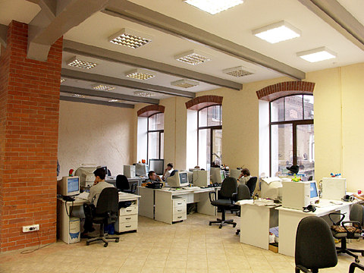
Expectations
Learn about work outside of universities
Companies, Government Institutions, Factories, Banks, etc.
You already learned the academic environment at the university.
During the summer training:
Learn company environment and organization
Learn about projects and processes there
This helps you to make a selection between
Career as an academician
Career as an engineer or project leader, …
5
5
Notes:
5

Slide 6
Expectations
See real world problems and what they involve
Learn how a real-life project is initiated, developed and managed.
real-life needs
Requirements Analysis
Design
Development
Tests
real product
or
system
6
6
Notes:
6

Slide 7

Expectations
Get opportunity to link real world problems to your university education
Summer
Training
University
Education
Real World
Problems
Computer Engineering
Curriculum
Software related
Hardware related
Configuration related
Administrative
Management related
….
7
7
Notes:
7

Slide 8
Expectations
Get out-of-university contacts and references
a Good Job
Your skills, abilities,
knowledge, and attitude
Summer
training
University
Education
Summer training can be another step that helps you to get a good Job after graduation.
8
8
Notes:
8

Slide 9
Expectations
Get opportunity to improve your communication skills
Oral
Written
Excellent work;
Good Quality Output
Good
Communication
Good
Communication
Others understand and appreciate
Project Team
9
9
Notes:
9

Slide 10
Expectations
Get familiar with new tools and development facilities
Obtain the chance to work in a professional team
Collaborate with people from other disciplines
Learn contemporary issues
10
10
Notes:
10

Slide 11
Expectations
Learn and practice professional work ethics
Be serious
Be dedicated
Be enthusiastic
Be honest
Be punctual
Target high quality work
Try to meet deadlines
…
11
11
Notes:
11

Slide 12
Expectations
See computer engineering discipline in action
Apply what you learned in a real work environment
The more expectations your training satisfies, the better it is.
12
12
Notes:
12

Slide 13
Criteria to select a company
The following are two mandatory requirements from a company where training will be done
1) The company/institution must work on computer engineering applications and/or systems, such as software/hardware design/development/testing.
2) Your supervisor/manager must be a computer engineer.
So that you can learn something from him/her.
13
13
Notes:
13

Slide 14
Criteria to select a company
The following are recommended requirements for a company to be selected as the training place
You should be able to work in a team, if possible a multi-disciplinary team
The company/institution should use contemporary tools and techniques
The company/institution should work on projects that have local or global impact
14
14
Notes:
14

Slide 15
Criteria to select a company
You should be able to observe the organization and work-plan of the company/intuition
So that you get any idea how a big project is managed.
How is the hierarchy
How a project progresses
The company/institution should follow engineering standards and methods
So that you can learn some standards that are followed in real life and that are important for a good quality product
15
15
Notes:
15

Slide 16
The Criteria
You should select a company based on the expectation to fulfill most if not all of the criteria listed under “Evaluation of the Work” on the Summer Training Grade form
Passing (or failing) CSx99 depends on these
The quality and quantity of your learning depends on these
The criteria are:
Able to perform work at the level expected from a summer training in the area of computer engineering. (this is the evaluation of all the work done in the summer training)
16
16
Notes:
16

Slide 17
The Criteria
Solves complex engineering problems by applying principles of engineering, science, and mathematics.
Recognizes ethical and professional responsibilities in engineering situations.
Able to make informed judgments that consider the impact of engineering solutions in global, economic, environmental, and societal contexts.
17
17
Notes:
17

Slide 18
The Criteria
Able to acquire new knowledge using appropriate learning strategy or strategies.
Able to apply new knowledge as needed.
18
18
Notes:
18

Slide 19
Some Policies
CS299 and CS399 must be done in 2 different companies
No academic Summer Training. But one academic Summer Training in a foreign county is allowed.
Can not do Summer Training in winter break unless you will graduate in that winter.
Can not do 2 Summer Trainings in one summer unless there is a legitimate reason for that
Need coordinator review and signature
Petition letter + transcript to coordinator
Approval of the Department Chair and Dean’s Office.

Slide 20
Outline
During Summer Training
Planning and Organization
Good Attitude
The “Big Picture”
Networking, teamwork, collaboration
Communication
When to Quit
Start the Report
20
20
Notes:
20

Slide 21
Planning and Organization
Staj Goals→ Weekly Goals → Daily Goals
Plan/budget time accordingly
Keep a 'Notebook'
Electronic (or paper) document to write things in
Keep a daily/weekly record of your progress
Experiments/efforts you tried
Things learned
Goals, plans, do-lists
People, contact info
Resources, references, links
21
21
Notes:
21

Slide 22
Maintain Good Attitude
Positive
Learner
Initiator (Girişimci)
Diligent/punctual/regular
Quality work: ask for it, produce it
22
22
Notes:
22
22
Be active, enthusiastic, motivated, and energetic.
Work hard.
Be pro-active. Do not wait for somebody to tell you what to do.
Go for Quality work: Do not forget that simple tasks such as installing software, changing the toner of a printer, or supporting users are not full-time duties of a computer engineer. …..
Consider extending beyond the 20 days, to gain greater benefit from the summer training

Slide 23
Learn the “Big Picture”
Be open, curious about the organization: LOOK, LISTEN, ASK, LEARN
Try to get a business perspective
about products, market, costs, profit, future growth, competitors, taxes/laws/regulations, etc
How does engineering (Ar-Ge) fit in?
Understand management structure and methods
Use your 'notebook' to record observations
23
23
Notes:
23

Slide 24
Learning from Others
“Networking”: establishing work/social relationships with others in your profession
Mentors: managers, project leaders, experienced engineers
Peers: new engineers, summer training students
Resource people: consultants, sales people, technicians, etc
Use your 'notebook' to record names and contact info
24
24
Notes:
24

Slide 25
Networking Skills
Be friendly, open to new relationships
Be a good listener, ask questions
Offer information and help
Offer and accept invitations
Lunch, tea breaks, evening/weekend activities
Introduce others to your network
Maintain contact with people
25
25
Notes:
25

Slide 26
Know When to Quit a Bad Staj
If you see that it will not meet the standards of our staj requirements, including most of the “Criteria” (it will be INVALID)
If you feel that you will not achieve at least some of the benefits and goals, especially the “Criteria” (it will be of LITTLE BENEFIT)
Otherwise, stay and make the best of your opportunities
26
26
Notes:
26

Slide 27
Be Thinking Ahead: Staj Report and Evaluation
Regularly check the Staj Evaluation Qs
Make adjustments as needed.
Regularly check the Staj Report requirements
Begin writing it while you work
Remember the “Big 9” and be observing how you are putting them into practice
Use your 'notebook' to record things for the report later
27
27
Notes:
27

Slide 28
Summary
DO plan and manage your time
DO set goals, and record your progress
DO keep a 'notebook'
DO make relationships, build a network
DO keep a good attitude
GO for high quality in all you do
DON’T stick with a bad staj placement
DON’T wait till school begins to start your staj report
28
28
Notes:
28

Slide 29
Outline
After Summer Training
Summer training report
Content and organization
Style and formatting
Evaluation
Report style and content
Quality of work done
29
29
Notes:
29

Slide 30
Summer Training Report: Content
Follow the Guidelines document in all aspects.
Divide the report into the following sections:
Introduction
Company information
Work done
Performance and outcomes
Conclusions
References
Appendix (optional)
30
30
Notes:
30

Slide 31
Summer Training Report: Content
Introduction
Provides a smooth beginning to the document
Introduces the company, department, focus areas
Describes your motivation for choosing that company
Summarizes
the work done
motivation behind it
its significance in the overall project
Explains the organization of the rest of the report
The reader will see the big picture and will know what to expect in the rest of the report.
31
31
Notes:
31

Slide 32
Summer Training Report: Content
Company Information
Here you will provide information about the company, department, your supervisor and the systems/resources there.
It must have the following subsections:
About the company
About the department
About hardware and software systems
About your supervisor
The supervisor’s name and job title, along with his or her university and department and year of graduation must be stated here.
Do not copy/paste text from other documents.
We are interested in your observations about the company organization and the systems/tools/resources used.
32
32
Notes:
32

Slide 33
Summer Training Report: Content
Work done
The most important part of your report
Organization (e.g., title, subsections) depends on what you have done
Includes
Information about the main project (if what you did is part of such a project)
Motivation and requirements for the work you did
Significance of your work
Detailed description of your work
33
33
Notes:
33

Slide 34
Summer Training Report: Content
Work done (cont.)
Detailed description of your work
Design methods learned and used
Algorithms/pseudo-code developed
Hardware/software environments used
Documentation methods learned and used
Testing methods learned and used
…
34
34
Notes:
34

Slide 35
Summer Training Report: Content
Work done (cont.)
State your own contribution
Do not forget that reader may not be familiar with the topic
We are interested in your observations about the engineering practices, and the project design/development/documentation/testing/ management methods used in the company.
We are interested in your own work (which problems you worked on, how you approached them, how you solved them).
35
35
Notes:
35

Slide 36
Summer Training Report: Content
Performance and Outcomes
In this section you will discuss your training performance and the outcomes of your training.
The section must have the following subsections, corresponding to the evaluaiton Criteria.
Solving Complex Engineering Problems
Ethical and Professional Responsibilities
Making Informed Judgements
Acquiring New Knowldge Using Appropriate Learning Strategies
Applying New Knowledge As Needed
36
36
Notes:
36

Slide 37
Summer Training Report: Content
Conclusions
Summarize the work done
State your contribution
Summarize what you have learned, experienced, and acquired
Relate these to what you have learned at Bilkent
37
37
Notes:
37

Slide 38
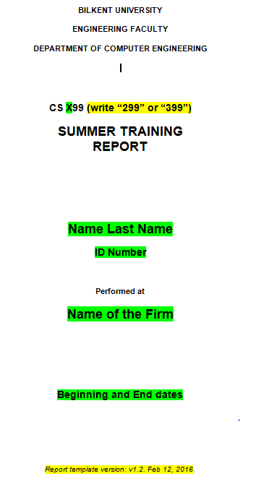
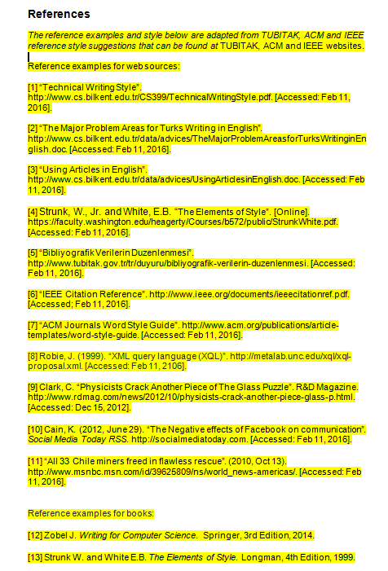
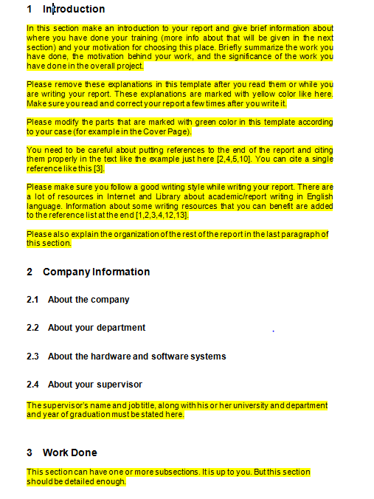
Summer Training Report: Template
There is a Report Template available on CS399/299 webpage. You must use it.
38
38
Notes:
38

Slide 39
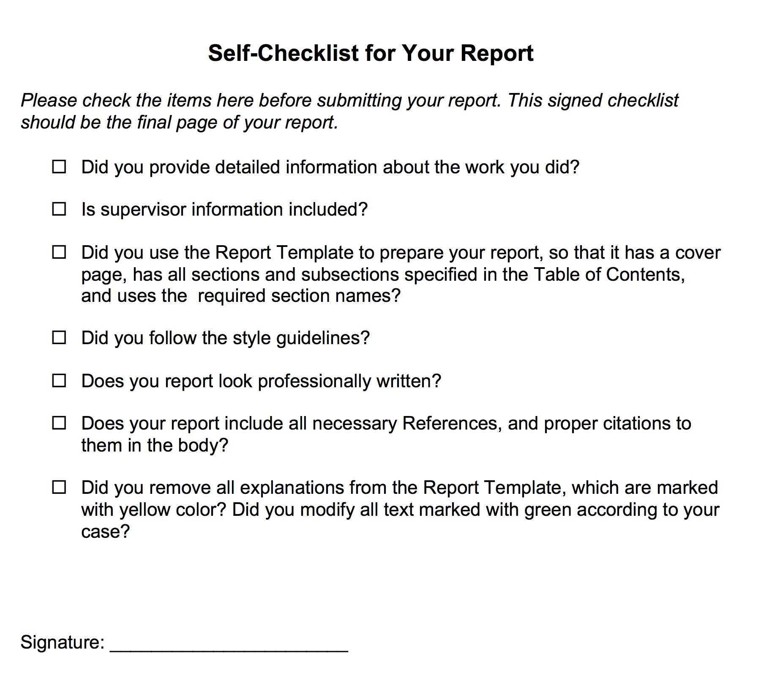
Summer Training Report: Checklist
At the end of the template, there is a Self Checklist that you must complete before submitting your Report.
39
39
Notes:
39

Slide 40
Summer Training Report
Things to remember:
Do not copy and paste information from other documents.
Properly quote or paraphrase information borrowed from other sources and cite them at the end of your report.
Be correct, consistent and complete.
Consult BILWRITE and other resources.
See this as an opportunity for improving your written communication skills.
40
40
Notes:
40

Slide 41
Summer Training Report
Follow the Guidelines; use the Report Template, and be consistent
Section numbering and titles
Figures/tables: numbering, captions, referring to them from text
References to other sources
Source code
Spell check
Page numbers
Binding
41
41
Notes:
41

Slide 42
Evaluation Process
Submit your reports by the deadline announced on the Department web page.
Your reports will be evaluated based on:
Quality of work done and performance/outcomes you achieved
Report style and content
You may be asked to revise your report if style and content are not found satisfactory.
You may be asked to repeat your internship if quality of work done is not found satisfactory.
42
42
Notes:
42

Slide 43
Evaluation Process
Faculty members evaluating your reports are asked questions about:
The work place
Quality of the work place
Evaluation by the employer
The report
Evaluation of the work (the criteria)
Evaluation of the report
Make sure that you check the evaluation form and satisfy the requirements in your training/report.
43
43
Notes:
43

Slide 44
Summary
For further information:
http://www.cs.bilkent.edu.tr/CS299/
http://www.cs.bilkent.edu.tr/CS399/
Have a nice summer!
44
44
Notes:
44

