Slide 1
Miniproject 3
Done by Haiman

Slide 2
How can I own a car today?
Today car prices are ever increasing.
Minimum car price is $30 k for used car.
Minimum car price is $100 k for new car.
Need to factor maintenance cost and taxes by the government
Will I be able to afford to buy a car in the future?

Slide 3
Agenda
Find out whether the price of a car is affordable or not.
Using the “Car_price_prediction.csv” dataset.
Visualize the data.
Showing 3 models to compare which is the best model to use to predict whether car prices are expensive or not
Conclusion.

Slide 4
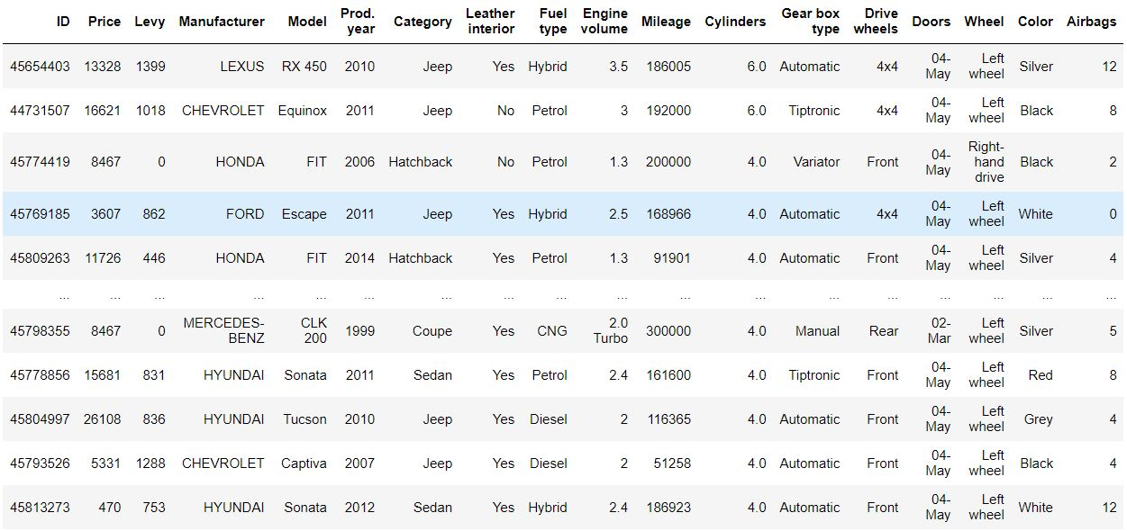
The dataset

Slide 5
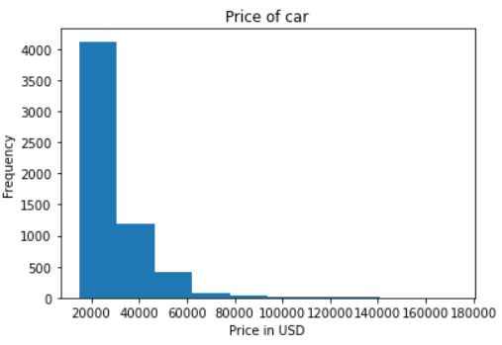
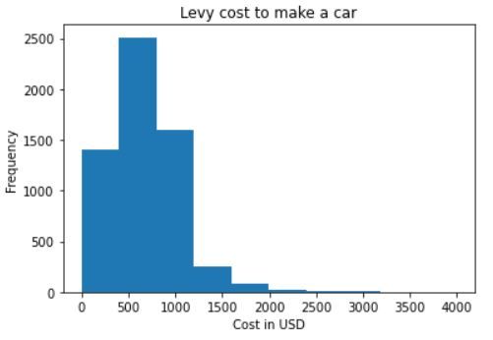
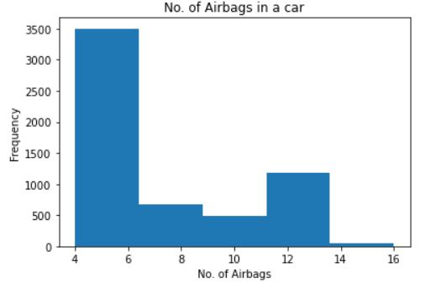
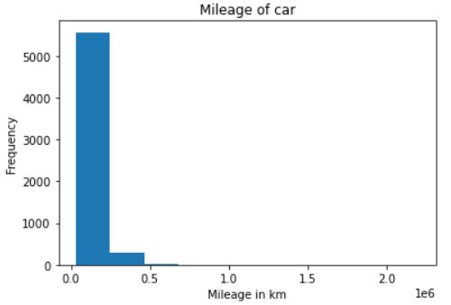
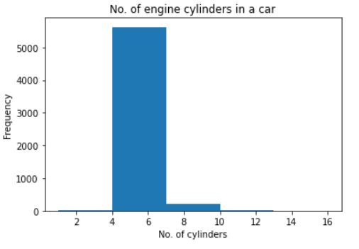
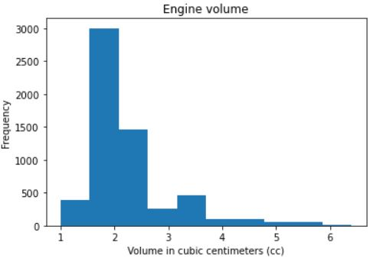
Visualization
0.5 x e^6 = 200km

Slide 6
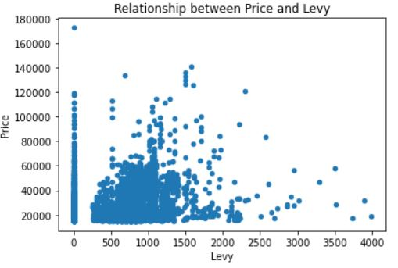
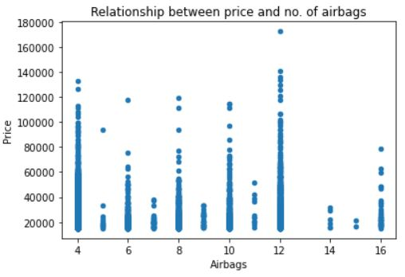
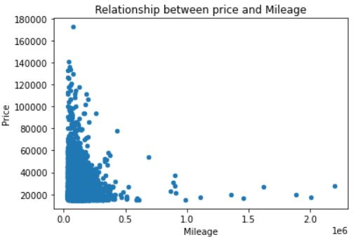
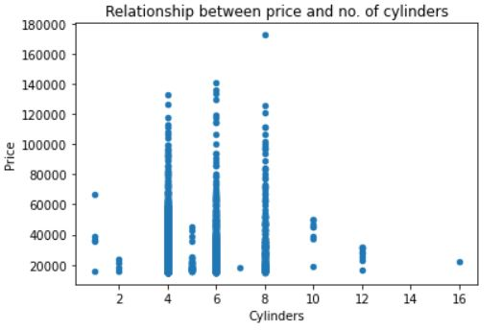
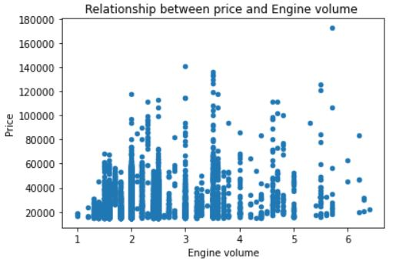
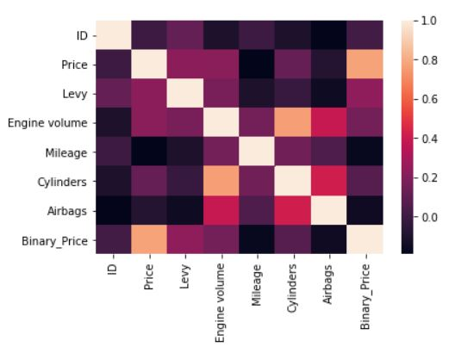
Relationship between the data

Slide 7
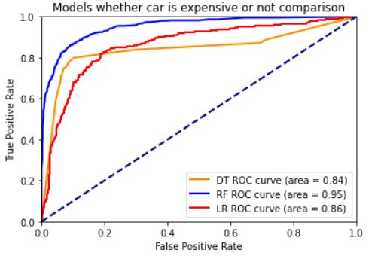
Plotting the graph
Best plot is the blue line with area of 0.95 from 3 different models.
This shows the car price will get expensive in the future 95% of the time.
How can I afford to own my own car?

Slide 8
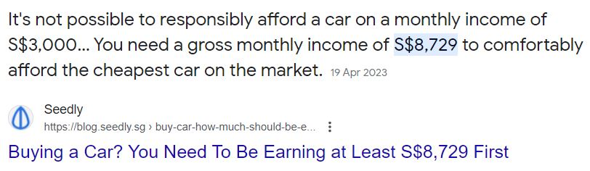
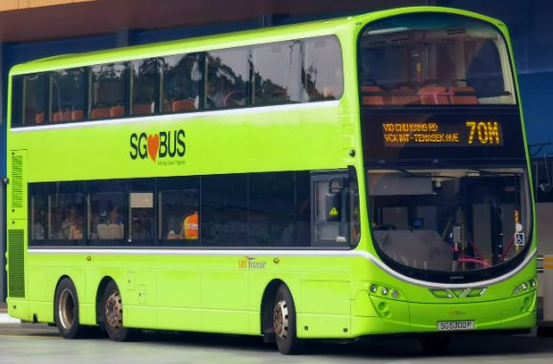

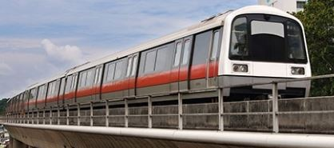
Conclusion
You cannot afford a car in the future.
You can only afford it if your monthly income is $ 8K or more.
What you can afford is public transport i.e. bus, taxi or train

Slide 9
End of Presentation

