Slide 1
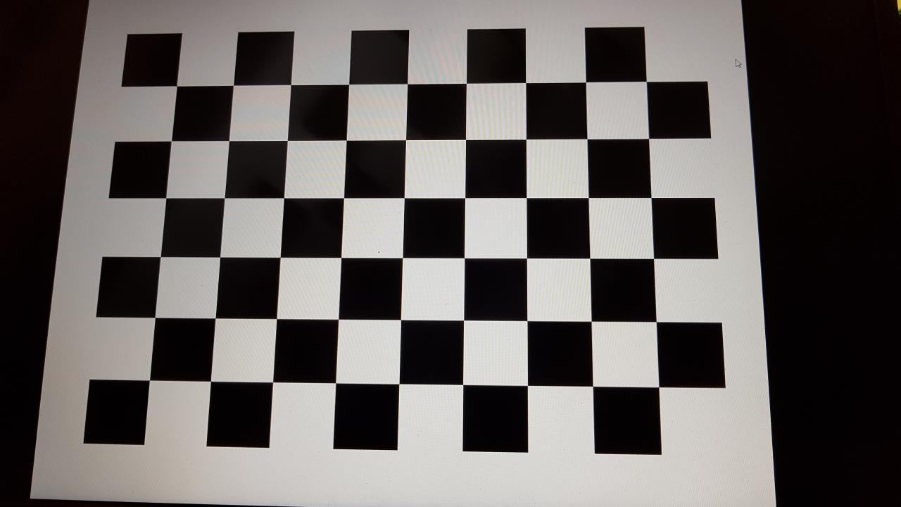

Slide 2
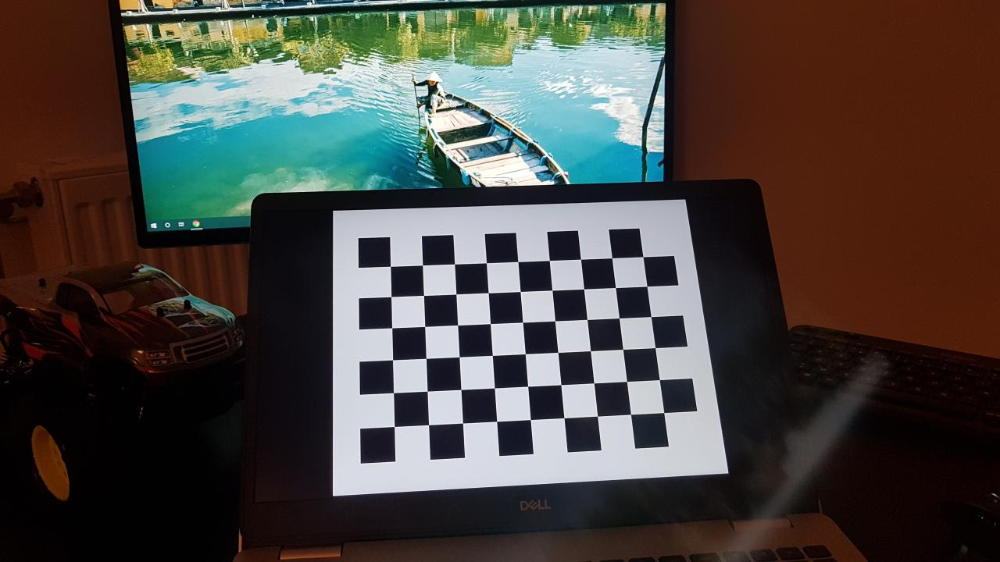

Photo taken by my S7’s rear camera
Chessboard finding

