Slide 1
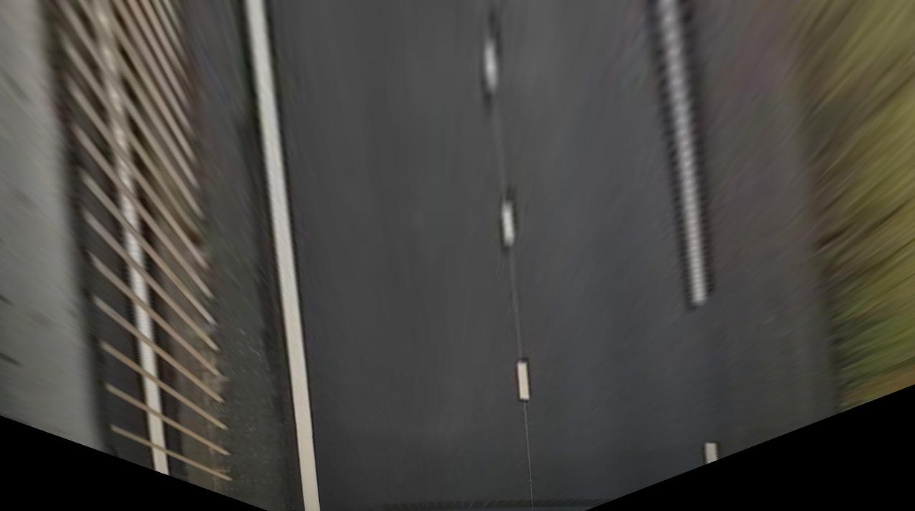
Frame’s topleft corner as origin
1 (pixels matrix dimension)
Frame’s centerline
X (frame coordination)
0
Y
Camera offset due to installation
Y
X (ego vehicle coordination)

