Slide 1
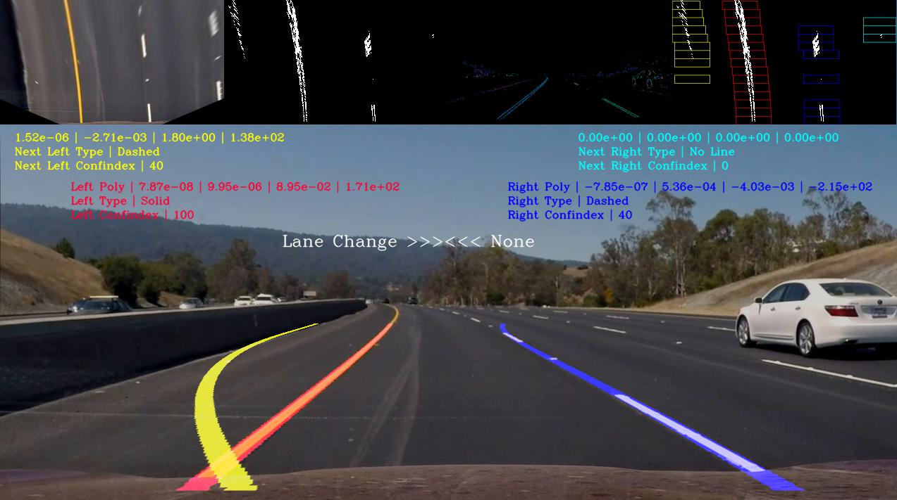
Photo taken by my S7’s rear camera

Slide 2
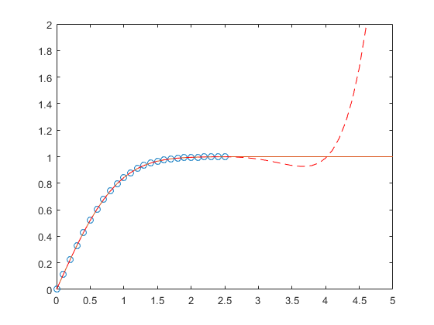
https://www.mathworks.com/help/matlab/ref/polyfit.html

