Slide 1
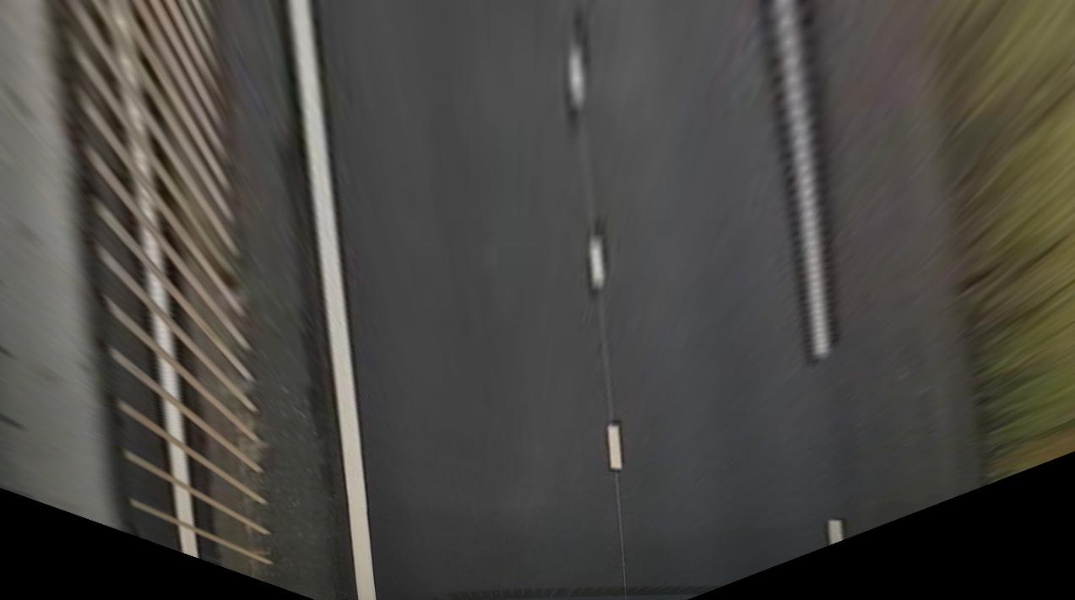

Look-ahead distance
Space-left-in-lane
Space-left-in-lane

