Slide 1
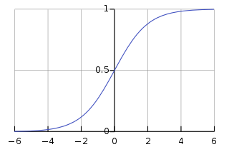

https://en.wikipedia.org/wiki/Sigmoid_function

