Slide 1
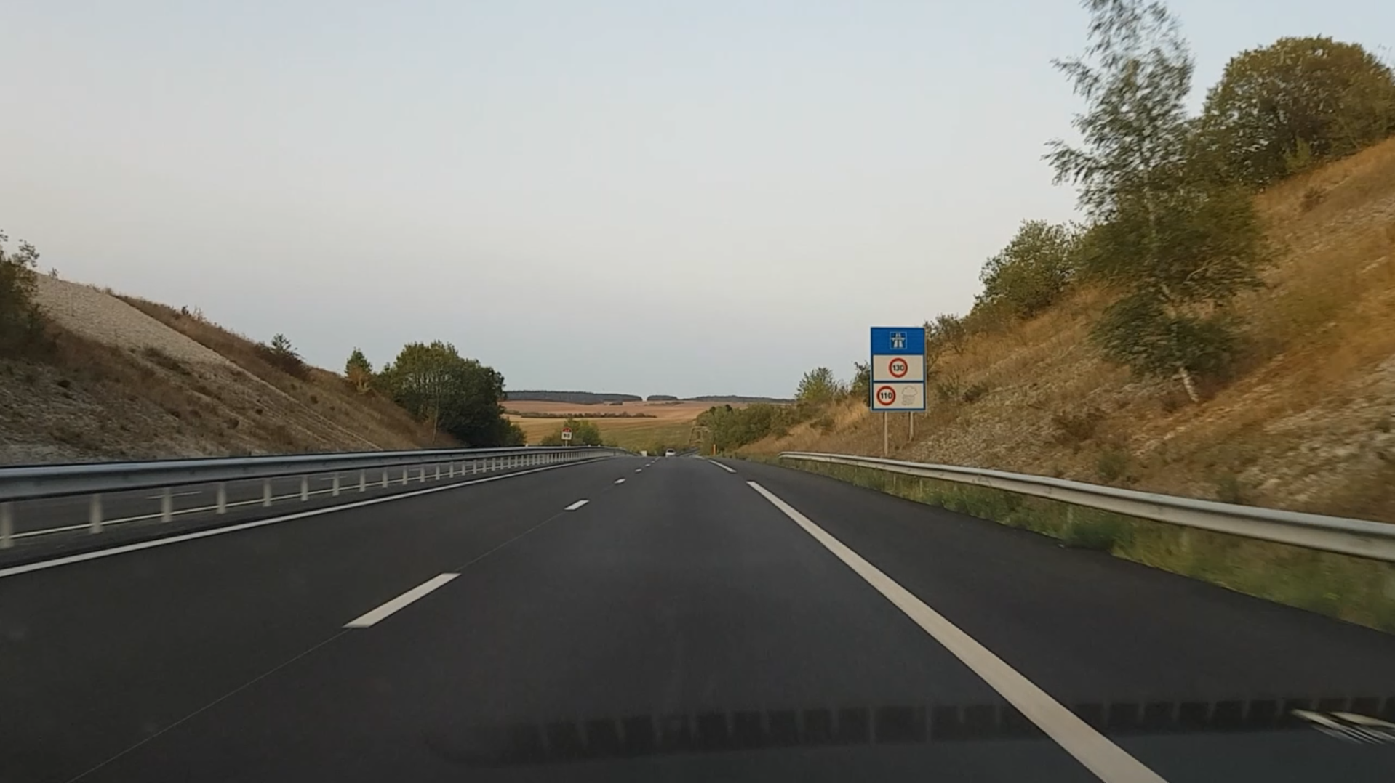
2m
milestone
barrier
3.5m, French highway standard

Slide 2
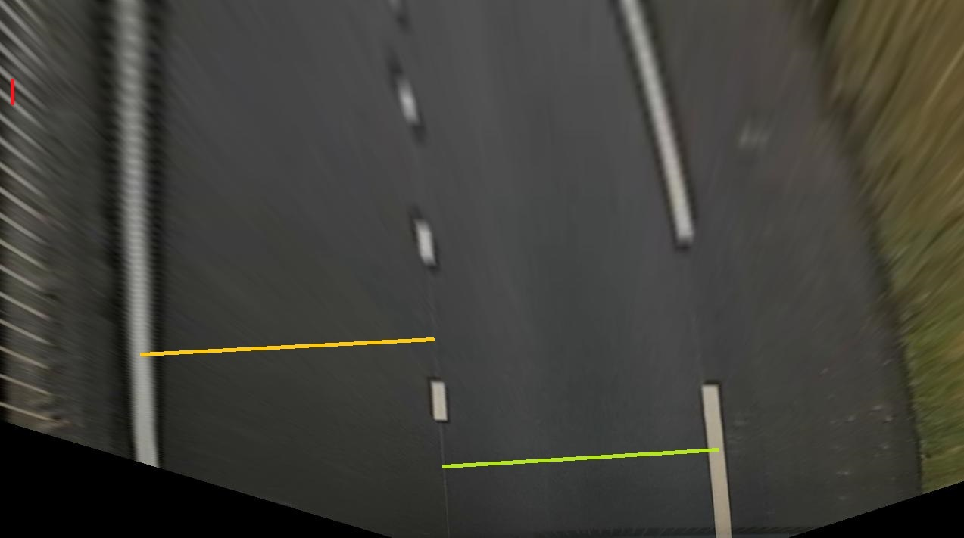
barrier
distance = 32 pixels
= 2 m
lane-width = 388.57 pixels
(573,448)
(185,469)
lane-width = 364,66 pixels
(949,594)
(585,616)
*lane-width = 3,5 m for French highway

Slide 3
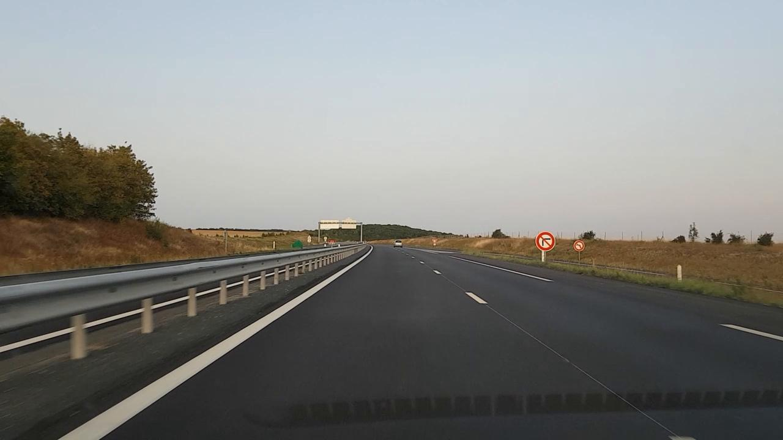

Slide 4
