Slide 1

Note: The data and information in this document is reflective of a hypothetical situation and client. This document is to be used for KPMG Virtual Internship purposes only.
Sprocket Central Pty Ltd
Data analytics approach
[Division Name] - [Engagement Manager], [Senior Consultant], [Junior Consultant]

Slide 2
Note: The data and information in this document is reflective of a hypothetical situation and client. This document is to be used for KPMG Virtual Internship purposes only.
Agenda
Introduction
Data Exploration
Model Development
Interpretation

Slide 3
Note: The data and information in this document is reflective of a hypothetical situation and client. This document is to be used for KPMG Virtual Internship purposes only.
Introduction
Overview of steps to be followed.
Derive insights from your data, specific columns to be selected that are best suited for model development.
Modification of the existing data will also be done to have them in a format that is optimal.
Outside resources will be employed such as the Australian Bureau of Statistics.
Building of model and subsequent evaluation.

Slide 4
Note: The data and information in this document is reflective of a hypothetical situation and client. This document is to be used for KPMG Virtual Internship purposes only.
Data Exploration
Discarding Irrelevant Data Fields:
Discarding irrelevant columns ensures that the resulting model is accurate by removing what is called ‘noise’. Additionally, the data used to build the model should be as closely similar to the data that is to be tested.
Columns that are to be excluded from their respective datasets in this model development include:
Transactions dataset:
‘transaction_date’ given that most transactions are all within the year 2017.
‘online_order’ is not relevant to study general customer recommendations that are to be targeted. However, would best fit in tracking customer behavior, whether they order online or not.
‘order_status’ is also not relevant in this model development but suitable in investigating your organization’s inner operations. For instance, why orders are cancelled.
‘brand’, ‘product_line’, ‘product_class’, ‘product_size’ columns are relevant in a model that investigates the kind of products customers order as opposed to targeting customers.

Slide 5
Note: The data and information in this document is reflective of a hypothetical situation and client. This document is to be used for KPMG Virtual Internship purposes only.
Data Exploration
Discarding Irrelevant Data Fields:
Transactions dataset:
‘product_first_sold_date’ column is also dropped as its metadata data does not offer quality as addressed in the data quality evaluation.
CustomerDemographic Dataset:
‘first_name’ and ‘last_name’ even though important in identifying a customer do not affect the model development process significantly.
‘default’ column is also dropped as its metadata data is inconsistent and thus does not provide any useful information.
CustomerAddress Dataset:
‘address’ column provides a wide range of values which are very specific to each customer and thus cannot be used in identifying similar charateristics in a group of customers.
‘country’ column can be dropped as we are dealing with customers who are all from Australia.

Slide 6
Note: The data and information in this document is reflective of a hypothetical situation and client. This document is to be used for KPMG Virtual Internship purposes only.
Data Exploration
Data Transformation and Manipulation:
Data manipulation can help extract useful information. Analyzing each dataset individually using the columns that have been classified as relevant, these can be derived:
Transactions Dataset:
In this dataset, we group the customers by their customer_id and then calculate the number of products they ordered, the total list_price and total standard_cost.
From the total list_price and standard_cost, their averages can be calculated by dividing with the number of products.
From this we can extract information about which customers buy more products and their average prices as well as costs.
CustomerDemographic Dataset:
In this dataset, the age of the customers needs to be extracted and then the DOB is dropped.
After all data manipulations are done, the 3 datasets will be merged in order to further analyze the data. This includes data distribution and correlation.

Slide 7
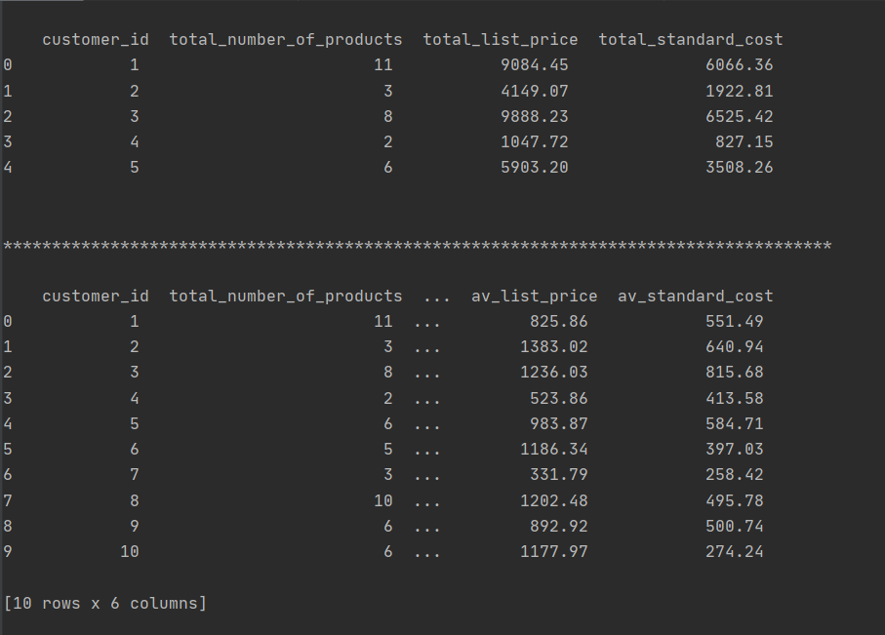
Note: The data and information in this document is reflective of a hypothetical situation and client. This document is to be used for KPMG Virtual Internship purposes only.
Data Exploration
Deriving Data Fields from Existing Data:
A snapshot of the transactions dataset after data manipulation.

Slide 8
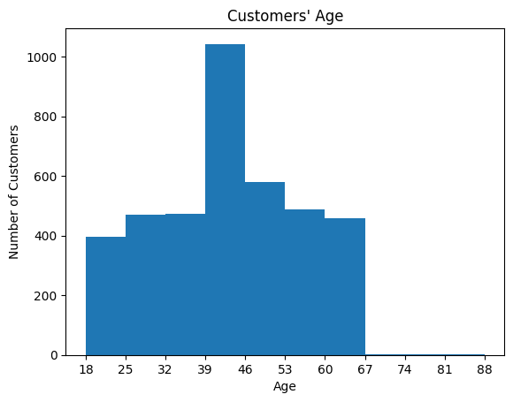
Note: The data and information in this document is reflective of a hypothetical situation and client. This document is to be used for KPMG Virtual Internship purposes only.
Data Exploration
Data Distribution/Visualization:
In Data Visualization, I look into the data fields and how they impact your business.
This involves analyzing individual data fields such as their frequency and also their correlation to other data fields.
For instance, looking into the age of customers, a histogram can show the distribution of their ages. Here we see that most customers are between the ages 39 and 46.

Slide 9
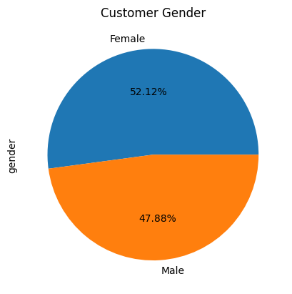
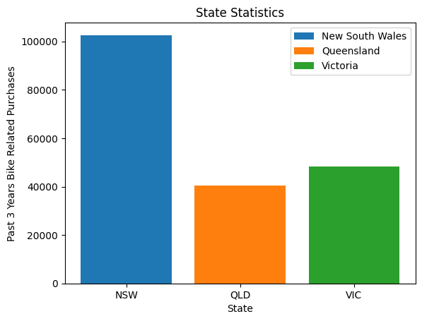
Note: The data and information in this document is reflective of a hypothetical situation and client. This document is to be used for KPMG Virtual Internship purposes only.
Data Exploration
Data Distribution/Visualization:
In the customer gender data, it’s distribution can be visualized to show which gender most customers are.
Investigating the number of purchases in the past 3 years in the various states show in which states your customers hail from in those 3 years.

Slide 10
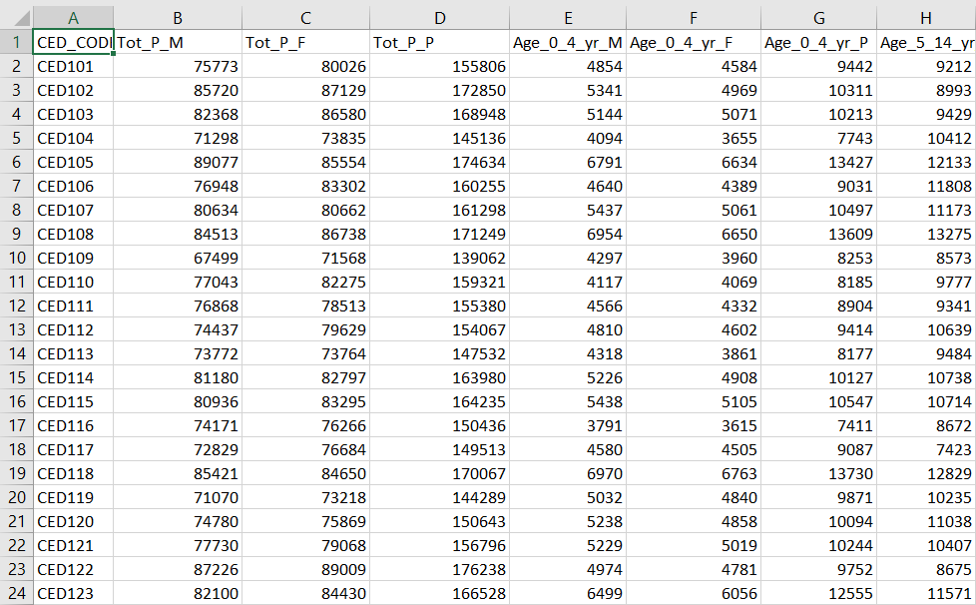
Note: The data and information in this document is reflective of a hypothetical situation and client. This document is to be used for KPMG Virtual Internship purposes only.
Data Exploration
Outside Data Sources:
External Data from the Australian Bureau of Statistics also proves to be helpful in adding more variables to our data.
For instance, from the census data, data showing the total number of males, females and persons as well as the number of people in different age brackets in the different states is essential.
This data will show the regions with more people ideal to be targeted and in which age brackets.
Sample Census Data for New South Wales State

Slide 11
Note: The data and information in this document is reflective of a hypothetical situation and client. This document is to be used for KPMG Virtual Internship purposes only.
Model Development
Feature Engineering and Algorithm Selection:
In Model Development, to achieve the best results, the algorithm used in building a model is very crucial as well as the features that are used as inputs to the model.
In this case, the following features, but not limited to these, will best suit for a customer recommendation model: age, postcode, state, gender, property valuation, job_title, job_industry, wealth_segment, deceased_indicator, owns_car and tenure.
Models also work best using numerical values and not categorical values. Therefore, data fields such as gender, state will be transformed to numbers by assigning a unique number or string of number to each of them. This is through a method called one-hot encoding.
Regression modeling will be best to predict customers who will be best for your organization. This will be based on the features selected to predict the number of purchases of customers based on their features.
The model is tested first through a process called validation and testing on data it has not used before to ensure that the best accuracy scores are achieved.

Slide 12
Note: The data and information in this document is reflective of a hypothetical situation and client. This document is to be used for KPMG Virtual Internship purposes only.
Interpretation
Results Interpretation:
From the model, we get the number of purchases of each customer that we would like to predict.
Customers with the highest number of purchases are deemed best and thus would be optimal for being targeted to drive the most value for your organisation.
Continuous iteration of the process based on results generated and feedback gained from your marketing team on their performance based on our suggestion is essential. This is to ensure the model is refined continuously for optimal performance.

Slide 13
Note: The data and information in this document is reflective of a hypothetical situation and client. This document is to be used for KPMG Virtual Internship purposes only.
Appendix

