Slide 1
Evaluating indoor wifi locating techniques
Presented by: Minjuan Deng-Westphal
Date: 09.04.2020

Slide 2
Agenda
Demonstration of the data science process
Comparison of models produced
Recommendations
Learning experience to share

Slide 3
Statement of goals
to investigate the feasibility of using "wifi fingerprinting" to determine a person's location in indoor spaces
to evaluate multiple machine learning models to see which produces the best result
to provide advice to clients on model(s) to be incorporated into a smartphone app for indoor locationing

Slide 4
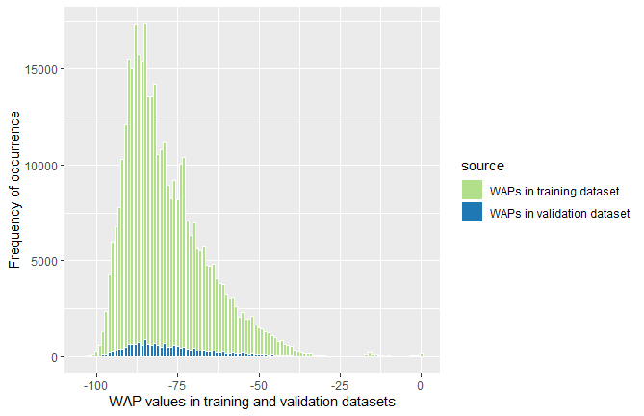
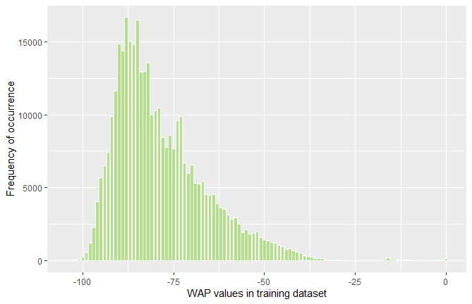
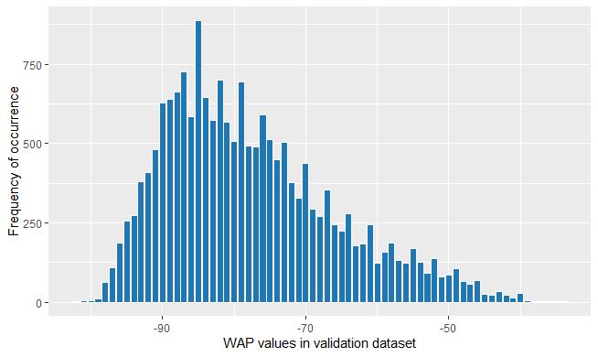
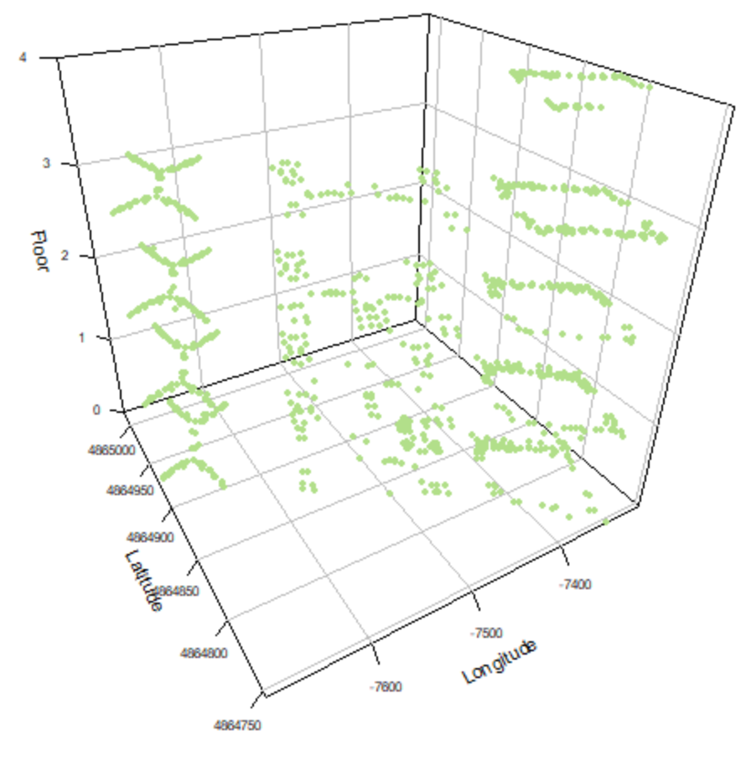

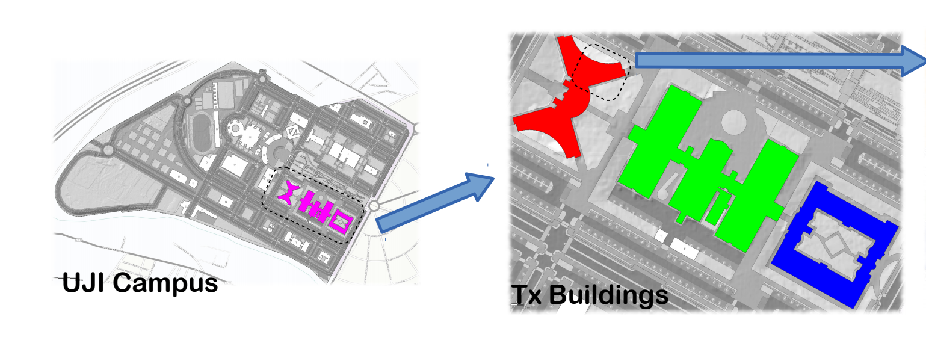
Description and location of related data sources
High dimension datasets, requiring simplification and an approach to subset/sampling
Frequency distribution of the Number of WAPs that are detected on a single capture.
“Footprints” in training dataset
“Footprints” in validation dataset

Slide 5
Known issues with data and solutions
Decisions and actions were made to simplifying and preparing data for modelling.
There is no missing data.
Repeated rows were removed -> 19337 to 19300 rows in training dataset
Transforming data types to appropriate ones
Near zero variances removed -> 529 -> 323 variables
Remove rows with no variance (with all WAPs = 100) -> removed c.a. 70 rows
Use a value of -110 to replace those WAPs = 100
Predictors to be included and excluded:
SPACEID, RELATIVEPOSITON
USERID, PHONEID
Timestamp
Drop longitude or latitude when predicting the other
Decision on how to subset the dataset: by BuildingID

Slide 6
Choice of ML models
High dimension datasets, requiring simplification and an approach to subset/sampling
Random Forest algorithm was chosen as the most fit one to train and test the model
To predict
BuildingID
Floor number*
Longitude*
Latitude*
Type of problem
Classification
Classification
Regression
Regression
ML model used
KNN
Random forest
Decision tree C5.0
Random forest
KNN
Random forest
KNN
Random forest
KNN
Outcome
Random Forest
Accuracy: 1
Kappa: 1
Random Forest
Confusion matrix of both models were presented in more details in later slides
Random Forest
Predicted vs. actual values of both models were presented in more details in later slides
Random Forest
Predicted vs. actual values of both models were presented in more details in later slides
* Both train data and validation data were subset by buildingID into Building 0, Building 1 and Building 2.

Slide 7
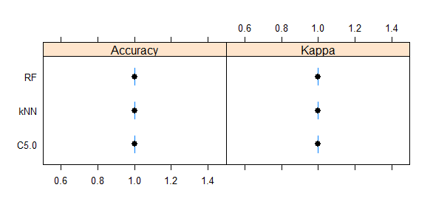
Predicting Building IDs
Random Forest, k-NN and Decision Tree C5.0 algorithms all produced highly accurate results.

Slide 8
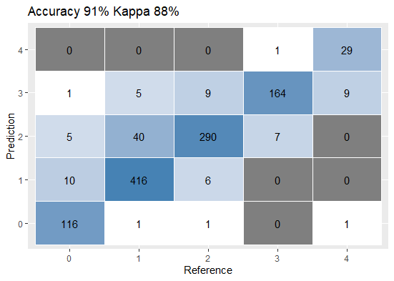
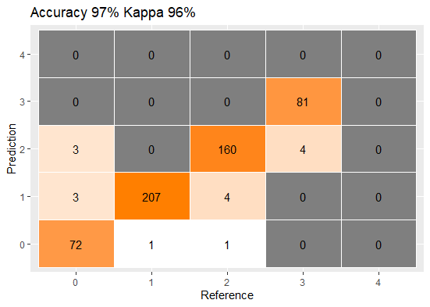
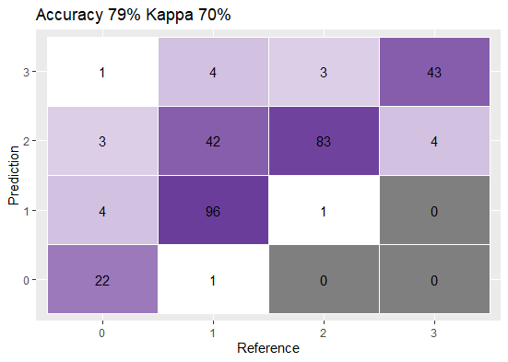
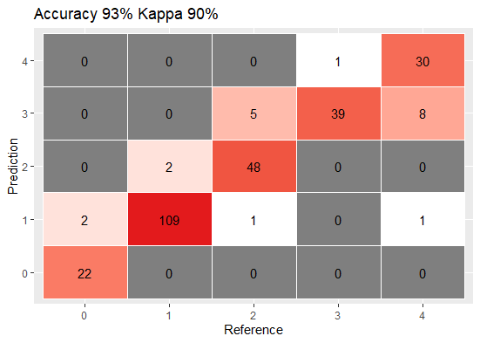
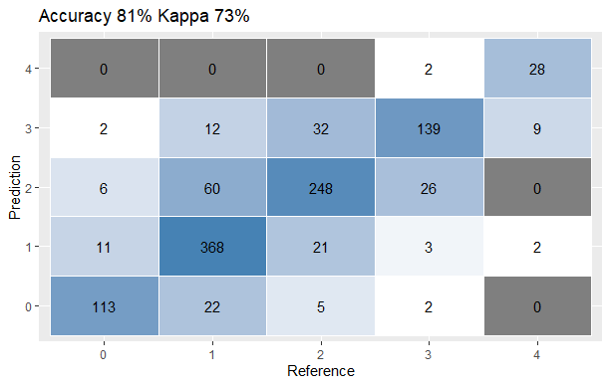
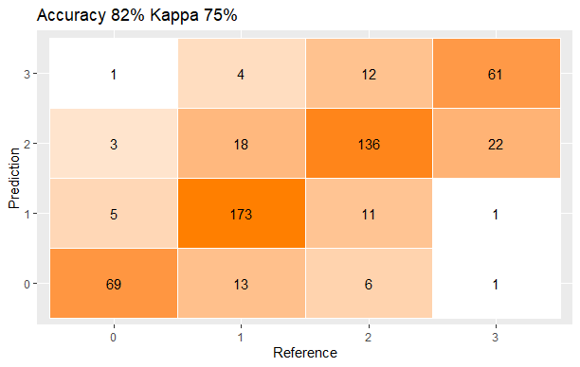
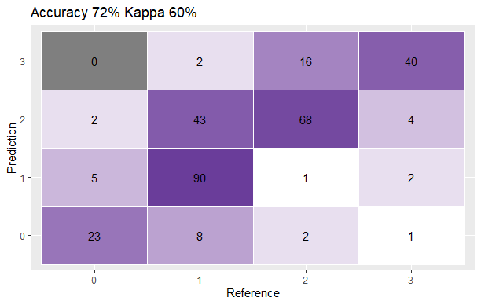
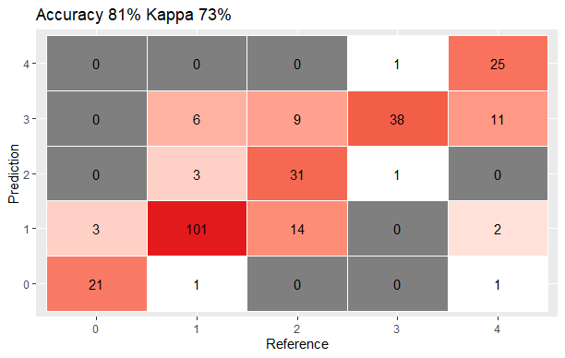
Predicting floors – with Random Forest
Predicting floor numbers
Legend
All buildings
Building 0
Building 1
Building 2
Predicting floors – with k-NN

Slide 9
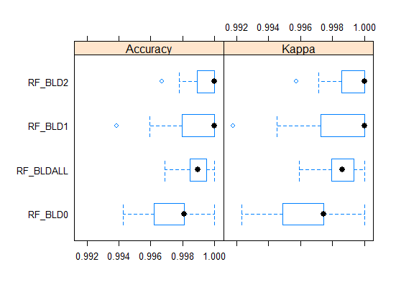
Predicting floor numbers – more with Random Forest
Accuracy and Kappa values of trained RF models
summary(results_floorpredic)
Call:
summary.resamples(object = results_floorpredic)
Models: RF_BLDALL, RF_BLD0, RF_BLD1, RF_BLD2
Number of resamples: 30
Accuracy
Min. 1st Qu. Median Mean 3rd Qu. Max. NA's
RF_BLDALL 0.9968799 0.9984393 0.9989600 0.9989079 0.9994800 1 0
RF_BLD0 0.9942639 0.9966703 0.9980916 0.9978391 0.9980989 1 0
RF_BLD1 0.9938776 0.9979592 1.0000000 0.9987768 1.0000000 1 0
RF_BLD2 0.9966960 0.9988990 1.0000000 0.9994860 1.0000000 1 0
Kappa
Min. 1st Qu. Median Mean 3rd Qu. Max. NA's
RF_BLDALL 0.9959281 0.9979633 0.9986428 0.9985747 0.9993214 1 0
RF_BLD0 0.9923151 0.9955408 0.9974447 0.9971058 0.9974540 1 0
RF_BLD1 0.9917702 0.9972574 1.0000000 0.9983557 1.0000000 1 0
RF_BLD2 0.9957291 0.9985770 1.0000000 0.9993357 1.0000000 1 0

Slide 10
Predicting longitude and latitude
Tasks of regression - Random Forest and k-NN algorithms
Chosen Random Forest and k-NN
Split data by building ID
Seeking correct number of trees and mtry: e.g. mtry = 210, ntree = 501
System processing time: RF - on average between 30m to 1h, k-NN much fasteer
Achieved improved results in R-squared after releveling floor number

Slide 11
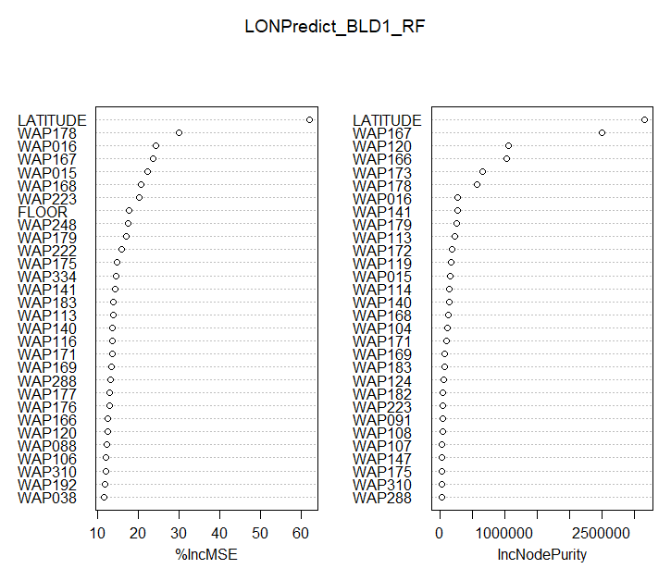
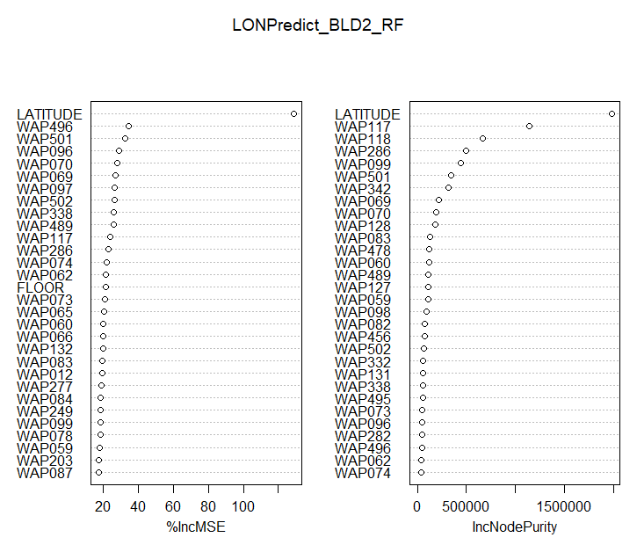
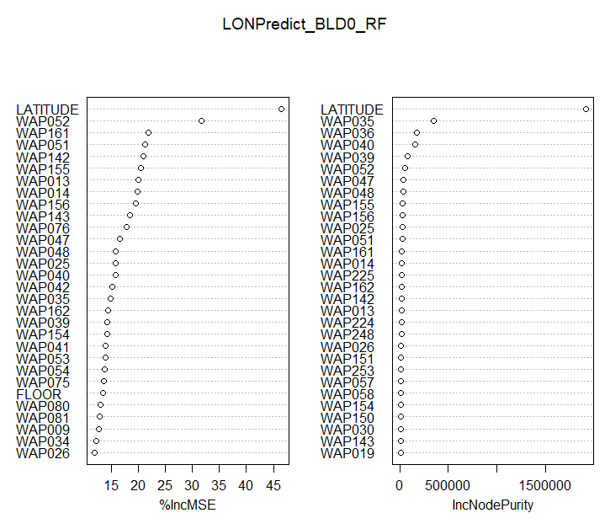
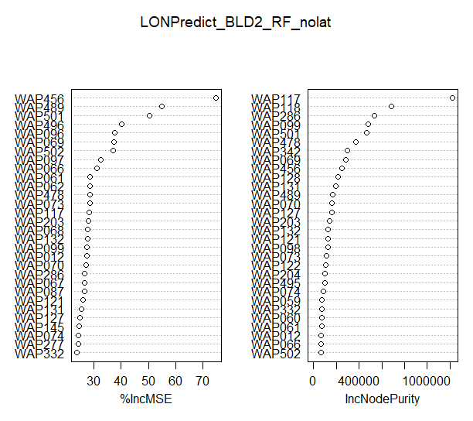
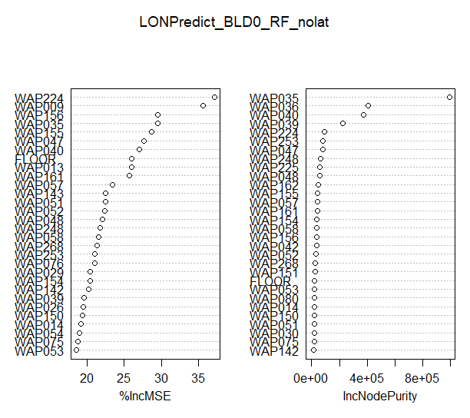
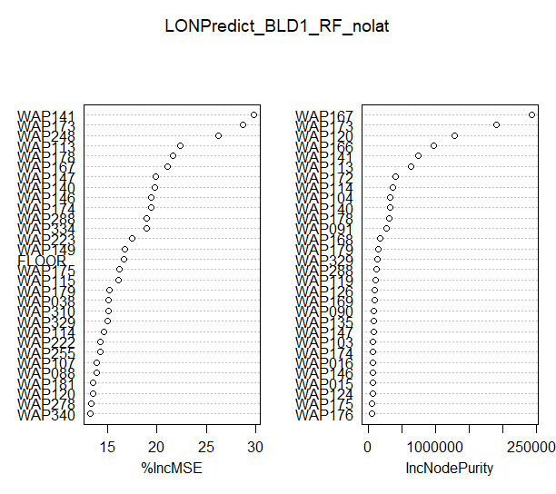
Variable importance – produced by Random Forest
Results of variable importance guided to drop one more variable
Before
After

Slide 12
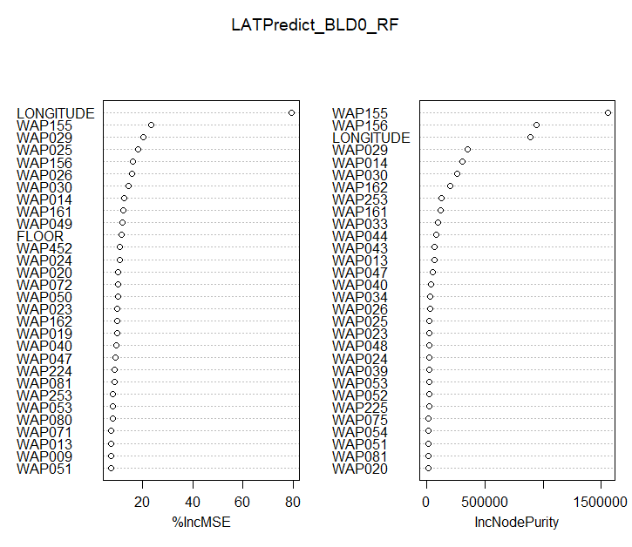
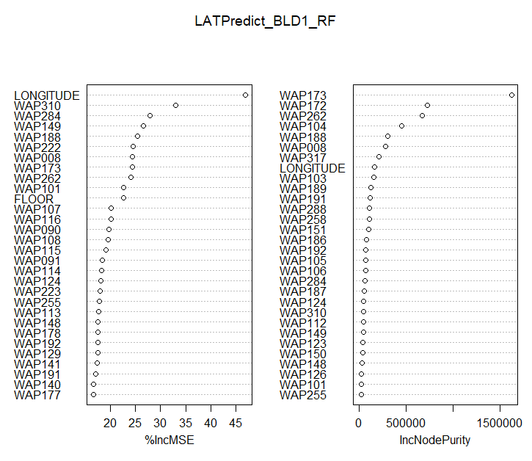
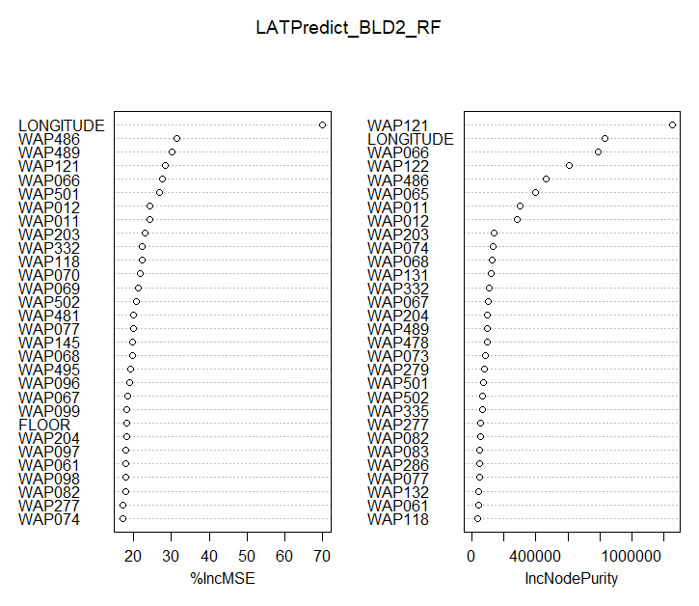
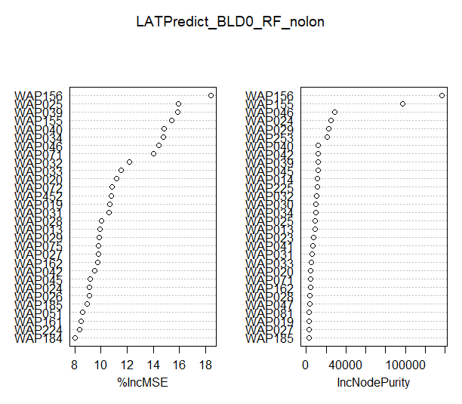
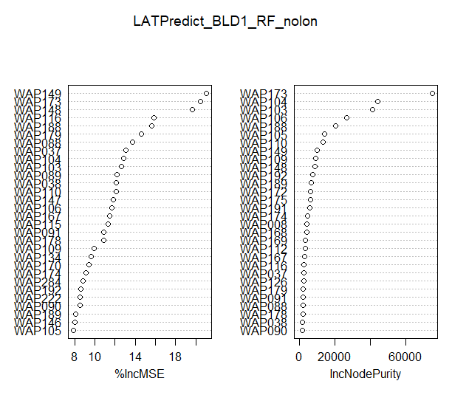
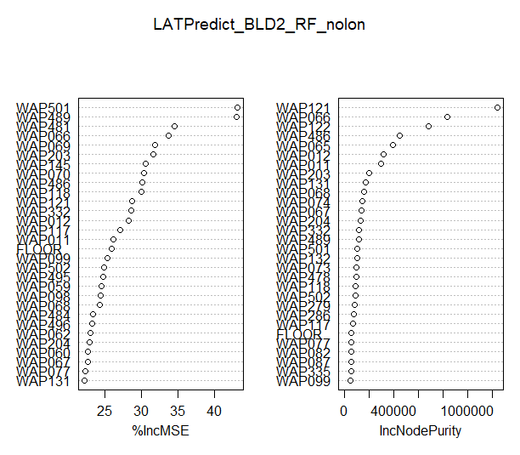
Variable importance – produced by Random Forest
Similar results of variable importance when predicting latitude with RF
Before
After

Slide 13
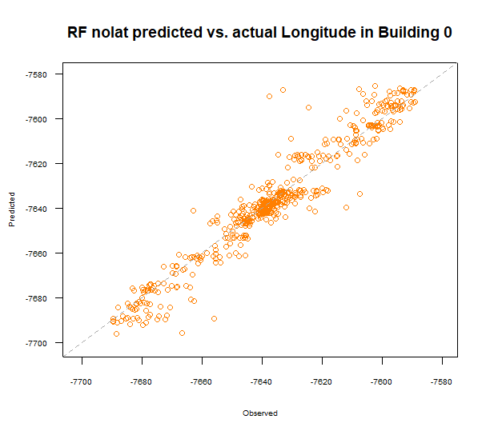
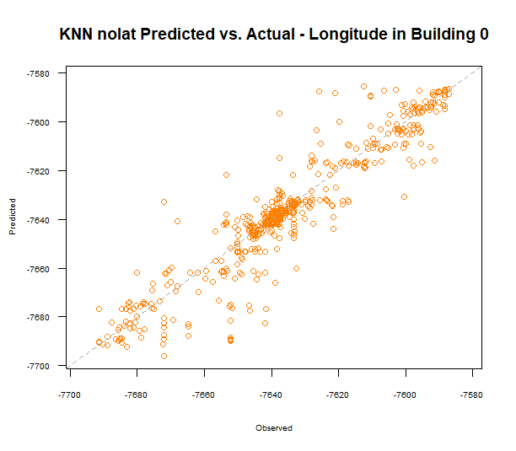
Predicting longitude – BLD 0
Legend
Building 0
Building 1
Building 2
Random Forest
RMSE | R-squared | MAE
7.1021124 | 0.9282857 | 4.6139655
k-NN
RMSE | R-squared | MAE
9.467573 | 0.871257 | 5.775361

Slide 14
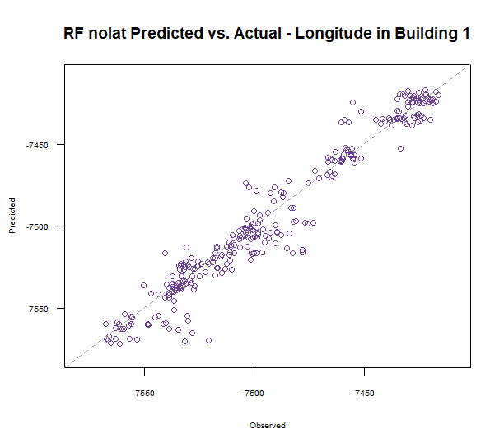
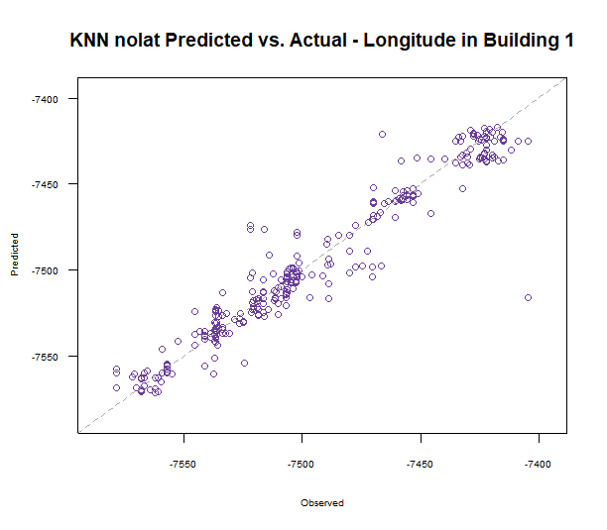
Predicting longitude – BLD 1
Random Forest
RMSE | R-squared | MAE
10.7463464 | 0.9479903 | 7.3630844
k-NN
RMSE | R-squared | MAE
12.2778283 | 0.9335014 | 7.4424852

Slide 15
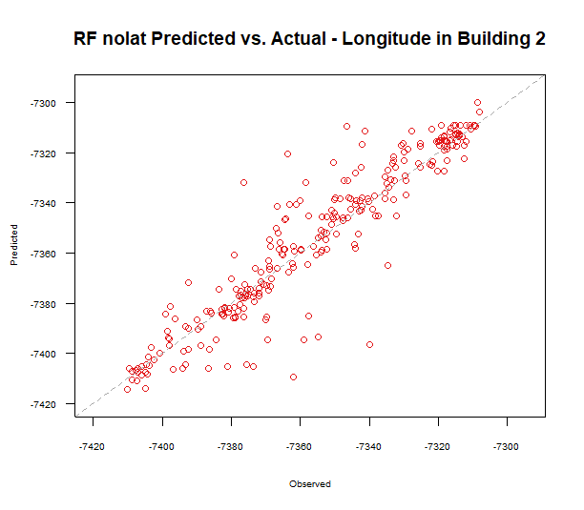
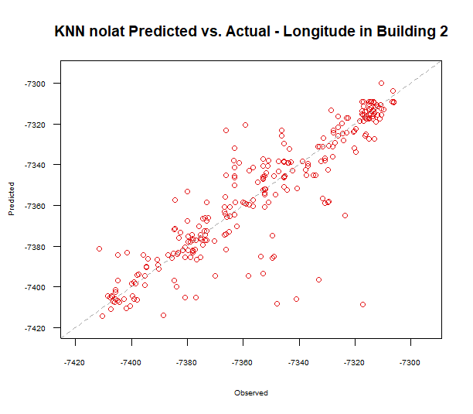
Predicting longitude - BLD 2
Random Forest
RMSE | R-squared | MAE
11.3796597 | 0.8709871 | 7.1960577
k-NN
RMSE | R-squared | MAE
14.3005508 | 0.7976781 | 8.3648688

Slide 16
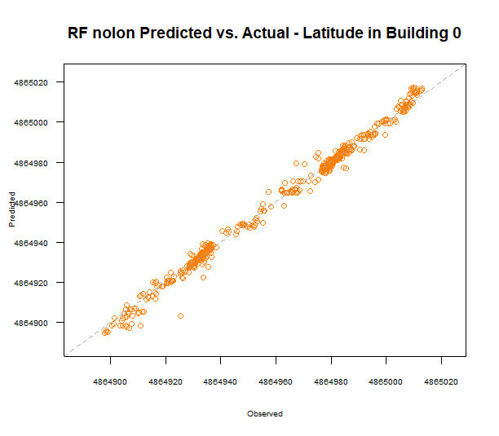
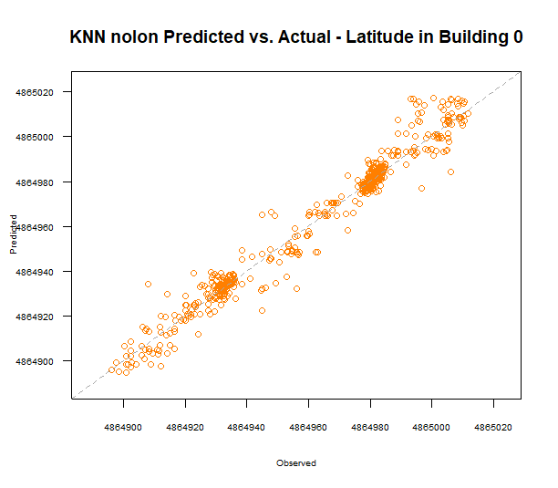
Predicting latitude – BLD 0
Random Forest
RMSE | R-squared | MAE
2.7879531 | 0.9928656 | 1.8295444
k-NN
RMSE | R-squared | MAE
5.7766551 | 0.9676765 | 3.8599257

Slide 17
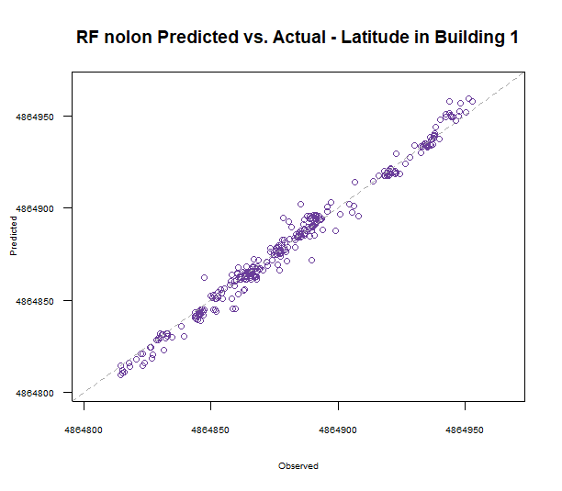
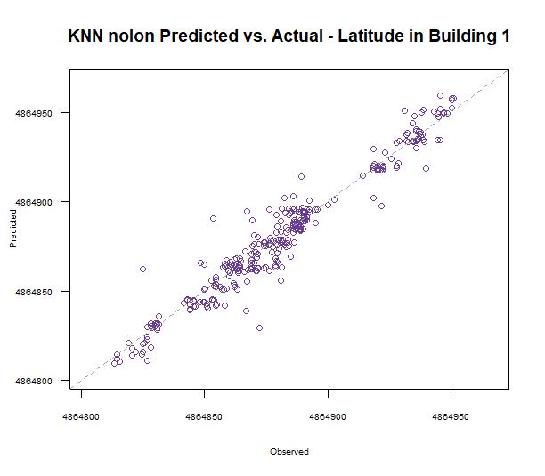
Predicting latitude BLD 1
Random Forest
RMSE | R-squared | MAE
4.3502805 | 0.9861122 | 3.0708664
Random Forest
RMSE | R-squared | MAE
8.3810700 | 0.9435328 | 5.7132799

Slide 18
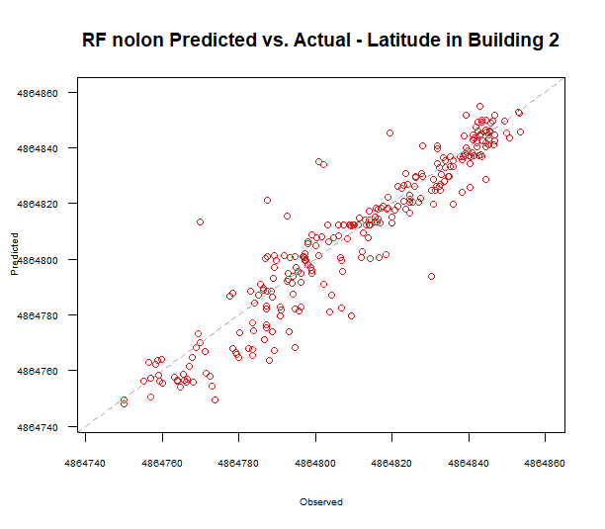
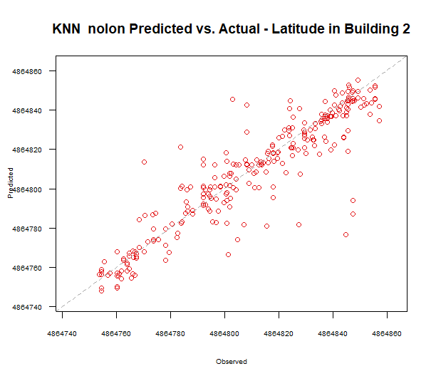
Predicting latitude – BLD 2
Random Forest
RMSE | R-squared | MAE
9.475073 | 0.893413 | 6.497230
Random Forest
RMSE | R-squared | MAE
12.2914682 | 0.8292684 | 7.6542600

Slide 19
Recommendations
Recommendations for improving results
Specific errors to fix: e.g. floor prediction in Building 1
Latitude and longitude prediction for Building 2: BLD 2’s data are disproportionate – more than 9000 observations in training dataset, but only around 200 in validation dt
the algorithm to be best for this data: Random Forest
Accuracy, errors
less false prediction in floor numbers
latitude and longitude “combined” MAEs:
running time:
KNN was in general faster – when RF models took on average 30mins above to run each one, KNN needed 15-30 mins to run.
some specific models were super faster and only took a few seconds to get results.
However, mtry were around 160 and 200 when predicting latitude and longitude with Random Forest regression, which could lead to model overfit – this should be investigated when time allows.
Data subset by… | Combined MAE of RF (meters) | Combined MAE of KNN (meters)
BLD0 | 1.70 | 3.21
BLD1 | 2.83 | 4.53
BLD2 | 4.82 | 5.65

Slide 20
Learning experience to share
Given that this project is part of the learning process, results and processes are not perfect due to time and resources limitation
Consideration/further research and learning
Omitted variables – how can these variables impact the prediction when included: SPACEID, Relative position, User ID, etc.
Investigating the potential over-fit of Random Forest algorithm
Running time
Certain problem: e.g. why the errors of floor prediction is high in Building 1
It is a process of running and readjustiung – e.g. removing latitude, decision of how to subset data, etc.

Slide 21
Thank you!

