Slide 1
Minjun Cho
Squarepoint Data Analysis

Slide 2
Analysis approach
First look
Holdout split
EDA
Variable selection
Transform, outliers, interactions
Models + comparison
Holdout test
rows, columns, types
kept aside, opened once
plots, missing values
forward / backward, AIC / BIC
y and x transforms, outlier rows, pairs
cross validation on unseen rows
final check, once
Every choice is made on the development part only. The holdout is opened once, at the end.

Slide 3
Data overview
Merged data into one data : Stock_days + market(key = “date”) + tickers(key = “ticker”)
Samples: 5805 rows, 27 columns
Target: realized_vol(numeric)
Numeric (9): premarket_vol_k, ret_prev, market_cap_bn, etc…
Categorical (14): logo_color, sector, cap_class, etc…
Date (2): date(from 2023-03-01 to 2024-05-08),
listed_date(from 1995-11-22 to 2020-04-23)
ID (1): row_id

Slide 4
Holdout split: time series
development: first 80% of the days
holdout: last 20%
time
Split by time: the last 20% of the days are the holdout (a day is never cut in two)
No shuffling: the future must not leak into the past
development: 2023-03-01 to 2024-02-13, 4640 rows
holdout: 2024-02-14 to 2024-05-08, 1165rows
The holdout is not used until the final test
Notes:
Keep only ONE of the two holdout-split slides (time series / not time series) and delete the other.

Slide 5
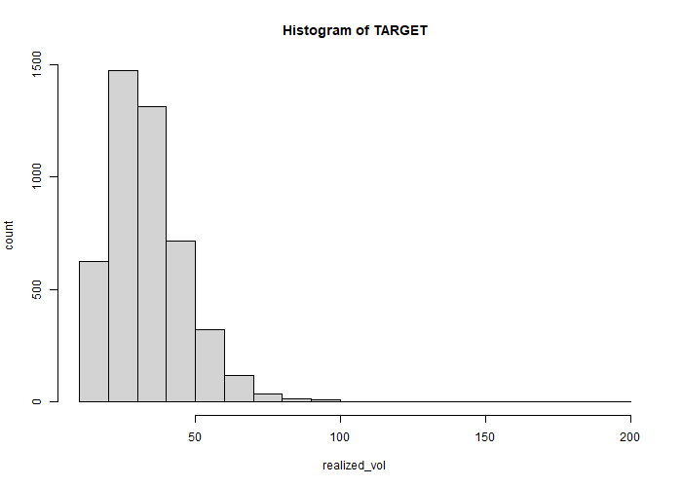
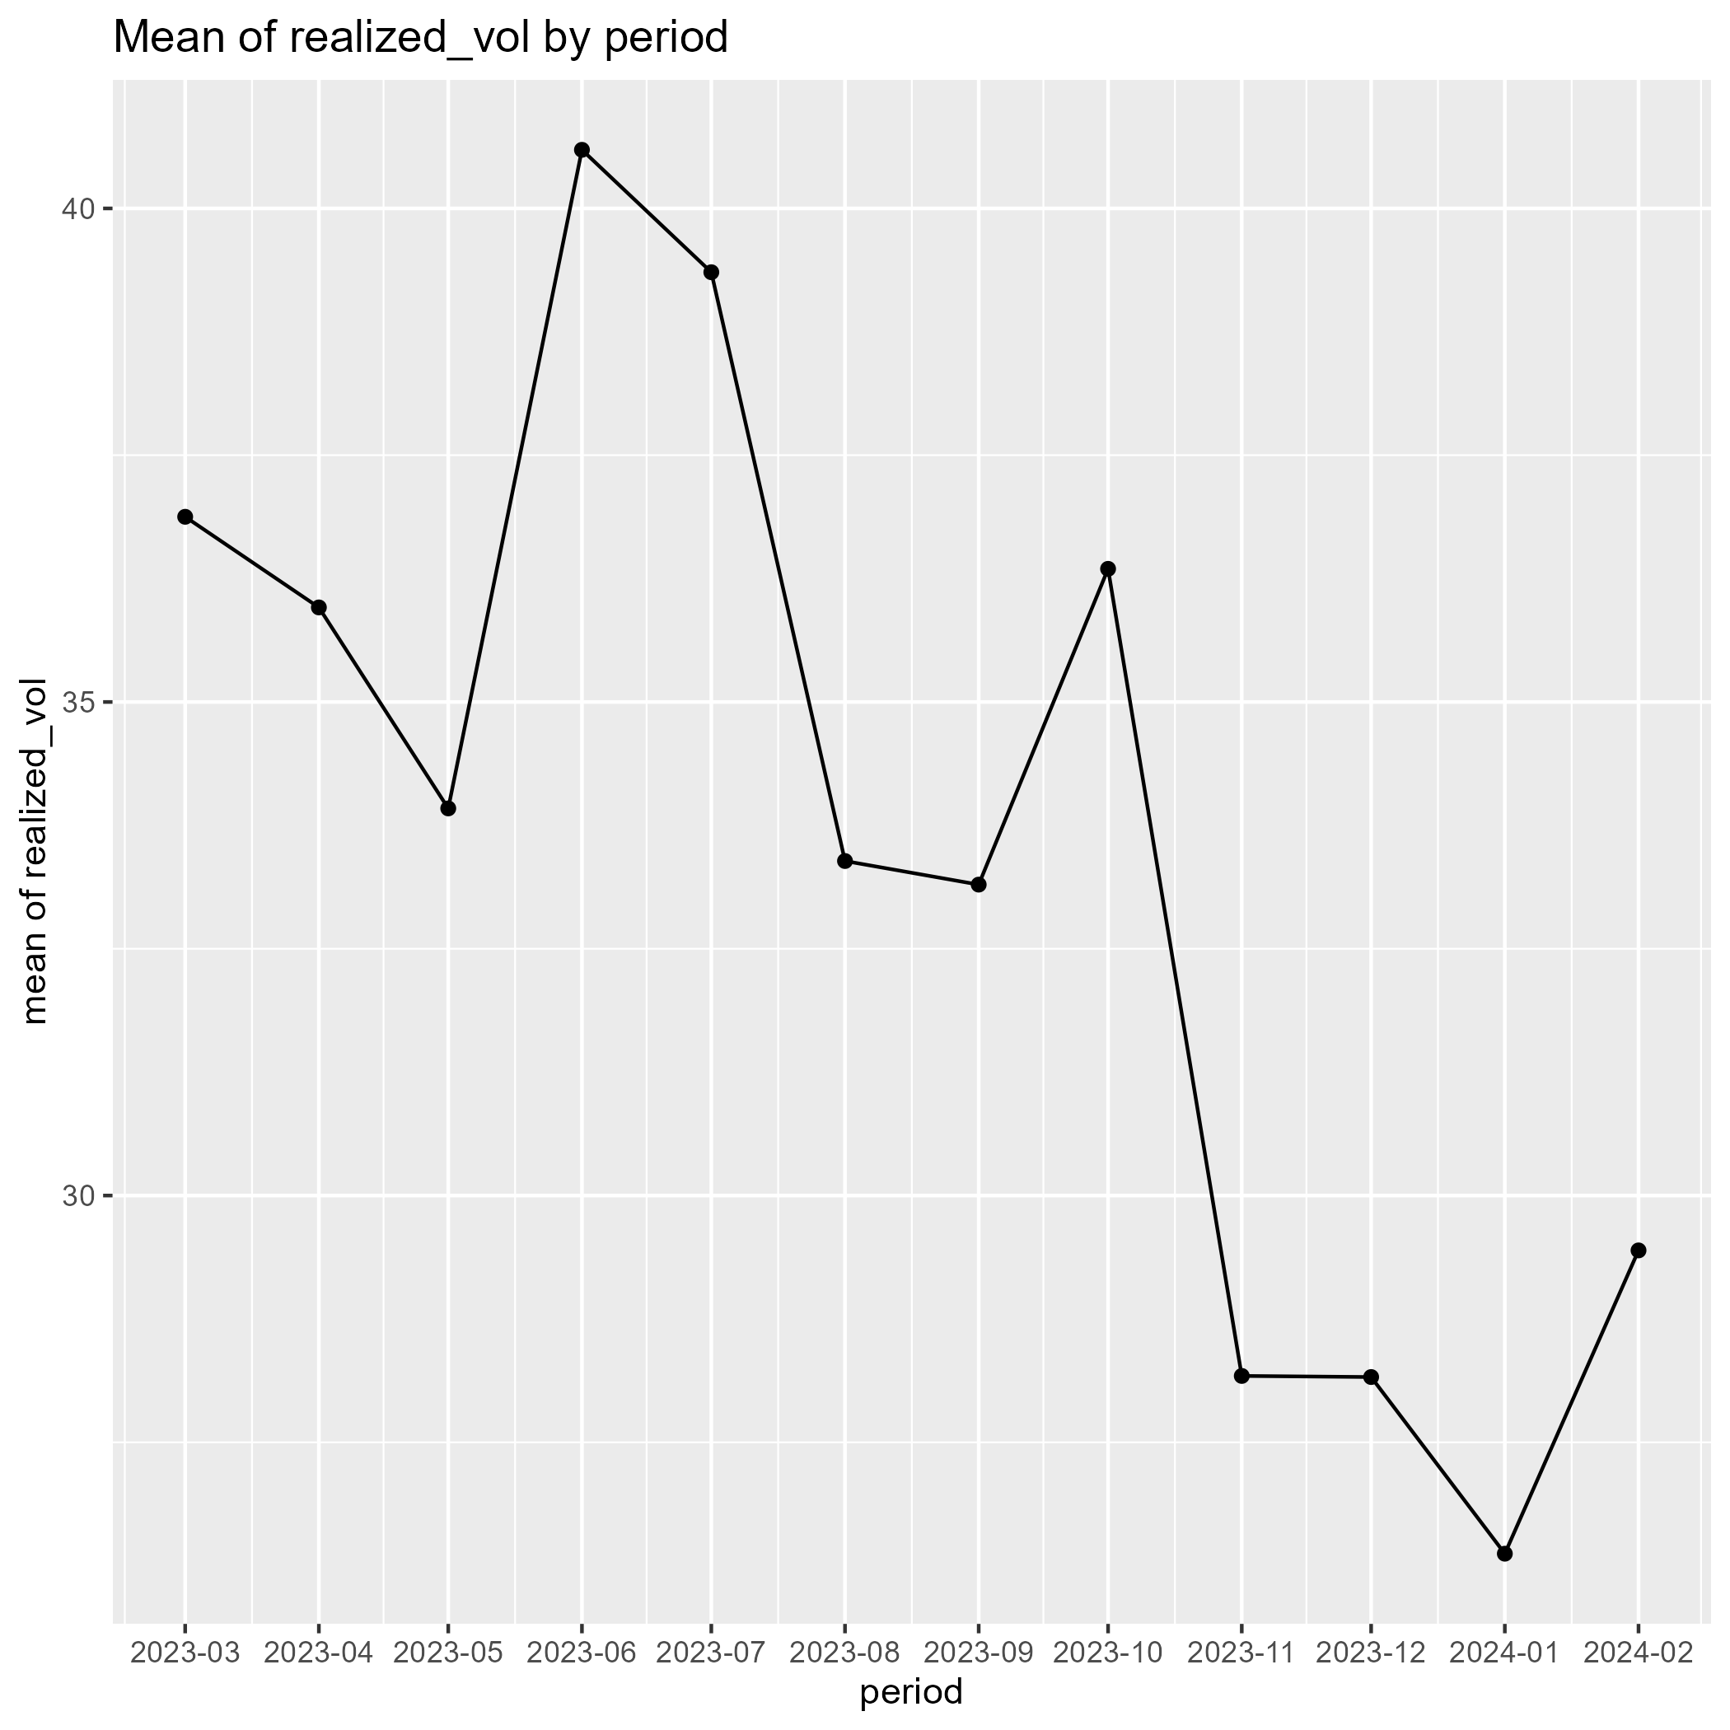
EDA: the target
Histogram of Target
Mean of the target y month
Basic Statistics: mean: 33.72, median: 31.39, min = 10.46, max = 192.6, sd = 13.89
Distribution: positive, right-skewed,
Over time: Decreasing over time
So what: a log transform may help

Slide 6
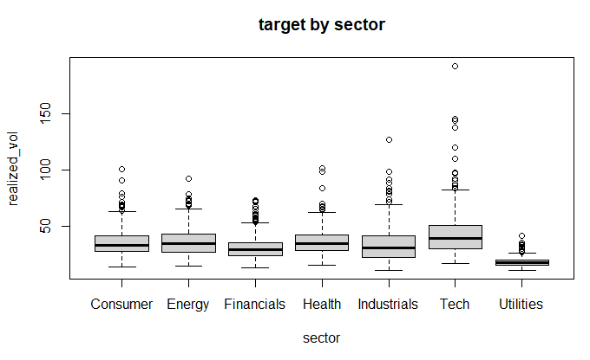
EDA: predictors vs target
Observations in the utilities sector tend to have lower target values overall.

Slide 7
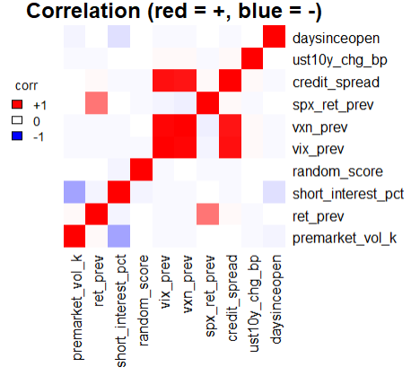
EDA: relationships between predictors
Strongly correlated:
(credit_spread, vxn_prev, vix_prev) have strong positive correlations.
corr(credit_spread, vxn_prev) = 0.91
corr(credit_spread, vix_prev) = 0.94
corr(vix_prev, vxn_prev) = 0.98
So what:
Our goal : make a model with good performance -> keep as long as model performs well

Slide 8
EDA: relationships between predictors
`Sector` and `Sector_code`
  We can expect that `Sector` and `Sector_cde` have the same information.
  But `Sector_code` does not have the missing value, while ‘Sector’ does.
  So I will remove the variable `Sector`.
Sector` and `Sector_code`

Slide 9
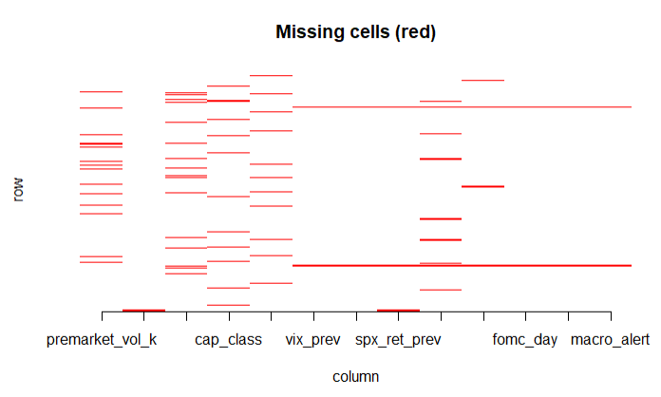
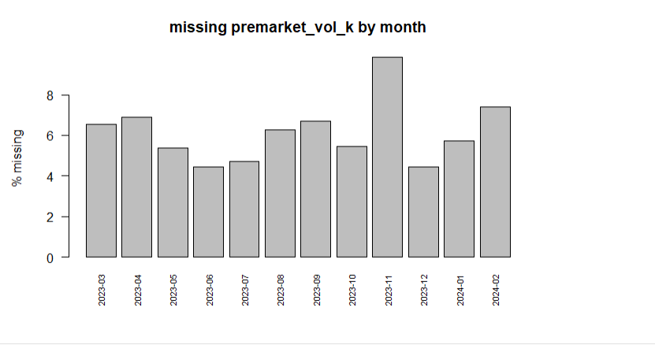
EDA: missing values
Insert plot here
(missing pattern)
Which columns (how much % is missing):
premarket_vol_k(6.1%), short_interest_pct(5.4%), cap_class(5.1%), pe_ratio(5.0%), …
Pattern: `vix_prev` is missing iff `vxn_prev` is missing
1127 rows with missing values, 3513 rows without missing values
There are few rows that a lot of variables are missing

Slide 10
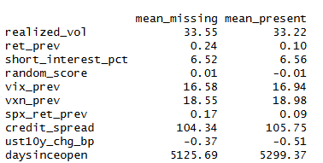
EDA: what does the missingness mean?
Mean of Numerical variables when `premarket_vol_k` is missing/ present
Doesn’t show big difference
-> Missing may not have special meaning
How to deal with missing values:
-> look back 60 days.
Numerical : impute with mean of past 60 days.
Categorical : impute with the frequest values.

Slide 11
Variable selection: AIC and BIC
AIC
AIC = 2k − 2 ln(L)
Pros: Light penalty: keeps more variables, good for prediction
Cons: Can keep noise variables (overfit)
BIC
BIC = k ln(n) − 2 ln(L)
Pros: Heavier penalty (grows with n): a simpler model that is easy to explain
Cons: May drop weak but useful variables (underfit)
k = number of parameters, n = number of rows, L = the maximized likelihood. Smaller is better. When n ≥ 8, BIC charges more for every variable than AIC.
Forward: start with no variable and add the one that helps most. Backward: start with all variables and drop the one that hurts least. Fitted on the lm of the target.

Slide 12
Variable selection: result
Method/ Used Measure | Number of Variables | AIC | BIC | R^2_adjusted
forward_AIC | 10 | 33296.9 | 33516.0 | 0.6015
forward_BIC | 8 | 33317.3 | 33504.2 | 0.5993
backward_AIC | 10 | 33296.9 | 33516.0 | 0.6015
backward_BIC | 8 | 33317.3 | 33504.2 | 0.5993
full | 24 | 33309.4 | 33599.3 | 0.6013
Used forward_AIC since AIC is better than BIC when our goal is prediction.
Selected: realized_vol ~ market_cap_bn + vix_prev + earnings_day + premarket_vol_k +
news_flag + fomc_day + macro_alert + weekday + opex_day + credit_spread

Slide 13
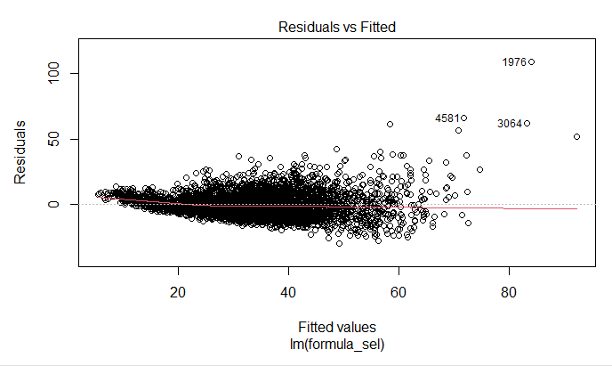
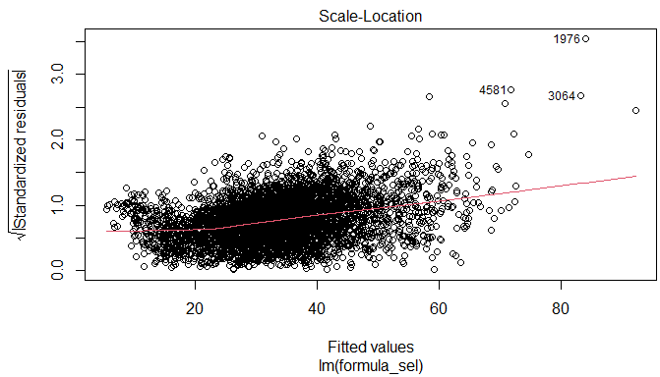
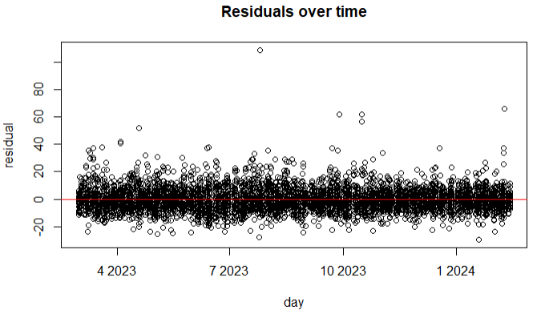
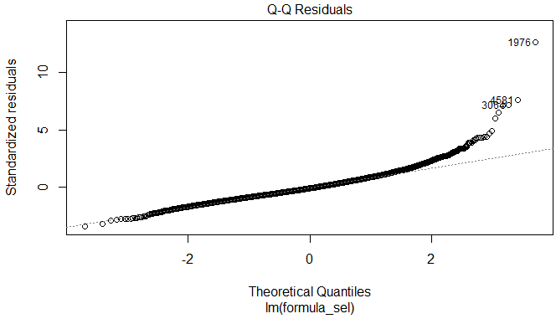
Assumptions check
Top-left : residual vs fitted
Top-right : root(residual) vs fitted
Bottom-left : qqplot
Bottom right: residual vs time
Target variable is right-skewed -> log transformation may be helpful
Variance of residuals increases as fitted value increase
-> generalized linear model : Poisson (variance ∝ mean), Gamma (variance ∝ mean^2)

Slide 14
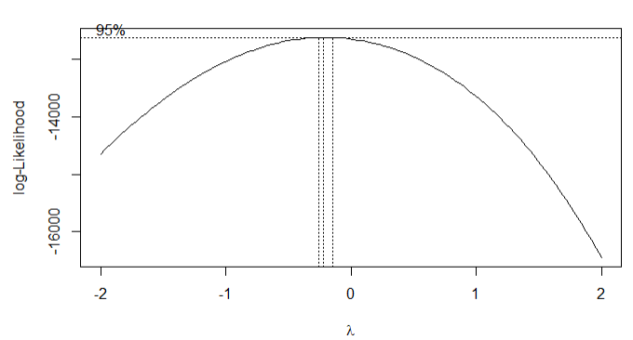
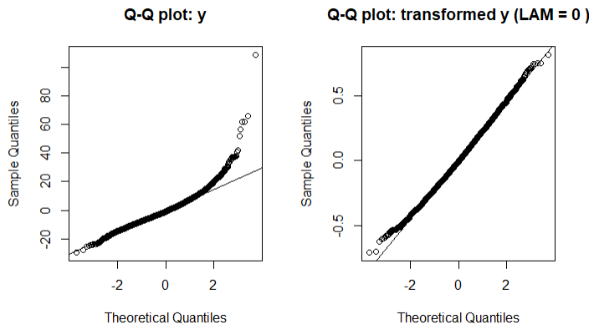
Box-Cox Transformations
Target (Box-Cox): lambda hat = -0.22, so use log(TARGET) (lambda = 0)
Predictors: "I(log(premarket_vol_k))" "I(vix_prev^2)"

Slide 15
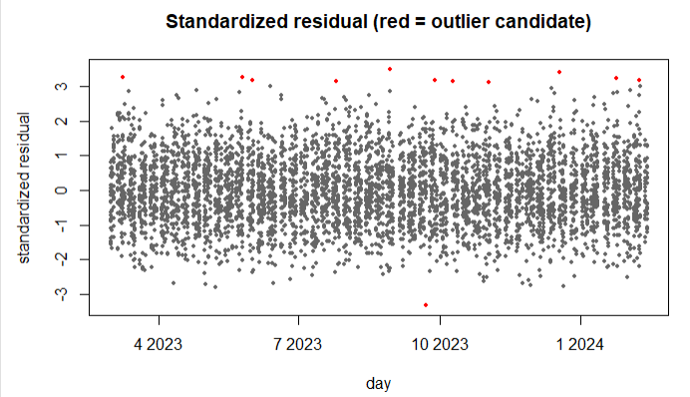
Outliers: how we handled them
Candidates: rows with |standardized residual| > [3] (red dots)
Looked at: the candidate rows, and how their other columns differ from the normal rows
Keep this outlier: seems like genuine outlier

Slide 16
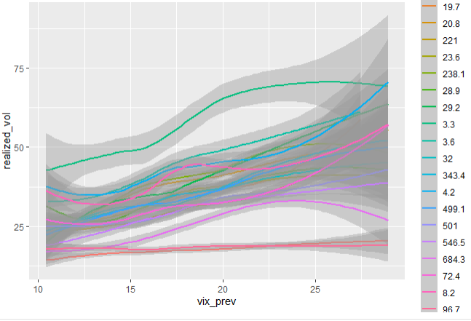
Interactions
Tested: vix_prev : market_cap_bn
(F-test in the lm)
Kept: vix_prev : market_cap_bn
(p-value 0)
Why it makes sense:
  Model performs better with this interaction term.
  The plot on the left show the different slopes for different market_cap_bn level.

Slide 17
Candidate models
baseline: the mean of the training y (the number to beat)
lm: ordinary least squares, on the transformed y
lasso, ridge: lm with shrunk coefficients (lasso can drop variables)
glm: Gamma family, log link, on the original y
mixed, glmm: lm / glm plus a random intercept per group
All candidates use the same variables, transformations and interactions.

Slide 18
Measures (1/2): RMSE and MAE
RMSE
RMSE = √( (1/n) Σ e² )
Pros: Same unit as y; punishes big errors; the standard score
Cons: Sensitive to outliers: a few big errors can dominate
MAE
MAE = (1/n) Σ |e|
Pros: Same unit as y; the average miss, easy to explain; robust to outliers
Cons: A big miss counts like several small ones
e = prediction − actual, n = number of rows. All scores are computed on the validation rows, in the original units of y.
Main score for choosing the model: RMSE.

Slide 19
Measures (2/2): MAPE, R² and Bias
MAPE
MAPE = (100/n) Σ |e| / |y|
Pros: In percent: comparable across scales
Cons: Explodes when y is near 0 (rows with y = 0 are left out)
R²
R² = 1 − Σ e² / Σ (y − mean y)²
Pros: No unit: 1 is perfect, 0 is as good as the mean
Cons: Can be negative on new data; hides the size of the error
Bias
Bias = (1/n) Σ e
Pros: Shows if the model predicts too high or too low
Cons: Errors cancel out: Bias near 0 can hide big errors
e = prediction − actual, n = number of rows, y = actual.

Slide 20
Cross validation: moving window (time series)
train: last [60] days
test
block 1
train: last [60] days
test
block 2
train: last [60] days
test
block 3
...
time
Train on the last [60] days, predict the next [7] days, then move the window forward by [7] days
A model only sees days before the days it predicts: no leakage
All the test predictions are collected and scored together (RMSE)
Every candidate uses the same blocks, so the scores can be compared
Notes:
Keep only ONE of the two cross-validation slides (moving window for time series, K-fold otherwise) and delete the other.

Slide 21
Cross validation: K-fold (not time series)
test
train
train
train
train
round 1
train
test
train
train
train
round 2
train
train
test
train
train
round 3
...
The rows are split at random into [5] folds (fixed seed)
Every fold is predicted by a model trained on the other folds
All the test predictions are collected and scored together (RMSE)
Used when there is no time column: random rows can be exchanged

Slide 22
Model comparison
Insert plot here
(score table, RMSE bar chart)
Score: RMSE (main); MAE, MAPE, R² and Bias are also shown
Best candidate: [model], RMSE [value]
Baseline: RMSE [value]: the number to beat
Others: [what we see, e.g. lasso is close to lm]
 | RMSE | MAE | MAPE | R2 | Bias
Glmm
Glm
Lasso
Lm
Mixed
Ridge
baseline

Slide 23
Combinations of steps: ideal vs this analysis
Ideal
This analysis
Try many combinations of the steps: variable selection (forward / backward, AIC / BIC), transformations, outlier handling, interactions, models
Compare all the combinations with cross validation
Keep the best combination
Limited time: every step was run once, in the order of the previous slides
The candidate models share the same variables, transformations and interactions
Only the candidates are compared, with cross validation; the best one is the final model

Slide 24
Final model
Insert plot here
(coefficient table or actual vs predicted)
Model: Gamma model
Variables: [selected] + [transformations] + [interactions]
Why: smallest cross-validated RMSE among the candidates
Cross validation: RMSE [value] vs baseline [value]

Slide 25
Final test on the holdout
Insert plot here
(holdout score table)
Insert plot here
(actual vs predicted)
Result: [model] RMSE [value] on the holdout
Compared with cross validation: [similar / worse] because [reason]

Slide 26
Conclusion
Findings
Limitations
Next steps
[main finding 1]
[main finding 2]
[limitation 1]
[limitation 2]
[next step 1]
[next step 2]

