Slide 1
Minjun Cho
Squarepoint Data Analysis

Slide 2
Analysis approach
First look
Holdout split
EDA
Variable selection
Transform, outliers, interactions
Models + comparison
Holdout test
rows, columns, types
kept aside, opened once
plots, missing values
forward / backward, AIC / BIC
y and x transforms, outlier rows, pairs
cross validation on unseen rows
final check, once
Every choice is made on the development part only. The holdout is opened once, at the end.

Slide 3
Data overview
Data: three tables merged into one: stock_days + market (key = date) + tickers (key = ticker)
Size: 5,805 rows, 27 columns
Target: realized_vol (numeric), so this is a regression problem
Numeric (9): premarket_vol_k, ret_prev, market_cap_bn, etc.
Categorical (14): logo_color, sector, cap_class, etc.
Date (2): date (2023-03-01 to 2024-05-08), listed_date (1995-11-22 to 2020-04-23)
ID (1): row_id

Slide 4
Holdout split: time series
development: first 80% of the days
holdout: last 20%
time
Split by time: the last 20% of the days are the holdout (a day is never cut in two)
No shuffling: the future must not leak into the past
development: 2023-03-01 to 2024-02-13, 4,640 rows
holdout: 2024-02-14 to 2024-05-08, 1,165 rows
The holdout is not used until the final test

Slide 5
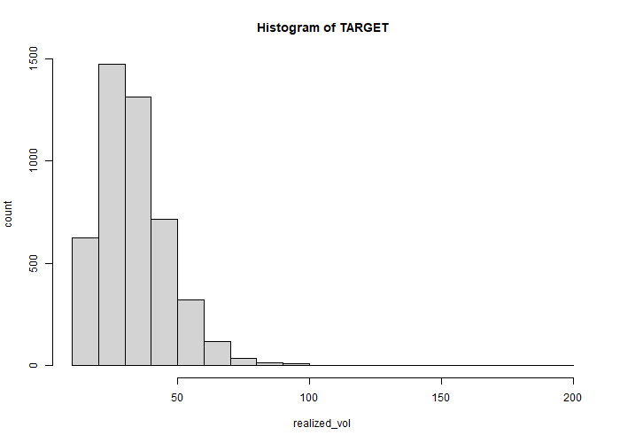
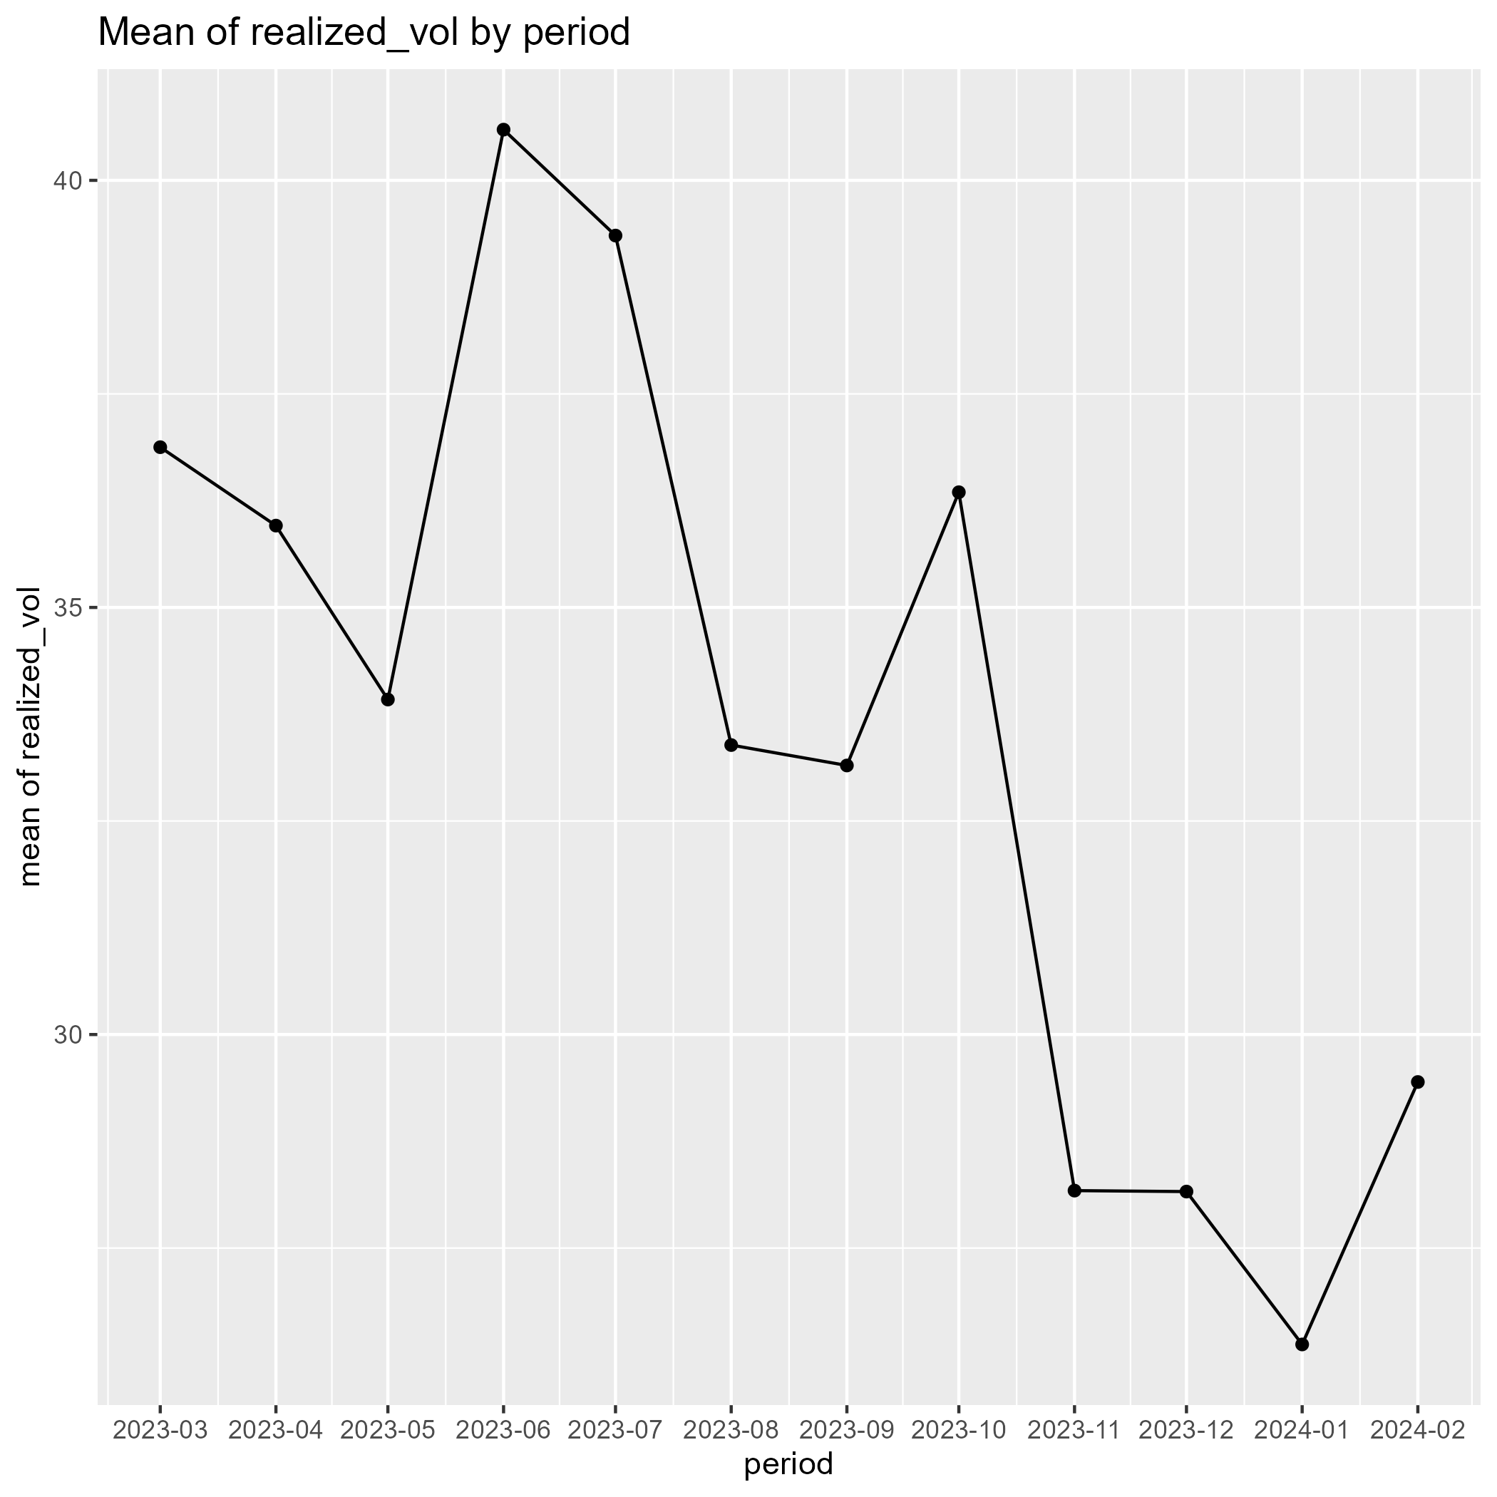
EDA: the target
Left: histogram of realized_vol (x = value, y = number of rows)
Right: monthly mean of realized_vol (x = month, y = mean)
Basic statistics: mean 33.72 > median 31.39, min 10.46, max 192.6, sd 13.89 → positive, right-skewed
Over time: the monthly mean decreases (about 37 in 2023-03 to about 29 in 2024-02)
So what: a log transform may help

Slide 6
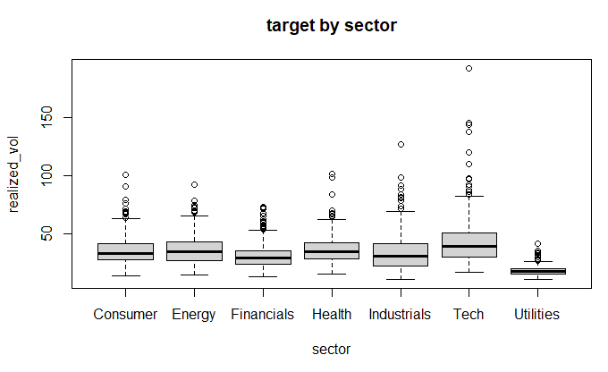
EDA: predictors vs target
Left: boxplot of realized_vol by sector (x = sector, y = realized_vol)
Utilities has clearly the lowest values overall
Tech has the highest median and the widest spread (the largest values, up to about 190)
Other sectors look similar to each other
So what: the type of the stock matters, so keep the sector information (as sector_code)

Slide 7
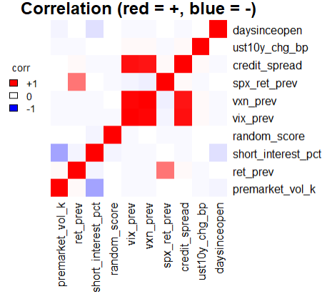
EDA: relationships between predictors
Left: correlation matrix of the numeric variables (red = positive, blue = negative, white = about 0)
Strongly correlated: credit_spread, vxn_prev, vix_prev (strong positive correlations)
corr(credit_spread, vxn_prev) = 0.91
corr(credit_spread, vix_prev) = 0.94
corr(vix_prev, vxn_prev) = 0.98
So what: our goal is a model with good performance, so keep them as long as the model performs well

Slide 8
EDA: sector and sector_code
Compared: sector and sector_code. We can expect the same information (the code is just a number for each sector)
But: sector_code has no missing values, while sector has ("unknown")
Decision: remove sector and keep sector_code
sector_code is treated as a categorical variable: the number is only a label

Slide 9
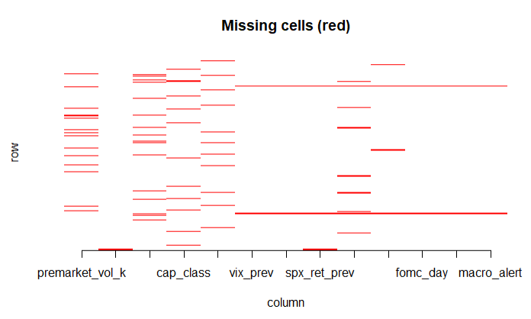
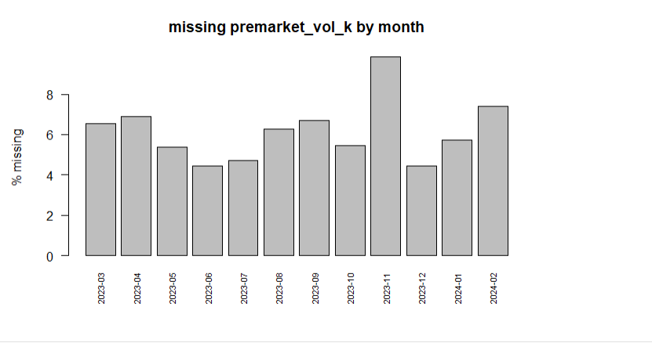
EDA: missing values
Left: missing cells (red) of each column; a long horizontal line is a row where many variables are missing together
Right: % of rows with premarket_vol_k missing, by month (about 4% to 10%, no clear trend)
Missing by column: premarket_vol_k (6.1%), short_interest_pct (5.4%), cap_class (5.1%), pe_ratio (5.0%), ...
Pattern: vix_prev is missing if and only if vxn_prev is missing
Rows: 1,127 rows with missing values, 3,513 rows without; a few rows have many variables missing

Slide 10
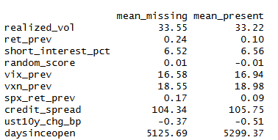
EDA: what does the missingness mean?
Left: mean of each numeric variable when premarket_vol_k is missing vs present
No big difference (e.g., realized_vol: 33.55 vs 33.22), so the missing values may not have a special meaning
How to fill the missing values: look back 60 days
numeric: mean of the past 60 days
categorical: most frequent value

Slide 11
Variable selection: AIC and BIC
Used linear regression (lm of the target)
Forward selection: start with no variable and add the one that helps most. Backward selection: start with all variables and drop the one that hurts least
What is “help”? Two criteria: AIC and BIC
AIC
AIC = 2k − 2 ln(L)
Pros: Light penalty: keeps more variables, good for prediction
Cons: Can keep noise variables (overfit)
BIC
BIC = k ln(n) − 2 ln(L)
Pros: Heavier penalty (grows with n): a simpler model that is easy to explain
Cons: May drop weak but useful variables (underfit)
k = number of parameters, n = number of rows, L = the maximized likelihood. Smaller is better. When n ≥ 8, BIC charges more for every variable than AIC.

Slide 12
Variable selection: result
Method / measure | Variables | AIC | BIC | Adj. R²
forward_AIC | 10 | 33296.9 | 33516.0 | 0.6015
forward_BIC | 8 | 33317.3 | 33504.2 | 0.5993
backward_AIC | 10 | 33296.9 | 33516.0 | 0.6015
backward_BIC | 8 | 33317.3 | 33504.2 | 0.5993
full | 24 | 33309.4 | 33599.3 | 0.6013
Used forward_AIC since AIC is better than BIC when our goal is prediction.
Selected: realized_vol ~ market_cap_bn + vix_prev + earnings_day + premarket_vol_k +
news_flag + fomc_day + macro_alert + weekday + opex_day + credit_spread

Slide 13
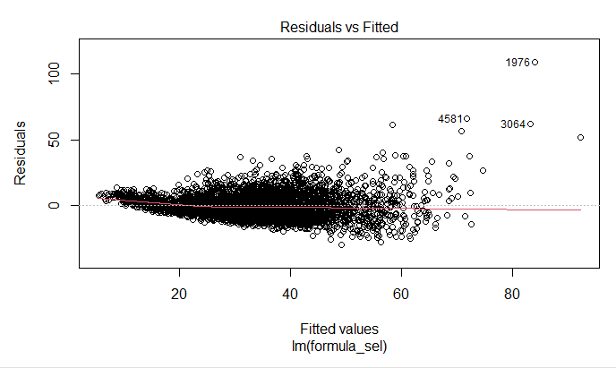
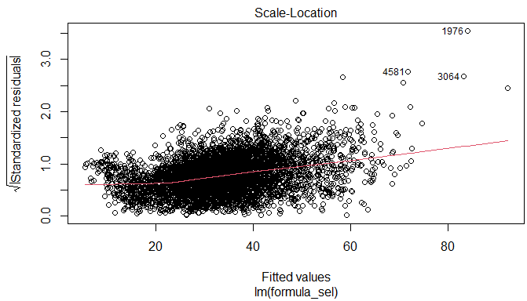
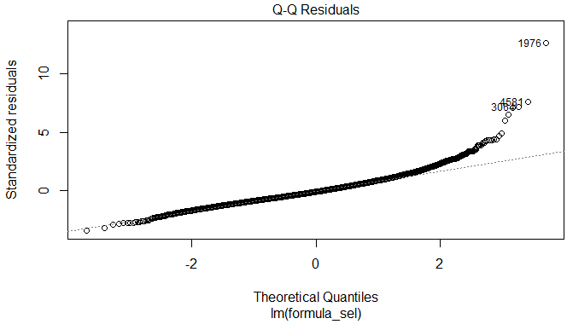
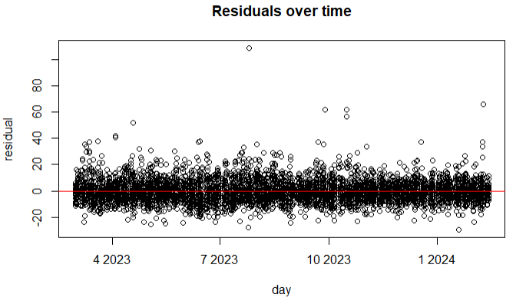
Assumptions check
Top-left: residual vs fitted → the spread gets wider as the fitted value increases
Top-right: root(standardized residual) vs fitted → the trend goes up (variance is not constant)
Bottom-left: Q-Q plot → the upper tail leaves the line (right-skewed)
Bottom-right: residual vs time → no clear trend, a few spikes
Target is right-skewed → a log transformation may be helpful
Variance of residuals increases as the fitted value increases → generalized linear model:
Poisson (variance ∝ mean), Gamma (variance ∝ mean²)

Slide 14
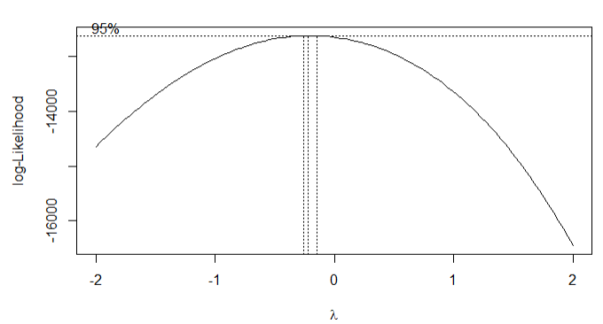
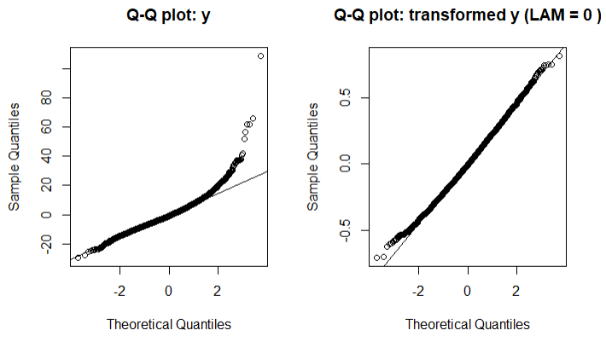
Box-Cox Transformations
Box-Cox formula: y(λ) = (y^λ − 1) / λ for λ ≠ 0, y(λ) = log(y) for λ = 0 (y must be positive; λ is chosen to maximize the log-likelihood of the lm)
Left: Box-Cox log-likelihood by lambda (dotted lines: 95% interval) → lambda hat = -0.22
Right: Q-Q plots of y (left one) and of log(y) (right one) → after the log, the points are much closer to the line
Target (Box-Cox): lambda hat = -0.22, the nearest simple value is 0, so use log(TARGET)
Predictors: log(premarket_vol_k) and vix_prev²

Slide 15
Checkpoint: the model so far
Linear regression (lm) on the log-transformed target
log(realized_vol) ~ market_cap_bn + vix_prev + earnings_day + premarket_vol_k + news_flag + fomc_day + macro_alert + weekday + opex_day + credit_spread + log(premarket_vol_k) + vix_prev²
In symbols: log(TARGET) = β₀ + β₁X₁ + β₂X₂ + … + ε, where X₁ = market_cap_bn
Left: the model so far (10 selected variables + 2 transformed terms; no interaction yet)
Reading β₁ (the first variable, X₁ = market_cap_bn):
X₁ increases by 1 unit (1 billion dollars) → log(TARGET) increases by β̂₁ (other variables fixed)
that is, TARGET is multiplied by e^{β̂1}
Estimate: β̂₁ = [__], exp(β̂₁) = [__]

Slide 16
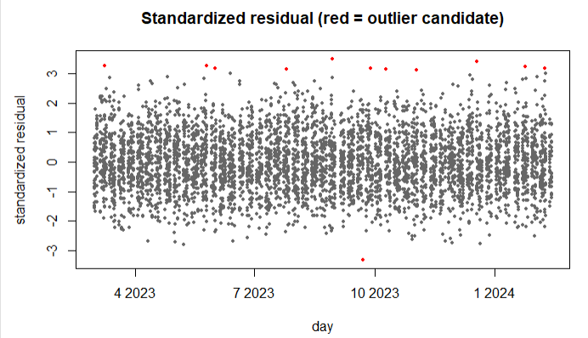
Outliers: how we handled them
Left: standardized residuals of the selected lm over time; red dots = outlier candidates
Candidates: rows with |standardized residual| > 3 (red dots): [n] rows, spread over the whole period (not one date)
Looked at: the candidate rows, and how their other columns differ from the normal rows: [what you found]
Decision: keep them; they look like genuine observations, not data errors
Also: MAE is shown next to RMSE, since RMSE reacts strongly to outliers

Slide 17
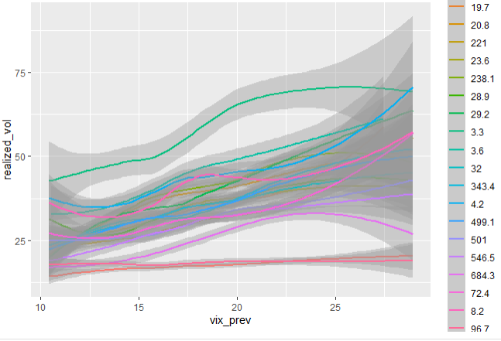
Interactions
Left: realized_vol vs vix_prev, one smoothed line per market_cap_bn value (each value is one stock)
Tested: vix_prev : market_cap_bn (F-test in the lm)
Kept: vix_prev : market_cap_bn (p-value < 0.0001)
Why it makes sense:
the model performs better with this interaction term
the slopes are different: some lines rise steeply with vix_prev, others are almost flat

Slide 18
Candidate models
baseline: the mean of the training y (the number to beat)
lm: ordinary least squares, on the transformed y
lasso, ridge: lm with shrunk coefficients (lasso can drop variables)
glm: Gamma family, log link, on the original y
mixed, glmm: lm / glm plus a random intercept per group
All candidates use the same variables, transformations and interactions.

Slide 19
Measures (1/2): RMSE and MAE
RMSE
RMSE = √( (1/n) Σ e² )
Pros: Same unit as y; punishes big errors; the standard score
Cons: Sensitive to outliers: a few big errors can dominate
MAE
MAE = (1/n) Σ |e|
Pros: Same unit as y; the average miss, easy to explain; robust to outliers
Cons: A big miss counts like several small ones
e = prediction − actual, n = number of rows. All scores are computed on the validation rows, in the original units of y.
Main score for choosing the model: RMSE.

Slide 20
Measures (2/2): MAPE, R² and Bias
MAPE
MAPE = (100/n) Σ |e| / |y|
Pros: In percent: comparable across scales
Cons: Explodes when y is near 0 (rows with y = 0 are left out)
R²
R² = 1 − Σ e² / Σ (y − mean y)²
Pros: No unit: 1 is perfect, 0 is as good as the mean
Cons: Can be negative on new data; hides the size of the error
Bias
Bias = (1/n) Σ e
Pros: Shows if the model predicts too high or too low
Cons: Errors cancel out: Bias near 0 can hide big errors
e = prediction − actual, n = number of rows, y = actual.

Slide 21
Cross validation: moving window (time series)
train: last 60 days
test
block 1
train: last 60 days
test
block 2
train: last 60 days
test
block 3
...
time
Train on the last 60 days, predict the next 7 days, then move the window forward by 7 days
A model only sees days before the days it predicts: no leakage
All the test predictions are collected and scored together (RMSE)
Every candidate uses the same blocks, so the scores can be compared

Slide 22
Model comparison
Model | RMSE | MAE | MAPE (%) | R² | Bias
baseline
lm
lasso
ridge
glm
mixed
glmm
Top-left: score table of the 7 models (cross validation, in the original units of y)
Bottom-left: bar chart of the RMSE (smaller is better)
Score: RMSE (main); MAE, MAPE, R² and Bias are also shown
Best candidate: [model], RMSE [value]
Baseline: RMSE [value]: the number to beat
Others: [what we see, e.g., lasso is close to lm]
RMSE bar chart of the models: paste here

Slide 23
Combinations of steps: ideal vs this analysis
Ideal
This analysis
Try many combinations of the steps: variable selection (forward / backward, AIC / BIC), transformations, outlier handling, interactions, models
Compare all the combinations with cross validation
Keep the best combination
Limited time: every step was run once, in the order of the previous slides
The candidate models share the same variables, transformations and interactions
Only the candidates are compared, with cross validation; the best one is the final model

Slide 24
Final model
Gamma GLM, log link (fitted on the original y)
realized_vol ~ Gamma(mean μ)
log(μ) = market_cap_bn + vix_prev + earnings_day + premarket_vol_k + news_flag + fomc_day + macro_alert + weekday + opex_day + credit_spread + log(premarket_vol_k) + vix_prev² + vix_prev × market_cap_bn
Left: model formula (Gamma GLM, log link)
Variables: 10 selected + 2 transformed terms + 1 interaction
Why Gamma:
the variance grows with the mean, as the residuals showed
y is positive and right-skewed; the log link keeps the predictions positive
the log link gives multiplicative effects, easy to interpret
[smallest cross-validated RMSE among the candidates, only if true]
Cross validation: RMSE [value] vs baseline [value]

Slide 25
Final model: interpreting a coefficient
Gamma GLM, log link
log(μ) = β₀ + β₁X₁ + β₂X₂ + …
μ = expected realized_vol, X₁ = market_cap_bn (the first variable)
Interaction in the model: vix_prev × market_cap_bn
Left: the final model in symbols
Reading β₁:
X₁ increases by 1 unit → log(expected TARGET) increases by β̂₁ (other variables fixed)
that is, the expected TARGET is multiplied by e^{β̂1}
Interaction: market_cap_bn is also in vix_prev × market_cap_bn, so the factor depends on vix_prev:
factor = exp(β̂₁ + β̂_int × vix_prev)
Example: at vix_prev = about 16.9 (its mean), the factor is [__]

Slide 26
Final test on the holdout
Holdout score table: paste here
Actual vs predicted: paste here
Left: holdout score table of the models (scores computed on the holdout)
Right: actual vs predicted of the final model on the holdout (points near the diagonal = good)
Result: Gamma model, RMSE [value] on the holdout (baseline [value], cross validation [value])
Compared with cross validation: [similar / worse] because [reason]

Slide 27
Conclusion
Findings
Limitations
Next steps
realized_vol is positive and right-skewed, and its variance grows with the level → Gamma GLM with log link
Drivers: market-wide conditions (vix_prev, credit_spread), stock size (market_cap_bn) and event days (earnings_day, fomc_day, opex_day); the effect of vix_prev depends on market_cap_bn
[Gamma model: RMSE __ vs baseline __ (cross validation), __ on the holdout]
Every step was run once, in a fixed order: not all combinations were compared
Short history and one holdout period (about 3 months): may not cover other market conditions
The window length (60 days) was not tuned; missing values are filled in a simple way
Try more flexible models (e.g., tree-based) for nonlinear patterns
Check whether the residuals are correlated over time; if so, add lagged features of the target
Tune the window length, try other combinations of the steps, and check the sensitivity to outliers

