Slide 1
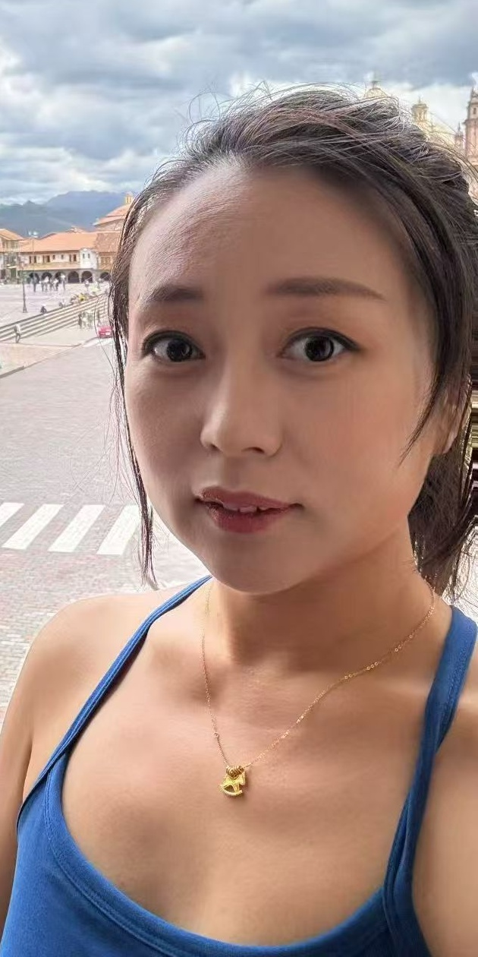
DTCS
Digital Twin for Chemical Science
Lean Transfer • Customer Discovery • Day 1
0
0
new interviews
total interviews
BUSINESS FOCUS
Who: Chemistry & materials R&D professionals—especially materials/design engineers, raw-material/application scientists, and scientists working with chemical reactions.
Product: DTCS connects computational chemistry, spectroscopy simulations, experimental data, and AI optimization to help interpret spectra and infer reaction mechanisms.
Why buy: Faster interpretation and mechanistic insight can reduce experimental iteration, lab time, and use of scarce characterization resources.
Minjun Zang
Customer discovery lead
BUSINESS VISUAL
Current hypothesis — to be validated through 5–10 customer interviews.
EXPERIMENT
→
DTCS
→
DECISION
Measured spectra
+ reaction data
Digital twin
+ AI inference
Mechanism
+ next experiment
DTCS • Lean Transfer • Customer Discovery
1/5

Slide 2
Expanded Business Focus
02
Three customer hypotheses to test first
01
Big Tech / Established R&D
02
Resource-Constrained Startups
03
Raw-Material Vendors
Materials & design engineers
Plastic • coatings • adhesives • other reaction-driven materials
Small chemistry/materials teams
Limited people, budget, and characterization capacity
Technical / application / R&D teams
Suppliers of specialty chemical or material inputs
Pain-point hypothesis
Pain-point hypothesis
Pain-point hypothesis
• Long experiment / characterization cycles
• Too few specialists to interpret every dataset
• Need evidence behind material performance
• High cost of lab time & instrumentation
• Expensive external characterization
• Customer-specific development can be slow
• Need stronger theory ↔ experiment feedback
• Need to move from data → decision faster
• Potential to differentiate with mechanistic insight
Interview goal: validate pain severity + workflow + willingness to pay.
Interview goal: validate pain severity + workflow + willingness to pay.
Interview goal: validate pain severity + workflow + willingness to pay.
Key discovery question
Who feels the pain most acutely—and who controls the budget to solve it?
DTCS • Lean Transfer • Customer Discovery
2/5

Slide 3
Skinny Business Model Canvas — Initial Hypothesis
03
Only the two blocks required for this first presentation
VALUE PROPOSITION
CUSTOMER SEGMENTS
Turn experimental spectra into
faster chemical understanding.
Established / Big Tech R&D
01
Materials & design engineers; chemistry-heavy workflows
• Connect computational chemistry with real-time experimental data
02
Resource-constrained startups
Small teams with limited people, budget, and characterization access
• Simulate / predict spectra and infer reaction mechanisms
• Use AI optimization to guide the next experiment
03
Raw-material vendors
Technical / application / R&D teams supporting material adoption
• Potential outcome: less trial-and-error and better use of characterization resources
Early-adopter hypothesis: teams with high experiment cost + limited interpretation bandwidth.
DTCS • Lean Transfer • Customer Discovery
3/5

Slide 4
Iteration Reflection
04
What We Thought → What We Did → What We Learned → What We'll Do Next
WHAT WE THOUGHT
WHAT WE DID
• Chemical characterization is slowed by weak real-time theory ↔ experiment feedback
• Users may value faster mechanism interpretation
• Pain may be strongest where experiments and characterization are expensive
• Discussed the product and market with the founder
• Narrowed potential customers to 3 segments
• Defined an initial interview strategy around roles that use chemistry reactions
WHAT WE LEARNED
WHAT WE'LL DO NEXT
• No customer interviews yet — these are hypotheses, not validated findings
• Likely value drivers: time, characterization cost, scarce expertise
• Segment-specific workflows may determine the strongest use case
• Conduct 5–10 interviews across the 3 segments
• Compare pain severity, current workflow, and alternatives
• Test willingness to pay / budget ownership
• Refine the target customer and first use case
Discovery principle
Do not sell DTCS in the interview—understand the customer's current process first.
DTCS • Lean Transfer • Customer Discovery
4/5

Slide 5
Customer Discovery Plan — Next 6 Interviews
05
Replace TBD fields with actual contacts before submission
Target
Role / profile
Company type
Contact
Why them?
01
Materials / Design Engineer
(polymer, coatings, adhesives)
Big Tech / established
Name: TBD
Email: TBD
Uses chemistry-driven materials; tests whether interpretation speed is a real bottleneck.
02
Raw-Materials / Formulation R&D
scientist
Big Tech / established
Name: TBD
Email: TBD
Can compare current characterization workflow and decision criteria.
03
Chemistry / Materials Scientist
Early-stage startup
Name: TBD
Email: TBD
Tests whether limited headcount creates a willingness-to-pay for automation.
04
Founder / CTO / Head of R&D
Early-stage startup
Name: TBD
Email: TBD
Can validate budget ownership and urgency of experimental iteration.
05
Technical / Application Engineer
Raw-material vendor
Name: TBD
Email: TBD
Tests whether mechanism + evidence could improve customer support or material adoption.
06
R&D / Product Development Scientist
Raw-material vendor
Name: TBD
Email: TBD
Explores vendor-side characterization needs and repeatable workflows.
JUSTIFICATION
Six interviews intentionally span the 3 segments (2 each) so I can compare pain severity, workflow, and willingness to pay before narrowing the ICP.
DTCS • Lean Transfer • Customer Discovery
5/5

