Slide 1

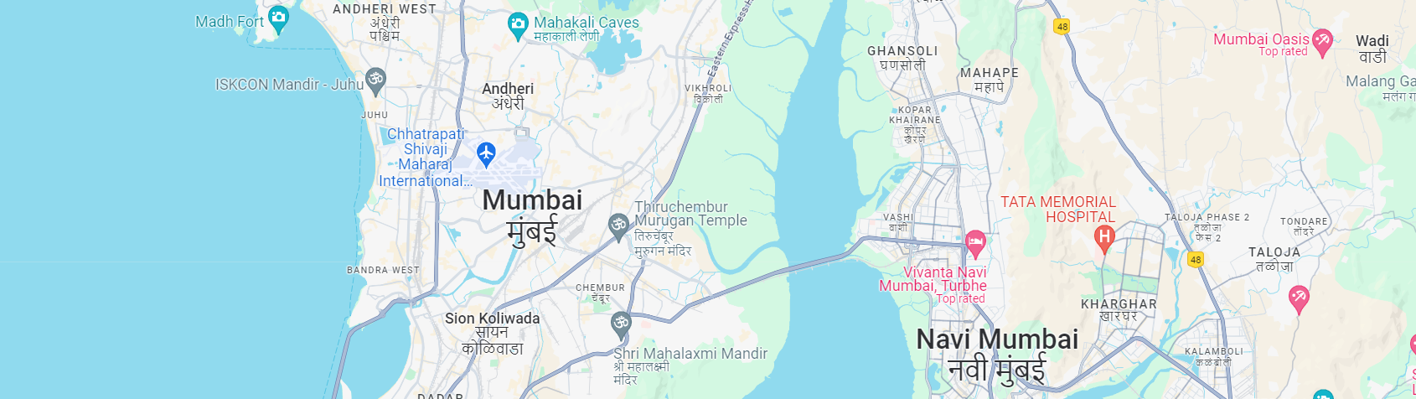
PREDICTING HOUSE RENT IN INDIA

Slide 2

01 PARTICIPANT IN THIS PROJECT
Khin Su Myat Moe
Phyu Phyu Khin
Tun Kyaw Maung
Su Su Oo
Aung Kaung Khant

Slide 3


02 DATA SET AND PROBLEM STATEMENT
PROBLEM STATEMENT
Kaggle
https://www.kaggle.com/datasets/iamsouravbanerjee/house-rent-prediction-dataset
The problem trying to solve is predicting rental prices for apartments in India.
We’re building a machine learning model than can learn from historical rental data and use that knowledge to predict rent prices for apartments.
This model can be used by renters to find apartments that fit their budget and by landlords to set competitive rental prices.
01
Data Set 2023
02
Data Type
Type
BHK – Numerical
Rent – Numerical
Size – Numerical
Area Type – Numerical (Extract Super & Carpet Area )
Bathroom – Numerical
City – Categorical
Point of Contact – Categorical
Floor – Categorical
House Rent Predicting Dataset with 4700+ Listings
Column To Use
BHK – Number of Bedrooms, Hall, Kitchen
Rent – Rent of the House
Size – Size of the House in Square Feet.
Area Type – Type of Area (Super , Carpet)
Bathroom – Number of Bathrooms

Slide 4
03 DATA PREPROCESSING
HANDLING MISSING VALUES
01
Removing rows with missing values
06
OUTLIER DETECTION
02
Check the outlier
FEATURE EXTRACTION
Extract the two features Super & Carpet Area from existing feature “Area type”
05
03
REMOVE THE WHITE SPACE
Remove the white space with python code
DATA STANDARDIZATION
Data standardization with sklearn.preprocessing using standardScaler
04
REMOVE THE DUPLICATE ROW
Remove the duplicate row with python code
drop_duplicates() function

Slide 5




04 FEATURE SELECTION
BHK
SIZE
SUPER AREA
BHK
SUPER AREA
SIZE
CARPET ARE
BATHROOM
CARPET AREA
BATHROOM

Slide 6






05 CROSS-VALIDATION AND MODEL TRAINING
Testing Size 30%
GridSearchCV
Using train_test_split function
Perform an automated hyperparameter tuning process.
StandardScaler, Polynomial, Linear regression
Cross-validation
Using sklearn library preprocessing
Leads to the best performance on the training set based on the chosen scoring metric (negative mean absolute error here).
Determine parameter and separate task with Pipeline
Fit
Using pipeline function for separate task
Using fit function to fit the data

Slide 7
06 FEATURE COMPARE WITH DEGREE
BHK AND BATHROOM
BHK AND SIZE
BHK AND SUPER AREA
BHK, SIZE AND CARPET AREA
SIZE AND SUPER AREA
BHK, SIZE AND SUPER AREA
SIZE AND BATHROOM
SIZE AND CARPET AREA
Degree
5
BHK, SIZE AND BATHROOM
BHK AND CARPET AREA
BHK, BATHROOM,SIZE, SUPER AND CARPET AREA
Degree
4
Degree
3
SUPER AREA AND
CARPET AREA
Degree
2
Degree
1

Slide 8
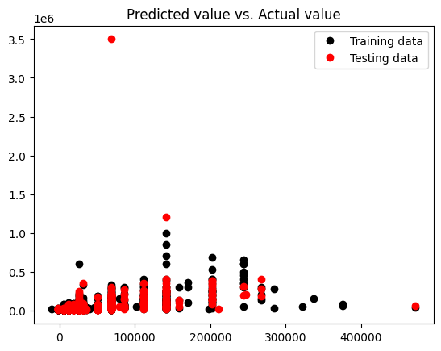
06 BEST DEGREE IN POLYNOMINAL (BHK, BATHROOM)

Slide 9
07 COMPARE FEATURES WITH R2 SCORE
SELECTED FEATURE | R2 SCORE Testing | R2 SCORE Training
BHK AND BATHROOM | 0.11632 | 0.51486
BHK AND SIZE | 0.11352 | 0.45298
BHK AND SUPER AREA | 0.12252 | 0.46222
BHK AND CARPET AREA | 0.12205 | 0.46225
SIZE AND BATHROOM | 0.12268 | 0.50227
SUPER AREA AND CARPET AREA | 0.02860 | 0.07198
SIZE AND CARPET AREA | 0.15138 | 0.41049
SIZE AND SUPER AREA | 0.15135 | 0.41042
BHK, SIZE AND BATHROOM | 0.12129 | 0.54323
BHK, SIZE AND SUPER AREA | 0.14571 | 0.52609
BHK, SIZE AND CARPET AREA | 0.14571 | 0.52613
BHK,BATHROOM,SIZE, SUPER AND CARPET AREA | 0.15298 | 0.61111

Slide 10
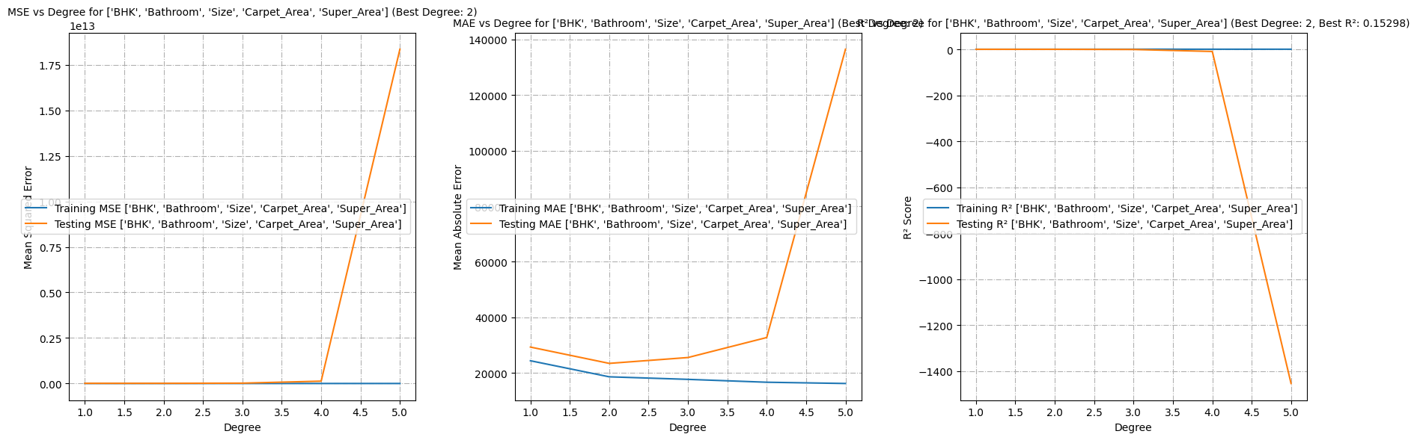
08 VISUALIZATIONS WITH MSE, MAE AND R2 PLOT1
BHK,BATHROOM,SIZE,CARPET AREA AND SUPER AREA
Degree
2

Slide 11
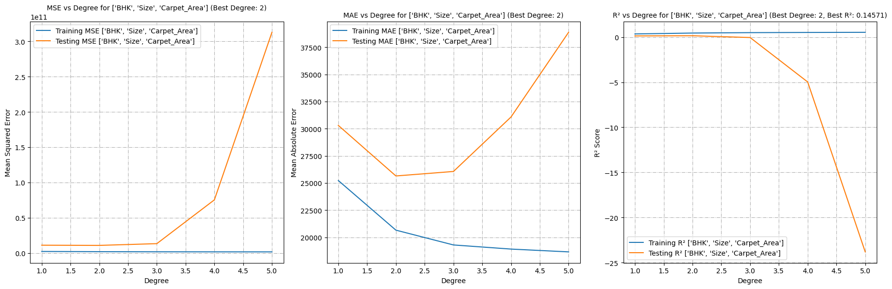
09 VISUALIZATIONS WITH MSE, MAE AND R2 PLOT
BHZ, SIZE AND CARPET AREA
Degree
2

Slide 12
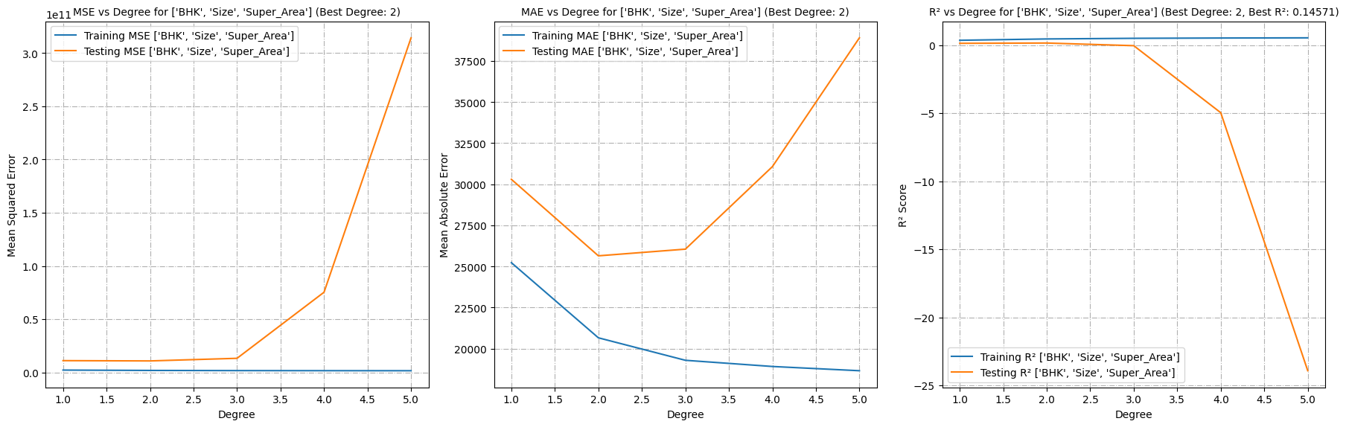
10 VISUALIZATIONS WITH MSE, MAE AND R2 PLOT
BHK, SIZE AND SUPER AREA
Degree
2

Slide 13
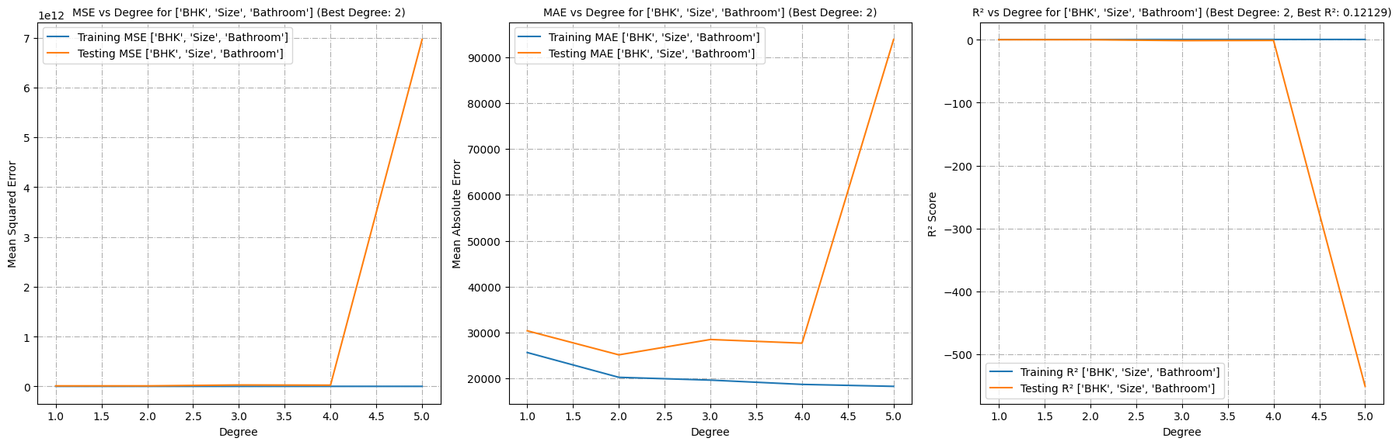
11 VISUALIZATIONS WITH MSE, MAE AND R2 PLOT
BHK, SIZE AND BATHROOM
Degree
2

Slide 14
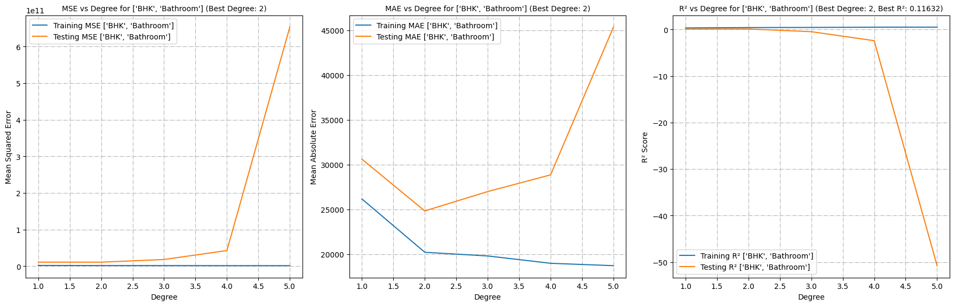
12 VISUALIZATIONS WITH MSE, MAE AND R2 PLOT1
BHK AND BATHROOM
Degree
2

Slide 15
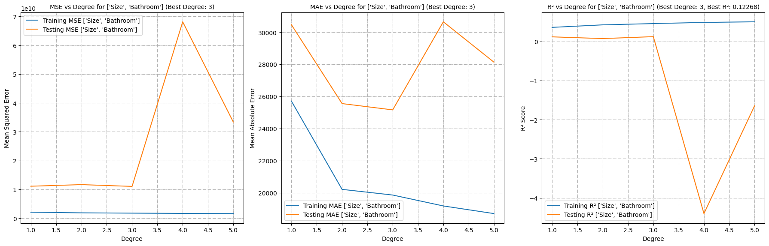
13 VISUALIZATIONS WITH MSE, MAE AND R2 PLOT1
SIZE AND BATHROOM
Degree
2

Slide 16
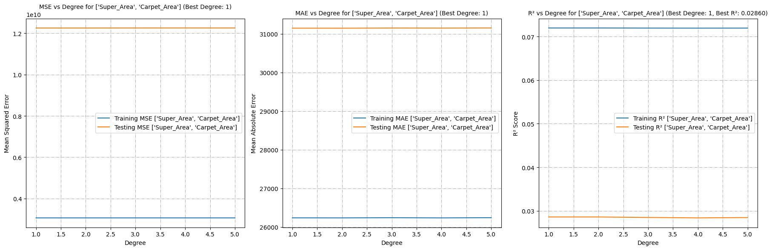
14 VISUALIZATIONS WITH MSE, MAE AND R2 PLOT1
SUPER AREA AND CARPET AREA
Degree
2

Slide 17
END

