Slide 1

GAM100
Minjae Yoo
Minki Cho
Yeeun Kim

Slide 2
INDEX
-
GAME NAME
02. HIGH CONCEPT
03.GAME SUMMARY
04. GAME FEATURES
05 GAME PLAN
-

Slide 3

GAME NAME
.

Slide 4


HIGH CONCEPT
LOOK
2D, top-down
GENRE
PVP
THEME
Survival

Slide 5

GAME SUMMARY
GREEN LOSE

Slide 6
GAME FEATURES
CORE MECHANICS
pushing back out of the map each other
WIN/LOSE
Lose when got out of the map by another player or trap
SPECIAL FEATURES
Add traps to the basic mechanic

Slide 7
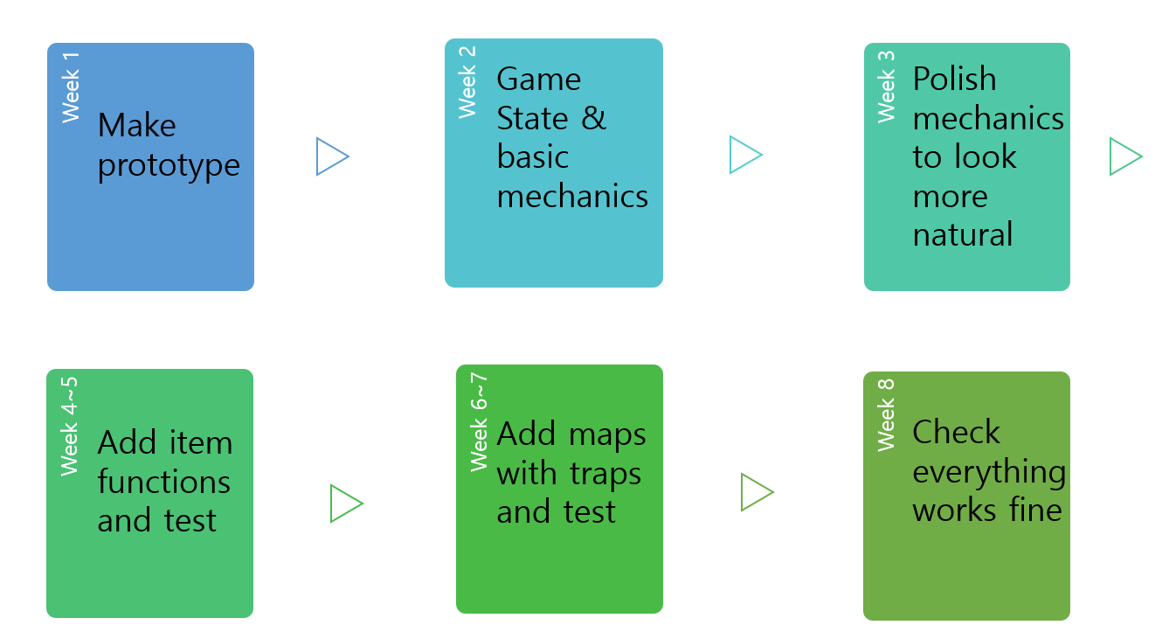
PLAN

Slide 8
Q&A
THANK YOU

