Slide 1

GAM100
Minjae Yoo
Minki Cho
Yeeun Kim

Slide 2
INDEX
-
HIGH CONCEPT
02. GAME SUMMARY
03.GAME FEATURES
04. GAME DEMO
-

Slide 3


HIGH CONCEPT
LOOK
2D, top-down
GENRE
PVP
THEME
Survival

Slide 4


GAME SUMMARY
GREEN LOSE

Slide 5
GAME SUMMARY
Prototype value
It will be more fun to develop by adding items and maps
What we learned
We learned that asking for help instantly is important.

Slide 6
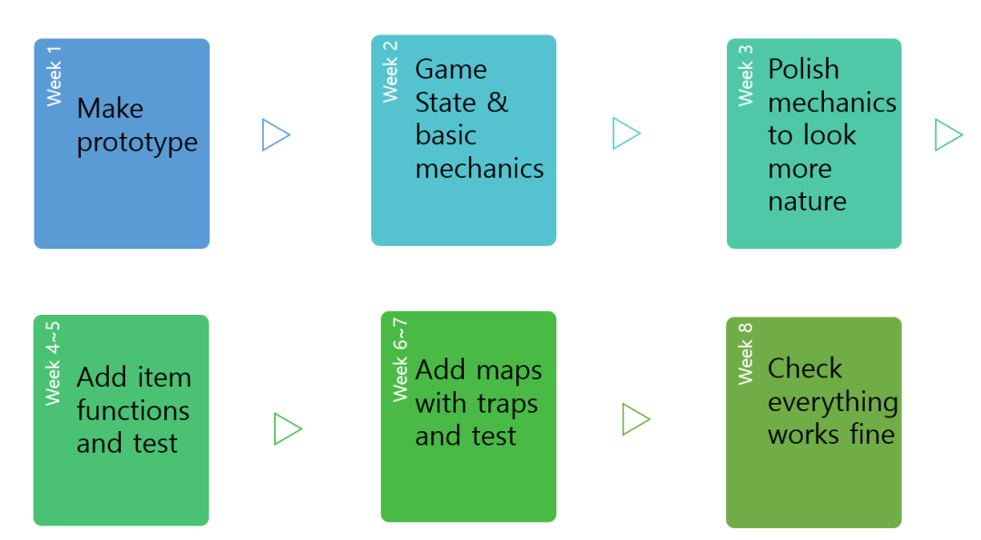
PLAN
👍

Slide 7

GAME DEMO
.

Slide 8
GAME FEATURES
CORE MECHANICS
pushing back out of the map each other
WIN/LOSE
Lose when got out of the map by another player or trap
SPECIAL FEATURES
Add traps to the basic mechanic

Slide 9
Q&A
TAHNK YOU

