Slide 1
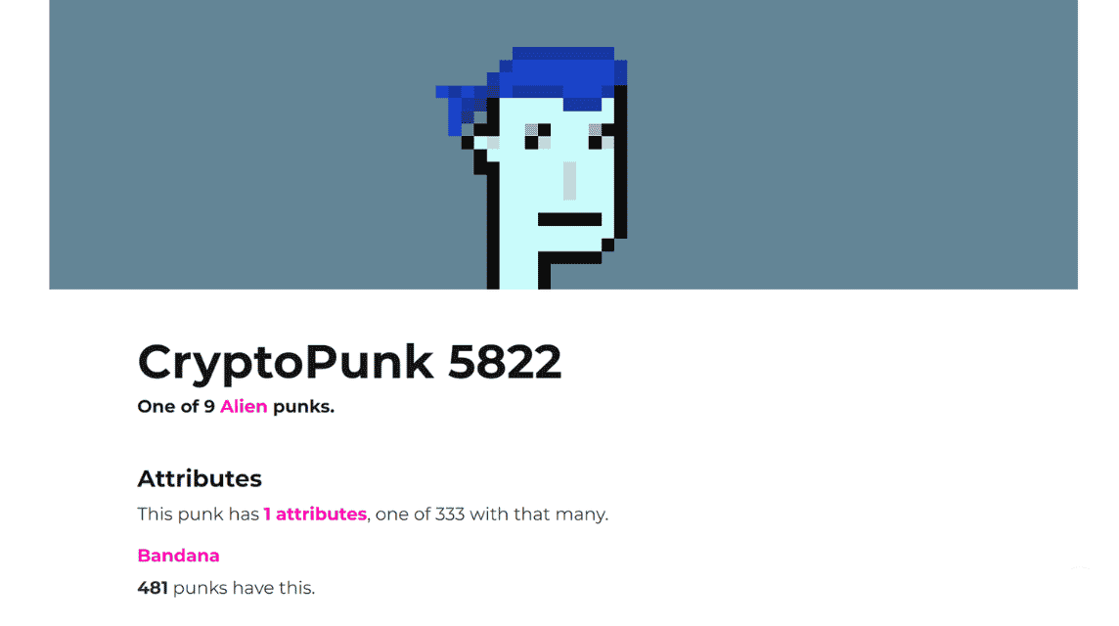
+
NFT ..?

Slide 2
+
NFT ..?
권리
입장권
세금 회피용?
…?

Slide 3
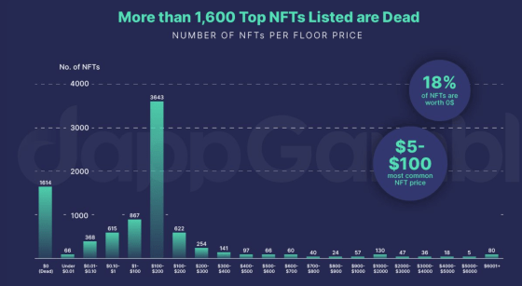
+
NFT ..?

Slide 4
+
Game Item Exchange
조민제

Slide 5
+
Introduction
Idea – Game Item Exchange
Smart Contract
React
More…?

Slide 6
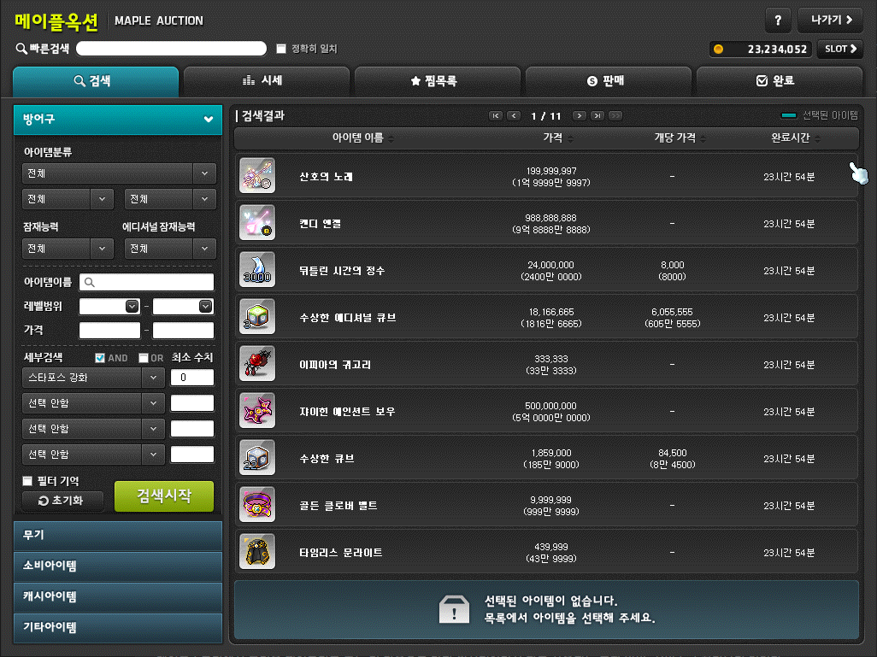
+
Idea
NFT의 활용 가능성
사용가능성
의미부여

Slide 7
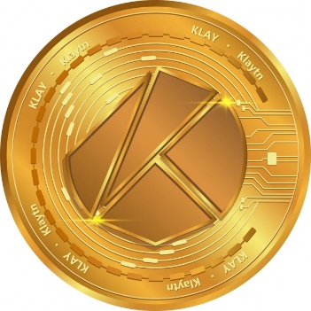
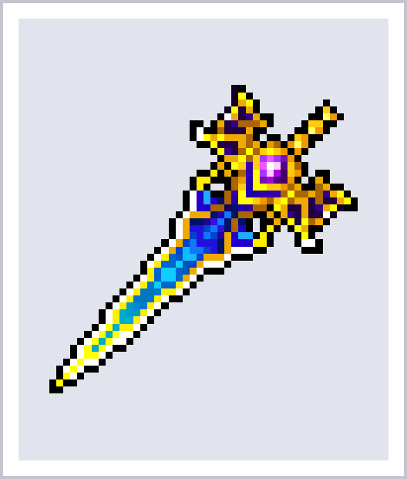
+
Smart Contract
ERC 20
MyToken.sol
ERC 721
MyNFT.sol
MyMarketplace.sol

Slide 8
+
Process
Code to NFT(minting)
NFT to Market
구매
Code to Game item

Slide 9
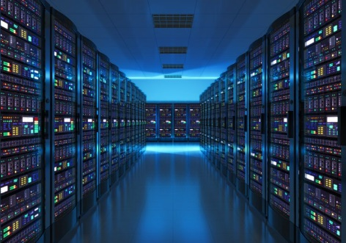
+
Before React..
<User>
<Server>
Code..

Slide 10
+
In React

Slide 11

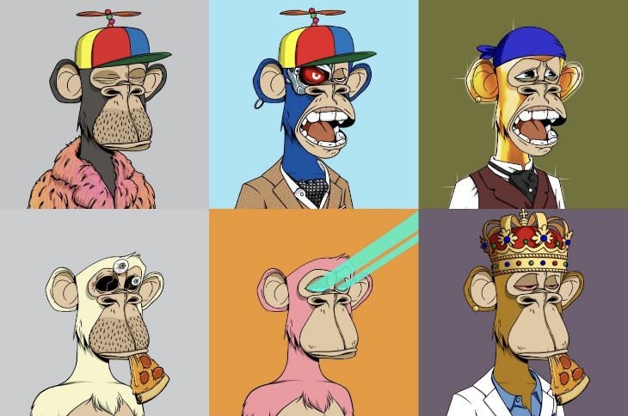
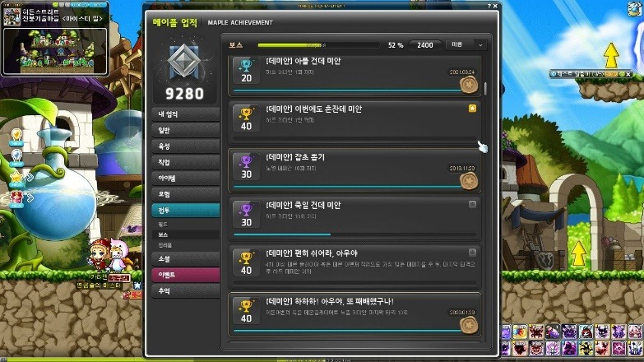
+
More..

Slide 12
+
감사합니다

