Slide 1

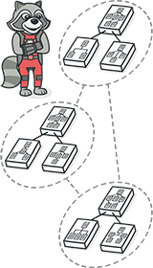
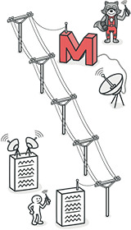
Software Design Patterns
Pull Up Method
Group 16
2250758 林继申 2251730 刘淑仪 2252843 杨宇琨 2256225 中谷天音

Slide 2

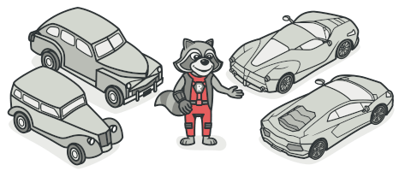
Software Design Patterns
Contents
Introduction
The problem that needs to be addressed
The refactoring solution
The detailed steps to implement the refactoring technique
A concrete implementation example
The advantages and disadvantages
Other related issues
Pull Up Method

Slide 3
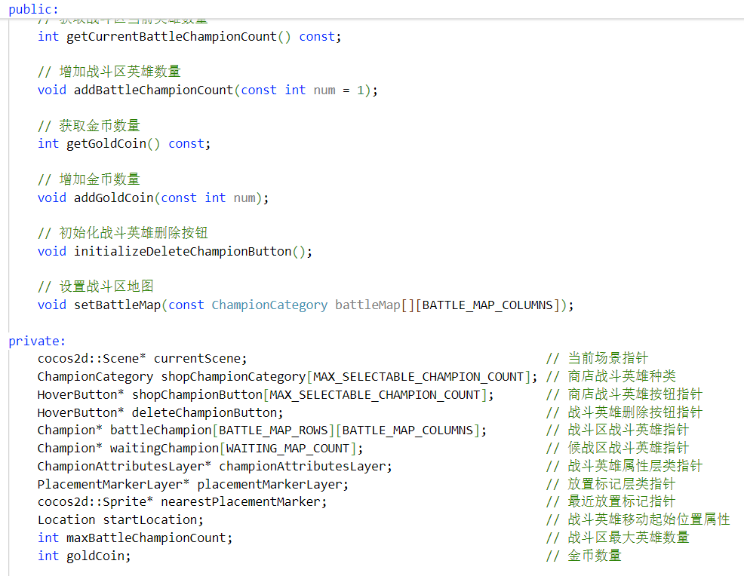
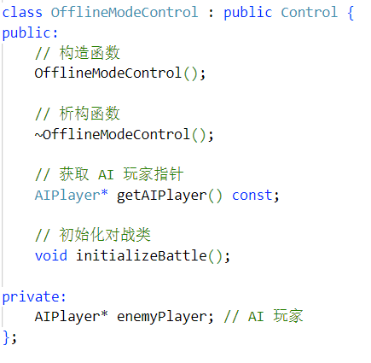
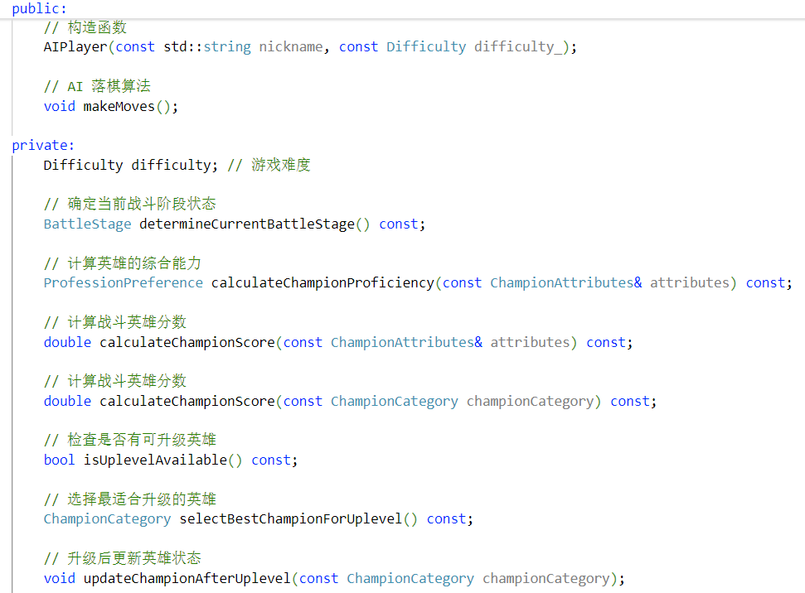
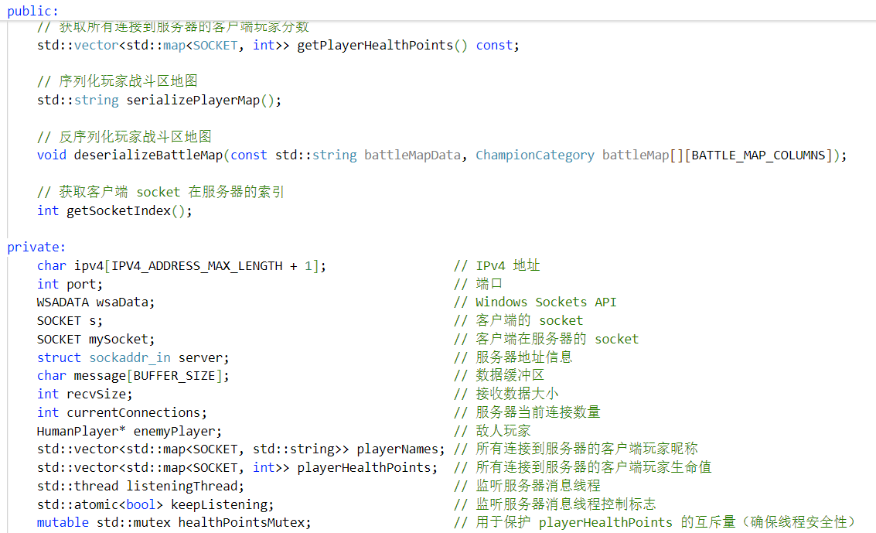
Introduction
In the development process, especially in object-oriented design projects, as the code evolves, duplicated code and unnecessary differences between classes often become apparent. This duplicated code is commonly referred to as “Code Smells“, particularly Duplicate Code and Divergent Change.
This is why we need refactoring!
When dealing with legacy code, refactoring helps transform it into clean, clear code with a well-structured design. The main goal of refactoring is to address technical debt. Although it may take some time, future extensions built on this foundation will be much less painful.
Software Design Patterns
Pull Up Method

Slide 4
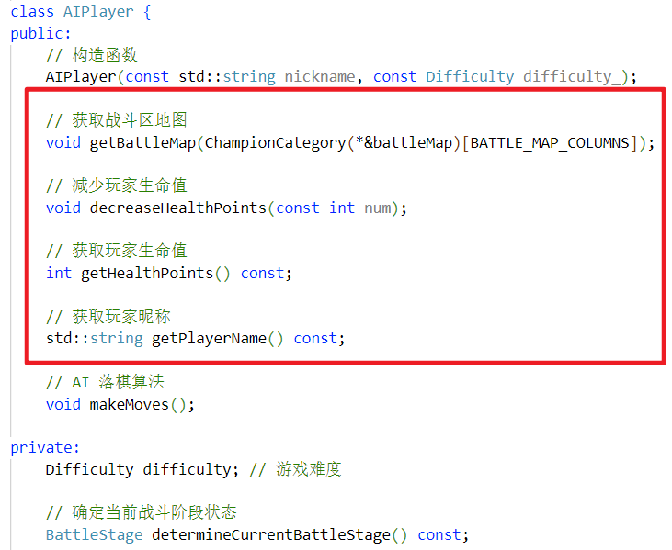
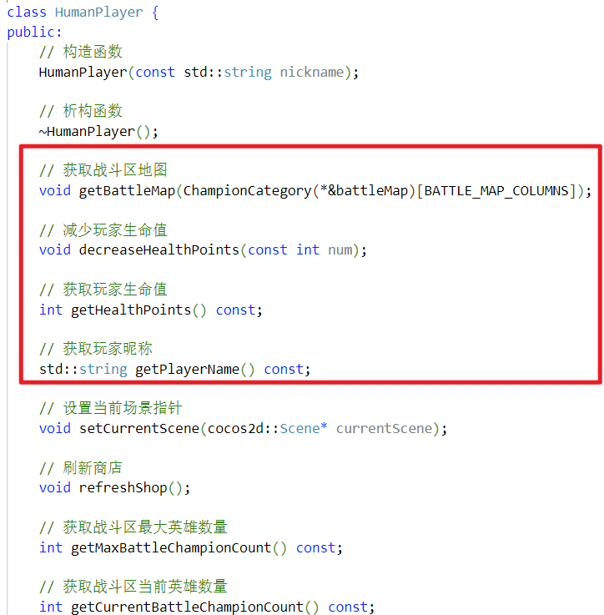
The problem to solve
In our Program Design Paradigm course, we developed a Teamfight Tactics game and encountered the following issues:
Firstly, the game has HumanPlayer and AIPlayer classes, which contain a lot of duplicate code and methods.
Software Design Patterns
Pull Up Method

Slide 5
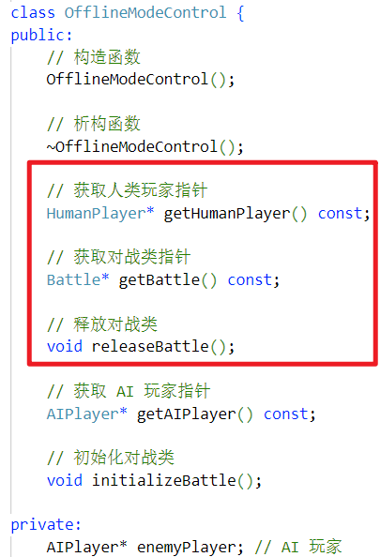
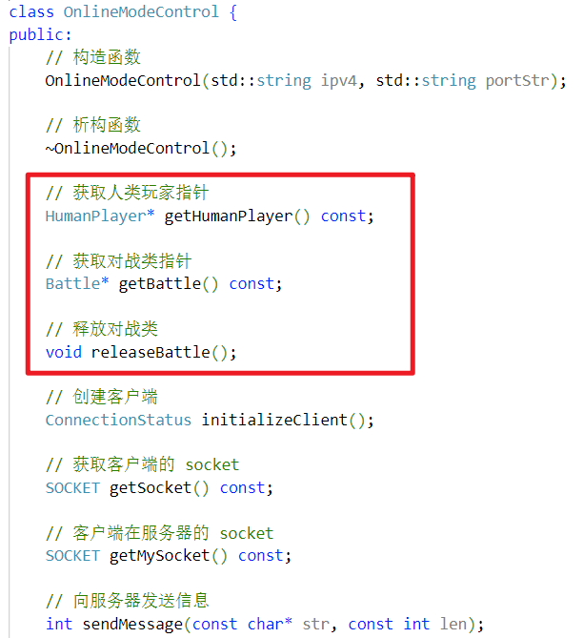
The problem to solve
In our Program Design Paradigm course, we developed a Teamfight Tactics game and encountered the following issues:
Secondly, the game has OfflineModeControl and OnlineModeControl, which also contain a lot of similar code and methods.
Software Design Patterns
Pull Up Method

Slide 6

The problem to solve
In our Program Design Paradigm course, we developed a Teamfight Tactics game and encountered the following issues:
Consequently, these similar code sections increase the complexity of code maintenance, requiring repeated updates in multiple places when changes are made.
As the project expanded, code duplication made the program difficult to extend and manage, leading to painful maintenance. Our project is full of Duplicate Code and Divergent Change, which resulted from our copy-paste programming approach.
Software Design Patterns
Pull Up Method

Slide 7
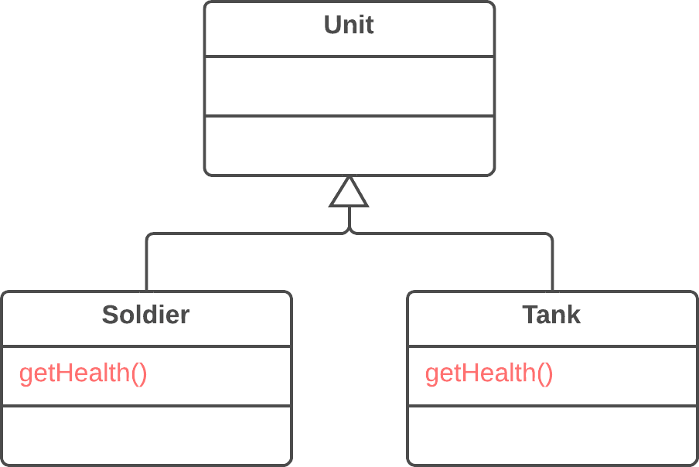
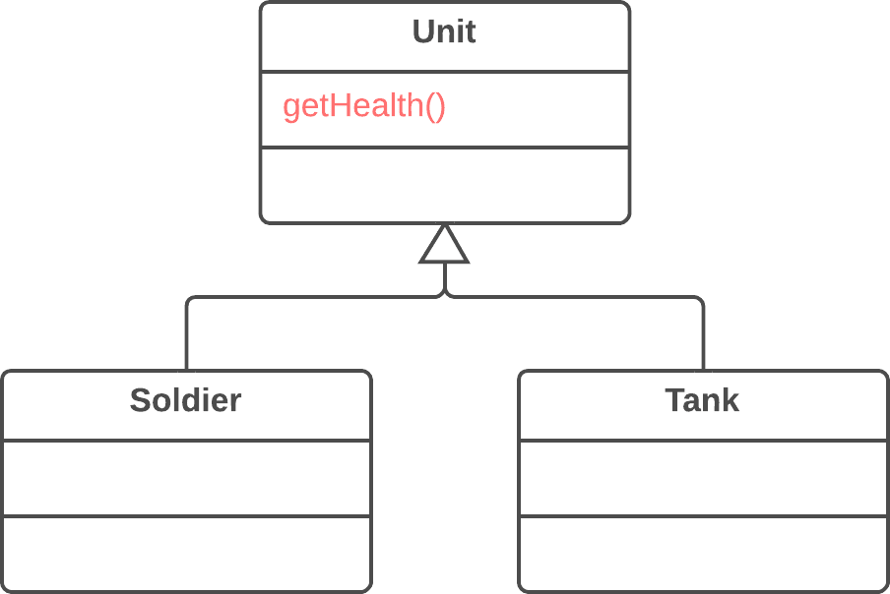
The solution of refactoring
To address the above issues, Pull Up Method is an effective refactoring technique.
The main idea is to extract similar or identical methods from multiple subclasses into the parent class, eliminating duplicate code and reducing the effort required for future modifications.
Software Design Patterns
Pull Up Method

Slide 8
Detailed steps to implement the refactoring technique
a) Identify similar methods in the parent class : check if there are similar methods in the parent class. If they are not identical, adjust them to have a consistent format.
b) Unify method parameters : if the methods use different sets of parameters, standardize them into a common format so they can be handled consistently in the parent class.
Software Design Patterns
Pull Up Method

Slide 9
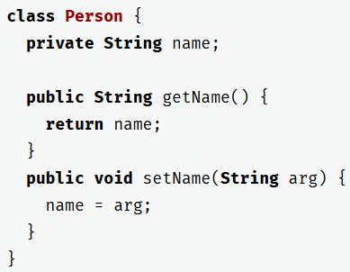
Detailed steps to implement the refactoring technique
c) Extract methods into the parent class : we can move these methods to the parent class. During this process, you might find that some methods rely on fields or methods that only exist in the subclasses. To resolve this, you can:
For fields : use the Pull Up Field or Self-Encapsulate Field refactoring. Create getters and setters in the subclass, then declare these getter methods as abstract in the parent class.
For methods : use the Pull Up Method refactoring or declare the methods as abstract in the parent class (note that this will turn the parent class into an abstract class if it wasn't one before).
Self-Encapsulate Field
Software Design Patterns
Pull Up Method

Slide 10
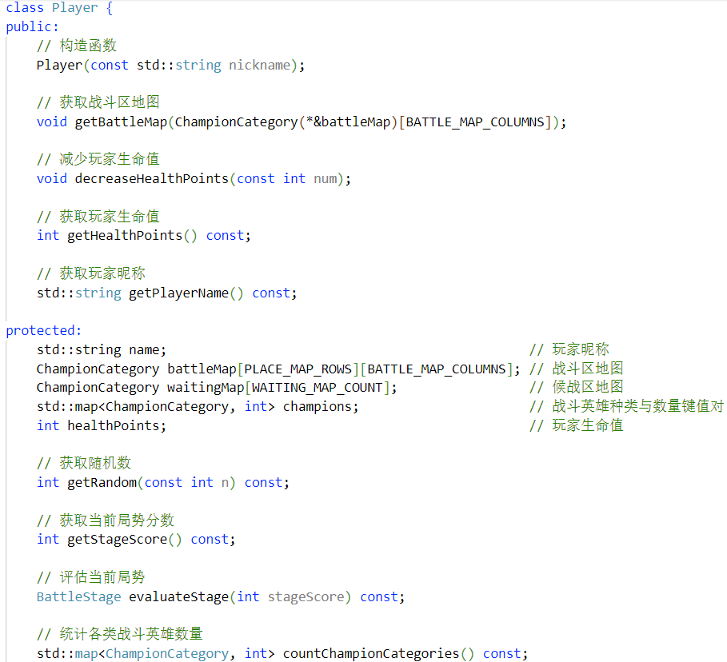
Detailed steps to implement the refactoring technique
d) Remove the methods from the subclasses : delete the duplicate methods from the subclasses, ensuring that all the common logic has been moved to the parent class.
e) Check where the methods are called : review the locations where these methods are called to see if you can replace the subclass with the parent class. This step helps further simplify the code structure and reduce dependency on the subclasses.
Software Design Patterns
Pull Up Method

Slide 11
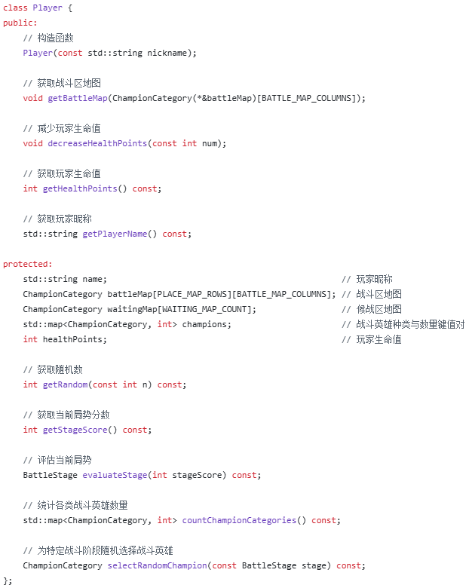
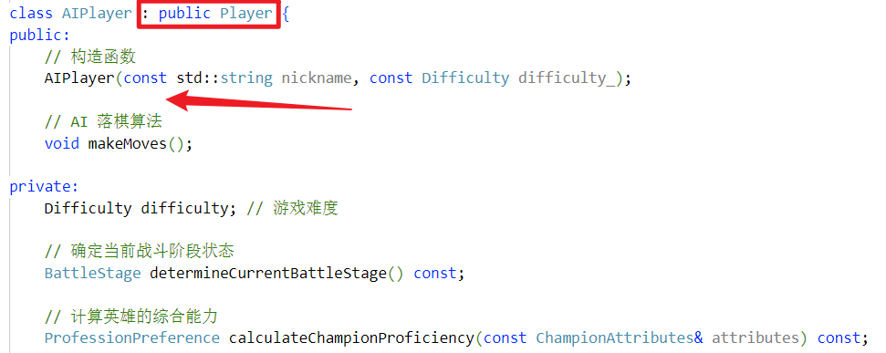
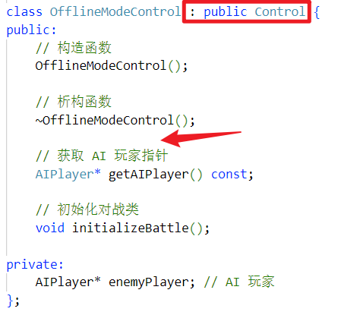
A concrete example of implementing the refactoring technique
After the refactoring, the code adheres to the following software development principles:
Single Responsibility Principle (SRP)
Open/Closed Principle (OCP)
High Cohesion and Low Coupling
The refactoring of the game's control classes is also similar!
Software Design Patterns
Pull Up Method

Slide 12
Benefits and drawbacks
Advantages
Reduced duplicate code : By extracting similar methods into the parent class, we avoid repeating the same code in multiple subclasses.
Easier maintenance : If the logic of the makeMove() method needs to be modified, we only need to update it in the parent class, avoiding the need to modify duplicate code in multiple subclasses.
Improved scalability : As new subclasses are added, if they need similar functionality, they can just simply inherit the method from the parent class, without needing to implement similar functionality again.
Software Design Patterns
Pull Up Method

Slide 13
Benefits and drawbacks
Disadvantages
Increased complexity of the parent class : After extracting common methods from different subclasses into the parent class, the parent class may become too large and complex, especially when there are many subclasses, which can blur the responsibilities of the parent class.
Reduced polymorphism and flexibility : If the parent class implements too many generic methods, subclasses may lack flexibility and be forced to inherit these methods, limiting their ability to override as needed.
Improved scalabilAdditional time and effort for refactoring and testing : Extracting methods into the parent class may require adjustments and refactoring of existing code, along with extensive testing to ensure that the changes do not introduce new issues.
Software Design Patterns
Pull Up Method

Slide 14
Other related issues
Level of abstraction of the method
Use abstract methods or interfaces in the parent class to define the method structure, allowing subclasses to implement the specific logic as needed.
Use the Template Method Pattern to control the order of method calls, ensuring the parent class contains the common flow while delegating the specific steps to the subclasses.
Avoid excessive refactoring
Keep the refactoring incremental, avoiding large-scale changes all at once.
Focus on small-scale refactoring, gradually eliminating duplicate code, and validate and test after each step to prevent introducing new issues during the process.
Software Design Patterns
Pull Up Method

Slide 15
Software Design Patterns
THANKS !
Group 16
2250758 林继申 2251730 刘淑仪 2242843 杨宇琨 2256225 中谷天音

