Slide 1
Intelligent Curtain Wall: System Architecture Server Operations and Data Set Management System
Project members : Jishen Lin, Shuyi Liu, Amane Nakatani
Instructor : Jie Huang
School of Computer Science and Technology, Tongji University
2025 / 4 / 21

Slide 2
1
Project Planning
Contents
2
Project Execution and Monitoring
3
Risk Management &
Future improvements

Slide 3

01
Project Planning

Slide 4
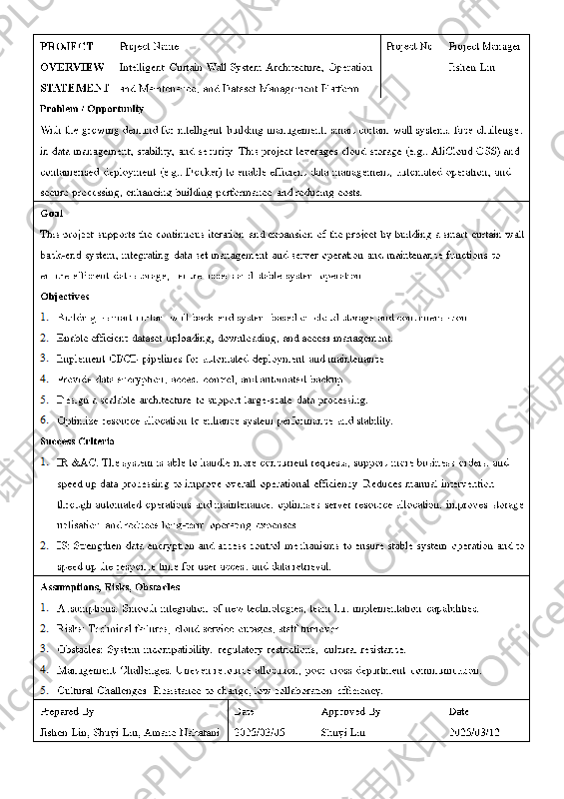
Project Planning
Building a smart curtain wall back-end system based on cloud storage and containerisation.
Enable efficient dataset uploading, downloading, and access management.
Implement CI/CD pipelines for automated deployment and maintenance.
Provide data encryption, access control, and automated backup.
Design a scalable architecture to support large-scale data processing.
Optimize resource allocation to enhance system performance and stability.
Notes:
构建基于云存储和容器化的智能幕墙后台系统​​
​​实现高效的数据集上传、下载与访问管理​​
​​部署CI/CD流水线以支持自动化部署与维护​​
​​提供数据加密、访问控制及自动化备份功能​​
​​设计可扩展架构以支持大规模数据处理​​
​​优化资源分配，提升系统性能与稳定性​

Slide 5
02
Project Execution and Monitoring

Slide 6
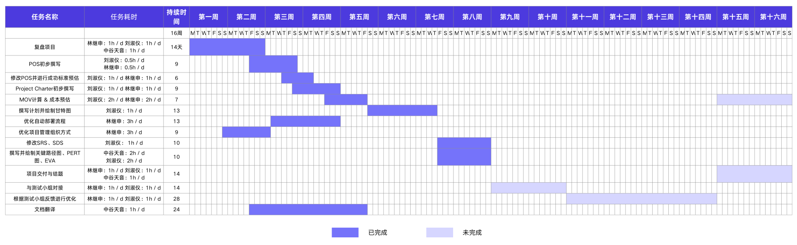
Project Planning
Figure 1: Project Gantt chart

Slide 7
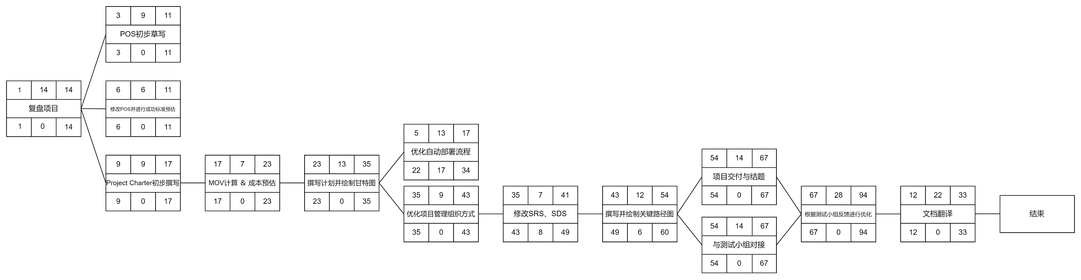
Project Execution and Monitoring
Figure 2: Project Critical Path Map
Notes:
项目启动​​：如"Project Charter初步撰写"、"MOV计算 & 成本预估"。
​​计划制定​​：如"撰写计划并绘制甘特图"、"绘制关键路径图"。
​​执行与优化​​：如"优化自动部署流程"、"修改SRS、SDS"、"与测试小组对接"。
​​收尾交付​​：如"项目交付与结题"、"文档翻译"、"复盘项目"。
​​箭头连线​​表示任务先后顺序，例如： "POS初步草写" → "修改POS并评估成功标准" → "优化自动部署流程"。
​​并行任务​​：某些任务无直接连线（如"撰写甘特图"与"绘制关键路径图"），可能需同步进行。
​​关键路径​​：长周期任务（如"项目交付与结题"标注"94"）可能是影响整体进度的关键。

Slide 8
03
Risk Management &
Future improvements

Slide 9
Risk Management & Future improvements
3.1 Risk Management
During performance and stress testing, the production environment configuration may be insufficient. If necessary, consider upgrading server specifications.
System integration, deployment, and delivery may face resource shortages due to parallel tasks, requiring proper scheduling.
3.2 Future improvements
Coordinate with the testing team to fix system-related bugs.
Conduct performance testing on the backend system to ensure high performance, high availability, and high load capacity.
Collaborate with all subsystem teams to complete the integrated deployment and delivery of the project.
Revise the SRS (Software Requirements Specification) and SDS (System Design Specification) documents.
Notes:
相关风险：
1. 在对系统进行性能测试和压力测试时，生产环境的配置可能不够，如果需要，可以考虑增加服务器配置
2. 系统集成部署与交付可能因多任务并行导致资源不足，需合理排期
后续工作计划：
1. 和测试小组对接，修复系统相关bug。
2. 对后端系统进行性能测试，保证系统的高性能、高可用和高负载。
3. 和所有子系统小组对接，完成项目的继承部署与交付工作。
4. 修改SRS、SDS文档。

Slide 10
Intelligent Curtain Wall: System Architecture Server Operations and Data Set Management System
Thanks!
School of Computer Science and Technology, Tongji University
2025 / 4 / 21

