Slide 1
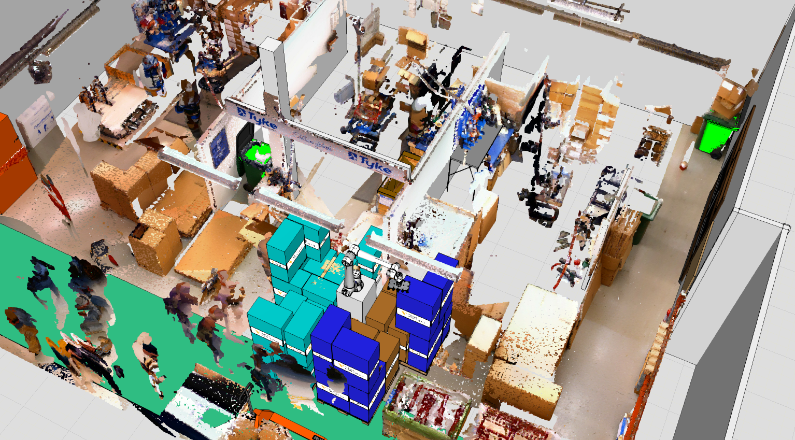
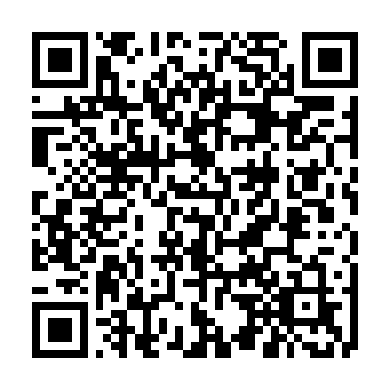



{{Label font size 40}}
{{Title font size 70, max. length two rows}}
{{Lead paragraph font size max. 34, length maximum of 4 rows.}}
{{More information, font size max. 25, length maximum of 5 rows.}}
{{Call out text e.g. read more, size max. 27, 2 rows}}

