Slide 1

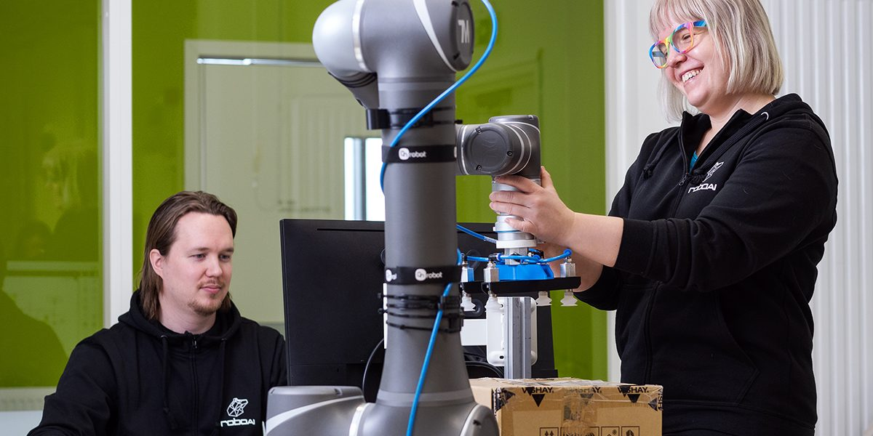

Apply to study at the RoboAI Academy!
Application open March 24 to April 12, 2026
Engineering students learn through hands-on projects rather than traditional lectures. Projects cover robotics, AI, and programming based on company needs.

