Slide 1
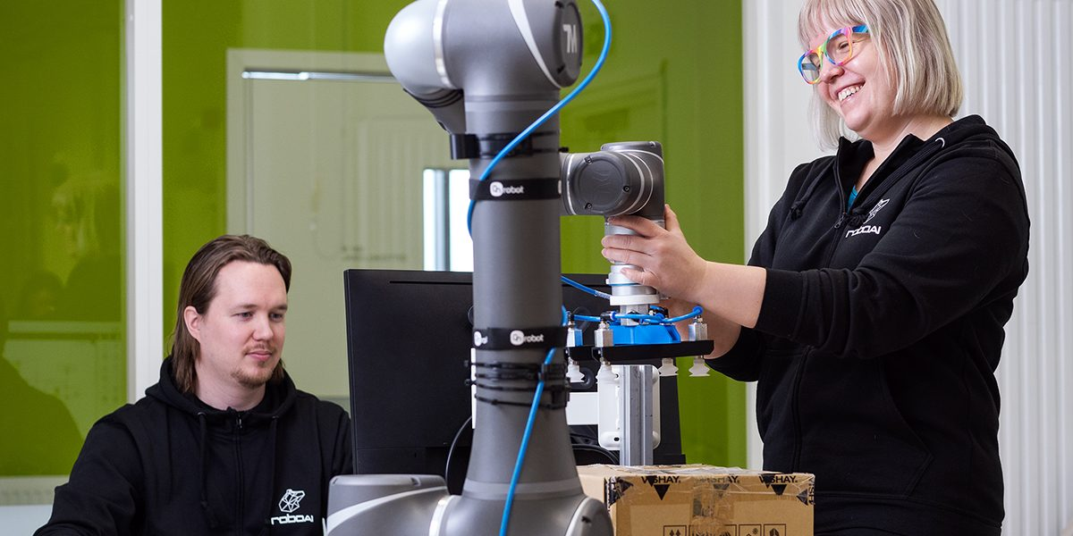

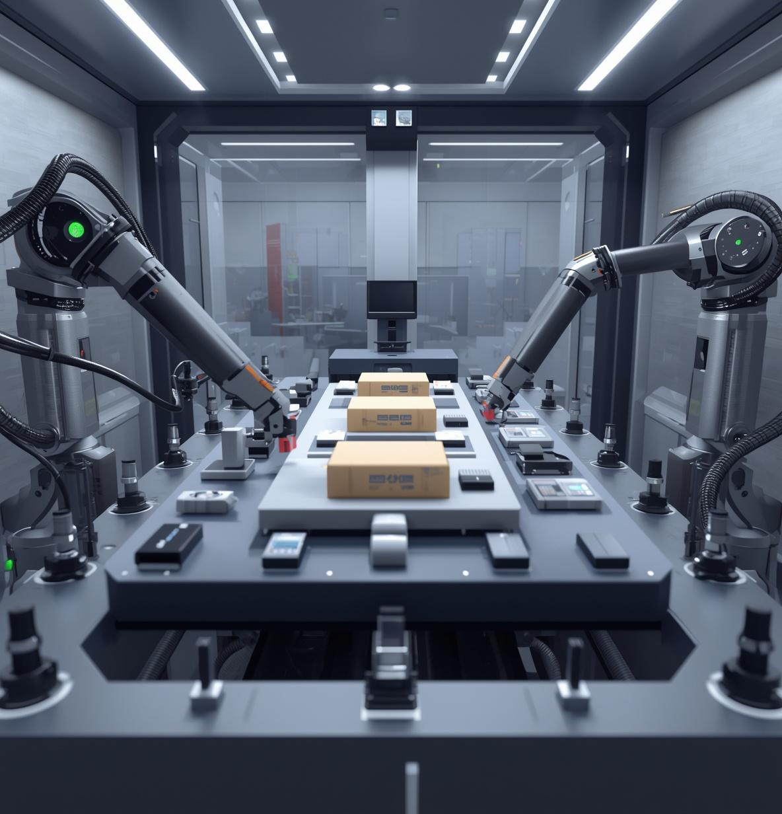
Hands-on learning through projects
Application period: March 24 to April 12, 2026
Apply to study at the RoboAI Academy!

